Slide 1


Living and Working
IN FRANCE
Notes:
General EURES title page

Slide 2




Summary
Living in France
Understanding the labour market
Working in France
Job search
Notes:
Content Main Slide. Select from General, Jobseekers and Employers

Slide 3
Living in France
Notes:
Content Main Slide. Select from General, Jobseekers and Employers

Slide 4
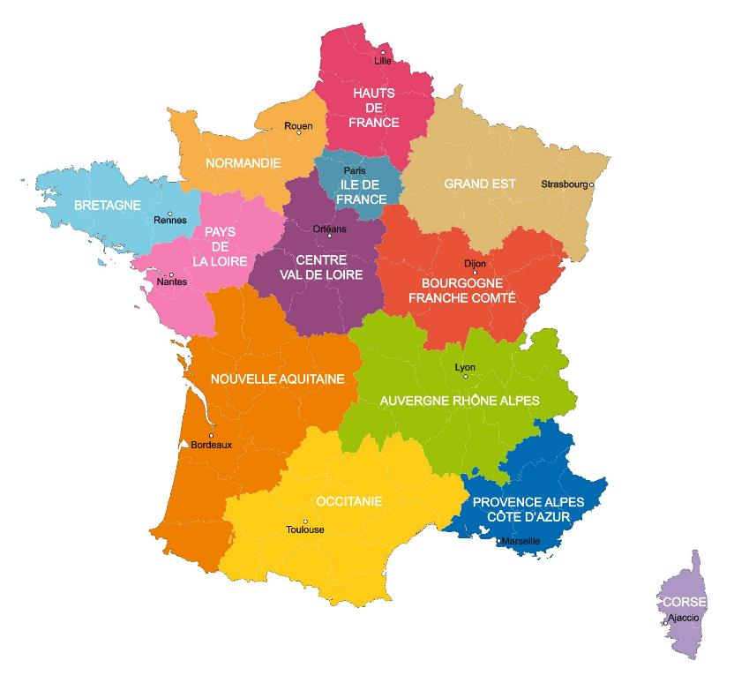

France at a glance
One of the most visited countries in the world
7th economic power in the world in terms of GDP*
Overseas departments and territories (DROM - COM)
Notes:
GDP : Gross domestic product Où se situe la france par rapport à d’autres pays européens? 2ème place après l’Allemagne.

Slide 5
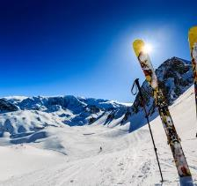
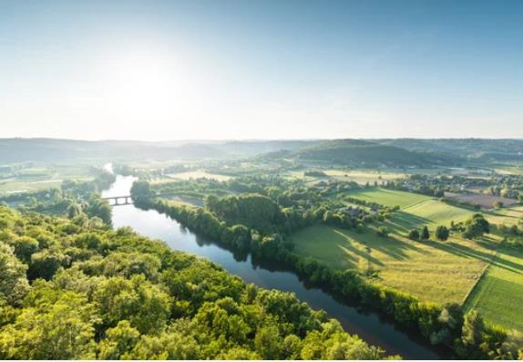
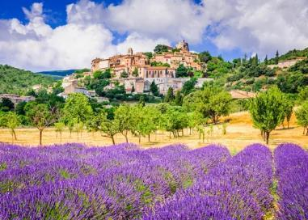
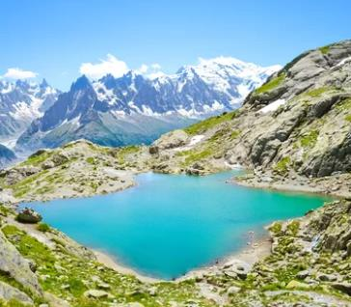
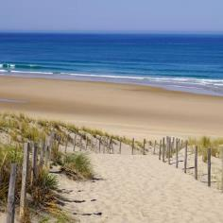

Notes:
France has a lagre territorial diversity :
Countryside : Nearly 80% of the territory
Seaside : Atlantique ocean, Mediterranean sea, North Sea, Manche
Mountains : Alpes, Pyrénées, Vosges, Massif central.
This large territorial diversity has an impact on the economical activity

Slide 6
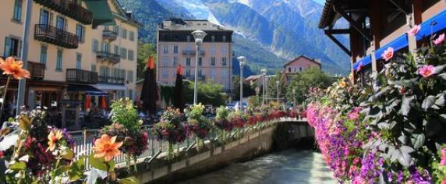
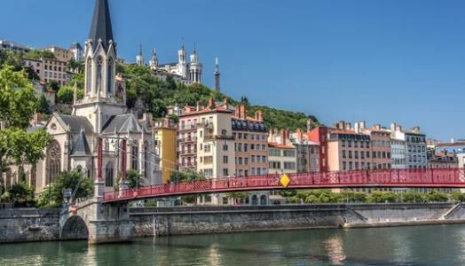
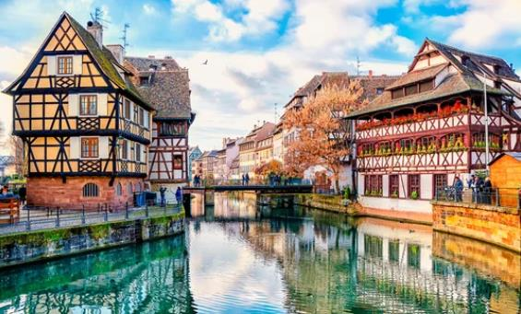
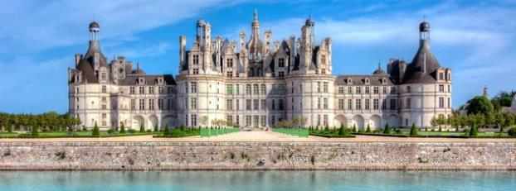
Notes:
Cities : Paris, Lyon, Marseille, Toulouse, Nice, Nantes, Montpellier, Strasbourg.
France has a lot of cities rich of history and culture, there are beautiful places to visit if you are working and living in France such as : The castles of the Loire you can see an example of the most beautiful castle that is Chambord – You can also see Annecy, a wonderfull small city in the Alpes.

Slide 7




Notes:
France is an attractive country for people who love sport.
Each year you can participate as visitor at Rolland Garros for Tennis and Tour de France bike competition
France hosted in 2024 the Olympics games
France organises and participate in many sport competition.

Slide 8
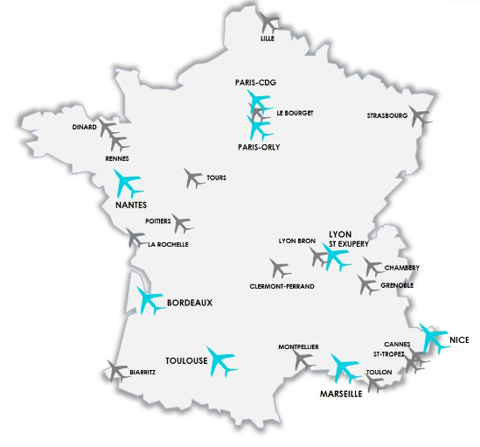
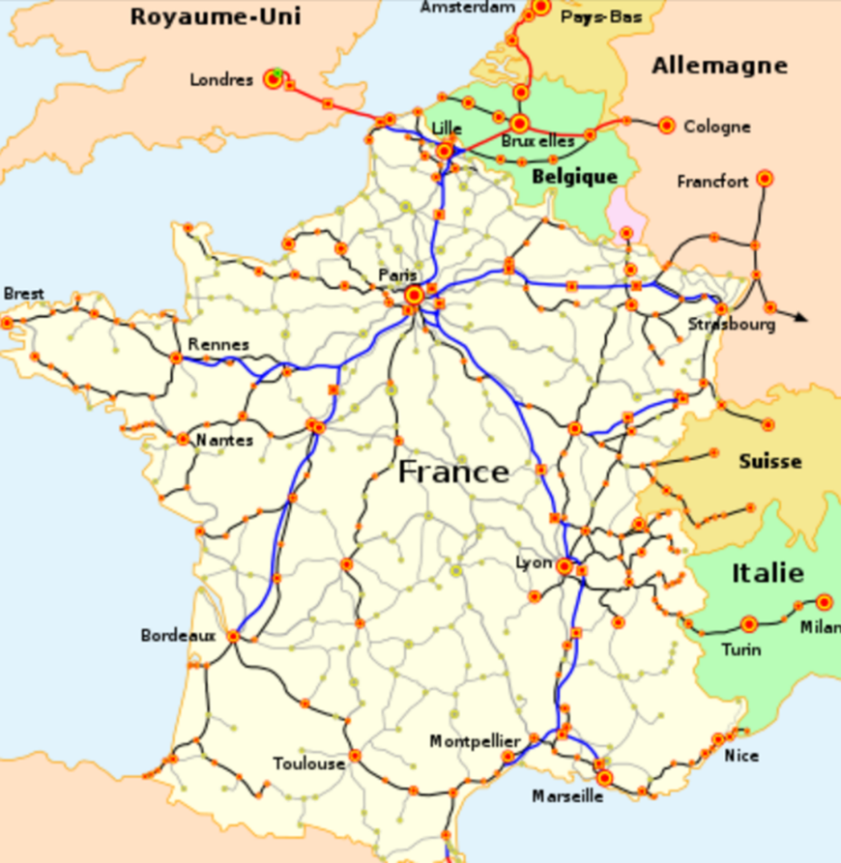
Transports
Notes:
France has large transport services, very important for working and living in France :
Plains : The main airports in France are Roissy Charles de Gaulle and Paris Orly but most of big french cities own regional airports
Train (51 217 km) – The national campagny is SNCF / The train network is very well developped for instance the journey from Paris to Lyon takes 2hours, from Paris to Lille : 1hour
Highways (12 379 km) – Allowed speed is 130km/h and on the national roads the speed is limited at 80 or 90km/h

Slide 9

Many advantages
Life Quality
Transportation
Healthcare system
Great Network
Culture
Hobbies
Diversity
Food and beverages
You can find detailed information on those items in the EURES portal.
Notes:
The quality of healthcare system is still very well in France.
1200 different cheese brands to accompany the cheese you have also different wines.

Slide 10
Understanding the french labour market
Notes:
Content Main Slide. Select from General, Jobseekers and Employers

Slide 11
Recruitment project by sector
Source : BMO Survey April 2025

Slide 12
Top 5 professions that recruit the most
1
Café and restaurants waiters
2
Kitchen helpers and multipurpose restaurant employees
3
4
5
Vineyard workers, arborists, pickers
Agriculteurs, farmers
Cleaning staff
Professions recruiting a lot of young people
Source: BMO survey April 2025

Slide 13
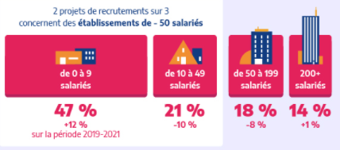
Lot of small business opportunities
2 out of 3 recruitment projects concern establishments with less than 50 employees
from 0 to 9
employees
from 10 to 49
employees
from 50 to 199
employees
200 and + employees
Notes:
Most of the companies in France are small ones from 0 to 9 employees. This part represent 47% of compagnies on the labour market.

Slide 14
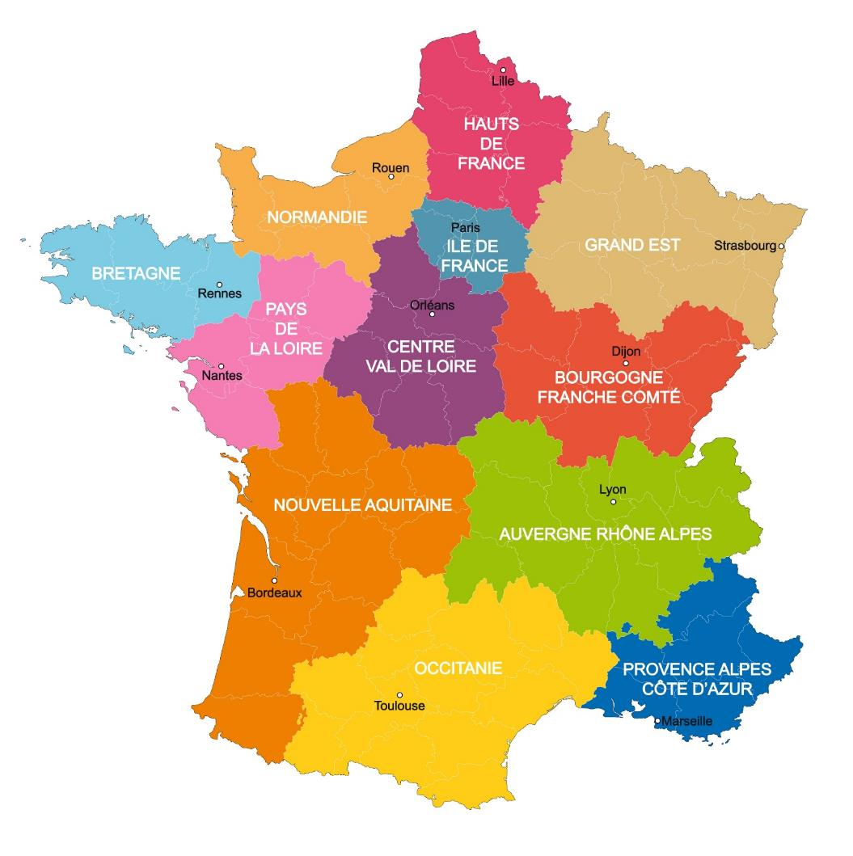

French regions by sectors
Ile de France :
First Business Region in Europe
First European region in Reasearch and devlopment
Haut de France / Grand Est / Bourgogne Franche-comté :
Automotive manifacturing
Garstronomy
Chemistry
Normandie / Bretagne / Pays de la Loire / Centre Val de Loire :
Agriculture
Fishing
Shipbuilding
Auvergne Rhône Alpe / Provence Alpe Côte d’Azur :
Plastics
Health
Agrifood
Research and innovation
Nouvelle Aquitaine / Occitanie :
Research and devlopment
Aeronautics

Slide 15
French region by sector
Corse / Overseas « département » : Guadeloupe / Martinique / Guyane Française / Réunion
Tourism
Agrifood
Sustainable and renewable energies
LA CORSE

Slide 16
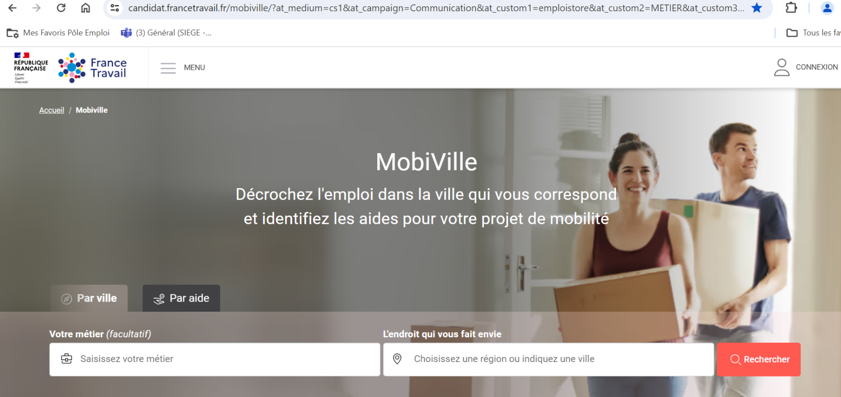
One complete website
An online service to find the job and the city that goes with it!
Mobiville:
facilitates mobility to employment areas that are recruiting;
helps you find the best living environment for your professional integration.
Notes:
You can check job possibilities in each city or region you are interested in

Slide 17
Working conditions
Notes:
Content Main Slide. Select from General, Jobseekers and Employers

Slide 18



Working conditions *
MINIMUM SALARY :
11,88 €/h (gross) or 9,40 € net and 1 426,30 € net / month*
LEGAL DURATION :
35 hours/week (excluding specific agreements according to sectors)
Holidays : 5 weeks holidays / 11 Bank holidays
TAXES ON YOUR SALARY :
23 % of gross income for social benefits (social security, retirement, unemployment….).
AVERAGE SALARY
2231 euros net
UNEMPLOYMENT RATE
7,4 %
* 1th January 2025
Notes:
Average salary : we are speaking about average salary estimated by INSEE

Slide 19
Contracts
Main types of contracts
CDI: permanent contract
CDD: fixed-term contract for a specific duration (max 18 months)
Temping contract: same as CDD with 3 parties involved: employer, employee & temping agency
Other types of contracts
Intermittent: specific short term contract for artist or technician
Seasonal: in agriculture and tourism
Apprenticeship: part time in a training and the rest of the time working
Notes:
Content Main Slide. Select from General, Jobseekers and Employers

Slide 20
Job search
Notes:
Content Main Slide. Select from General, Jobseekers and Employers

Slide 21

France Travail
A governmental agency. French public employment service
Free digital services on https://www.francetravail.fr/candidat/ and 21800 advisers dedicated to jobseekers in 896 agencies throughout France
7 international mobility teams (guidance, mobility tools and helps, many services for jobseekers and companies)
National coordination Office for EURES France
Around 66 EURES advisers (national and cross boarder)
Notes:
Content Main Slide. Select from General, Jobseekers and Employers

Slide 22

APEC
Created in 1966. 50 agencies, 500 consultants : your partners to provide tailored, free-of-charge career coaching.
WHO CAN HELP APEC?
Executives who are looking for new opportunities,
or who are looking for a job.
HOW CAN IT HELP?
Prepare your job application.
Make a career change
APEC will help you review your project and your skills
Notes:
Content Main Slide. Select from General, Jobseekers and Employers

Slide 23

CHEOPS Cap emploi
1000 agencies in France, 2 500 employees to provide tailored, free-of-charge job search coaching.
WHO CAN HELP CHEOPS Cap emploi?
People in situation of disabilities or with heath problems (under conditions)
HOW CAN IT HELP?
Prepare your job application
Review your project and skills
Help to find a job adapted to the disability
Match your profile with private and public companies
Notes:
Content Main Slide. Select from General, Jobseekers and Employers

Slide 24
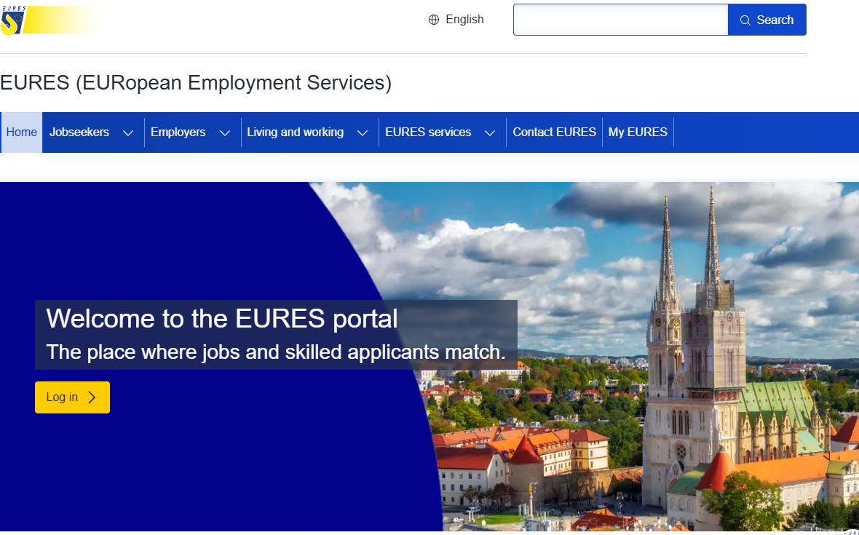
EURES (EURopean Employment Services)
EURES is a European cooperation network set up by the European Commission to help jobseekers find work and employers find suitable candidates.
Its objectives are:
Promoting the principle of free movement of workers in Europe.
Matching job offers and CVs via the EURES portal.
Providing access to information on living and working conditions in the Member States (taxation, health insurance, social security, etc.).
Information, guidance and other support services for workers and employers.
All services are completely free of charge.
31 countries
EURES = network of 1.000 advisers
3.4 million job vacancies daily
Notes:
Content Main Slide. Select from General, Jobseekers and Employers

Slide 25
Job search Tools

Slide 26
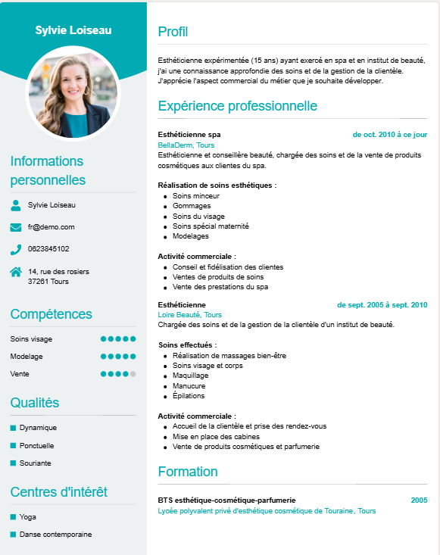
RESUME
Title : job wanted
Work experience
Training and qualifications
Professionnal skills
Personal information: Phone number, E-mail, Address
IT / software expertise
Languages
Hobbies / interests
Notes:
The resume on the slide is just an example of resume, other examples are possible.
The data indicated in this example of resume are fake.

Slide 27


GOOD TO KNOW
The cover letter
Rules to write a successful cover letter : short, punchy, focus on company needs and how your skills match with their needs
The job interview
Prepare well the job interview : prepare a short (3 minutes) presentation about yourself, gather information about the company and the vacancy before interview, think about questions you would ask, avoid negative opinions !

Slide 28

GOOD TO KNOW
Have a minimum level in French
Any professional experience is welcome
The diplomas are to be highlighted
The CV on one page and in French
The cover letter is personalized
Interviews will be conducted in French

Slide 29
WELCOME TO FRANCE !

