Slide 1



Employment contracts in Italy and recruitment incentives
10-11 November 2020 – E.A. Rosario De Luca

Slide 2


Employment contracts in Italy
Paid/subordinate employment:
Permanent employment contract with rising protection against unfair dismissal;
Fixed-term employment contract;
Staff leasing contract instead of former temporary agency contract;
On-call contract ;
Apprenticeship contract;
Traineeships;
Accessory work – Occasional employment PrestO and Family register “Libretto Famiglia” (atypical);

Slide 3
Employment contracts in Italy
Self-employment:
Professional services.

Slide 4
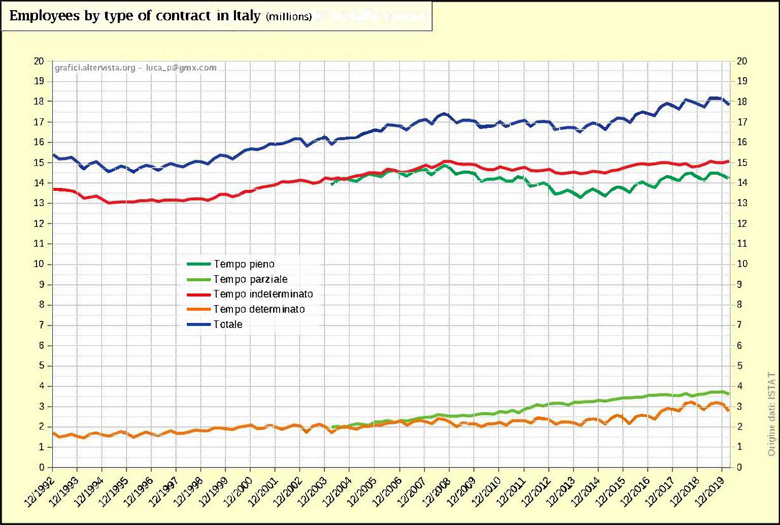
Employment contracts in Italy

Slide 5
Permanent employment contract
The most frequently used form of contract in Italy.
Further simplification in the case of termination of employment.
The employee may be assigned to each level task of job agreement provided that it falls within the same category.
It's legitimate assigning employee to lesser duties, but only in the case of processes of Company restructuring and reorganisation, in oder to avoid dismissal.

Slide 6
Fixed-term employment contract
The apposition of a term must be stated in the written act, under penalty of invalidity.
The maximum duration is set at 12 months and increased to 24 months only under special conditions.
It can be renewed but respecting intervals of time from 10 to 20 days.
Can be made up to a maximum of 20% of the number of permanent workers.

Slide 7

Part-time contract
It is not a contract but only a reduced working time scheme
It may be requested by the worker for special needs.
Horizontal part-time: every day but less hours than normal working
Vertical part-time: full-time only on some days of the week, month or year.
Mixed: combination of vertical and horizontal.

Slide 8



Staff leasing contract
It provides for the signing of a written contract between the enterprise using the worker for its activities and the authorised agency registered in the appropriate register.
It may be permanent or fixed-term.
It may be renowed but respecting intervals of time from 10 to 20 days.
Can be made up from 20% to 30% of the number of permanent workers.

Slide 9

On Call contract
It provides that the work is done only on call of the company or the employer.
A written act is mandatory.
It may have objective or subjective cause.
It can be a fixed term or a permanent contract.
The maximum duration of a “on call contract” cannot exceed 400 days in 3 years, with the exception of some areas, such as: tourism sector; retail sector; entertainment sector.

Slide 10

Apprenticeship Contract
Apprenticeship for qualification and professional diploma;
Professionalizing apprenticeship or trade contracts;
Higher education and research apprenticeship.
It is a contract with training content
It is a permanent contract
Includes a period of training in the Company or at organizations accredited by the Regions
Age limit 29 years (exceptions in individual regions)

Slide 11

The Training Internship
It is a contract with training content
Does not qualify as an employee work
Curricular traineeships (University).
Extracurricular internships (work placement)
Disciplined by the Regions and Autonomous Provinces under the Agreement of 25/05/2017.
Drafting of an Personal Training Plan
Trainee
Promoter (Pes - Accredited Entities - Municipalities ...)
Host Subject (Companies - Public Institutions)
Limited number
Duration: min 2 months max 12 months (up to 24 months for some categories)
Participation allowance (established by the Regions - min. 300€ monthly)

Slide 12
Accessory work – Occasional employment -
Family register (Libretto di Famiglia)
The accessory employment contract regulates an occasional, i.e. occasional work activity.
By Law no. 96 of 21 June 2017, it was renamed the occasional service (or collaboration) contract.
Employer (client) → Worker (collaborator)
Enrollment on the INPS portal
Remuneration: € 8/hour net through Family Register
Remuneration: € 9/hour net by voucher ''PrestO''
Max remuneration € 5,000/year - € 6,666 for special categories

Slide 13
Professional Services
By professional services, commonly called “Partita IVA” (VAT numbers), we mean the services of self-employed workers who offer, for remuneration and without any subordination to the client, a service or the construction of a work
Cooperators, freelancers, consultants and other independent professionals.
A written act is mandatory

Slide 14
Incentives for hiring in Italy
These are regulatory or economic benefits, which are granted to employers who decide to hire, without being obliged by law to do so, certain categories of people, especially disadvantaged workers. They are, therefore, public contributions that serve to support the employer's share of the cost of new hires.
The incentives can be provided by national legislation, by specific programs activated by Anpal Servizi, in collaboration with the Regions and Autonomous Provinces, and by regional regulations.

Slide 15
1 | INCENTIVE STABLE YOUTH EMPLOYMENT
ABOUT | Three-year exemption from contributions for employers recruiting young people under-35 who have never had a permanent employment relationship
BENEFICIARIES | Private employers
CONCESSIONS | Contribution relief: 50% of social security contributions – excluding premiums and contributions due to INAIL – for a maximum amount of 3,000 EUR
AGE | < 35 anni
TYPE OF CONTRACT | Permanent employment contract
ARRANGEMENTS | Contribution adjustment

Slide 16
2 | INCENTIVE NEETS EMPLOYMENT
ABOUT | Contribution relief reserved for recruitments of people enrolled in the Youth Guarantee Programme. The incentive may be used in compliance with EU regulations on «de minimis» aids.
BENEFICIARIES | All private employers, including non-entrepreneurs
CONCESSIONS | The incentive is equal to the social security contributions payable by the employer - excluding premiums and contributions due to INAIL - for a maximum amount of 8,060 EUR on annual basis, monthly re-scaled and applied for 12 monthly payments and usable, on pain of revocation, within the term of 28 February 2021.
AGE | < 35
TYPE OF CONTRACT | Permanent recruitments - also for agency work purposes - as well as vocational apprenticeship relationships, may be objects of the incentive.
ARRANGEMENTS | Preliminary application on INPS and Flussi UNIEMENS portal.

Slide 17
3 | INCENTIVE SOUTHERN EMPLOYMENT
ABOUT | Contribution relief reserved to employers recruiting in the South Italy Regions^{(*)}
BENEFICIARIES | Private employers hiring: male or female workers ageing 16 to 34 male or female workers ageing 35 and over, who have been uemployed in a regularly-paid job for at least 6 months.
CONCESSIONS | The incentive is equal to the social security contributions payable by the employer - excluding premiums and contributions due to INAIL - for a maximum amount of 8,060.00 EUR on annual basis, monthly re-scaled and applied for 12 monthly payments.
AGE | 16 to 34 - >34 uemployed for at least 6 months
TYPE OF CONTRACT | Permanent employment contract
ARRANGEMENTS | Application on INPS and Flussi UNIEMENS portal
^{(*)} Abruzzo, Molise, Sardegna, Basilicata, Calabria, Campania, Puglia e Sicilia

Slide 18
4 | INCENTIVE "IO LAVORO"
ABOUT | It is aimed at employers that hire unemployed people up to 25 years of age or older if certain requirements are satisfied
BENEFICIARIES | Employers hiring new employees between 1 January and 31 December 2020
CONCESSIONS | It will be equal to a maximum of 8,060 euros that will be recognized for the first 12 months of employment.
AGE | a) Age between 16 and 24 years old; b) > 25 years of age, without regular paid employment for at least 6 months
TYPE OF CONTRACT | Permanent contracts - professionalizing apprenticeship
ARRANGEMENTS | Preliminary application on INPS portal

Slide 19
5 | RECRUITING APPRENTICESHIP
ABOUT | Incentives of various kinds related to the contract type defined as “a permanent employment contract aimed at youth training and employment”.
BENEFICIARIES | Employers, regardless the circumstance whether or not entrepreneurs, including employers in the agricultural sector.
CONCESSIONS | Contribution relief, economic and wage incentive: Reduced tax rate Concessions reserved to first- and third-level apprenticeships Possibility of sub-classification (or of a percentage reduction in the remuneration) Exemption from the basis of calculation for the application of certain establishments provided for by the Law or the collective agreements With training obligations set up at the entering into of the contract.
AGE | 18 - 29 anni
TYPE OF CONTRACT | Apprenticeship contract
ARRANGEMENTS | https://www.cliclavoro.gov.it/Aziende/Incentivi/Pagine/Apprendistato.aspx

Slide 20
6 | INCENTIVE "DECRETO AGOSTO"
ABOUT | Six-month relief on employers' social security contributions, if they hire workers with an open-ended contract by 31 December 2020
BENEFICIARIES | All private employers
CONCESSIONS | Includes total exemption from employers' social security contributions up to 8,060 €.
AGE
TYPE OF CONTRACT | Permanent employment contracts
ARRANGEMENTS | Preliminary application on INPS portal

Slide 21
7 | RECRUITING OVER 50
ABOUT | Contribution relief for the fixed-term or permanent recruitment (also as agency work) of people ageing at least 50, who have been unemployed for over 12 months.
BENEFICIARIES | Private employers
CONCESSIONS | Reduction in contribution equal to 50% for employers recruiting. The concession is granted for a maximum of 12 months in case of a fixed- term recruitment, increased to 18 months in case of a conversion of the fixed- term contract into a permanent contract, or in case of an originally permanent recruitment.
AGE | > 50
TYPE OF CONTRACT | Fixed-term or permanent recruitment
ARRANGEMENTS | Contribution adjustment

Slide 22
8 | RECRUITING WOMEN
ABOUT | Contribution relief for the fixed-term or permanent recruitment (also as agency work) of women falling within special cases.
BENEFICIARIES | Private employers.
CONCESSIONS | Reduction in contribution equal to 50% for employers recruiting. Female workers are required to not have been employed with a regular remuneration for at least 24 months, or 6 months if residing in less-favoured areas or working in a profession or economic sector characterised by a significant gender employment inequality.
AGE
TYPE OF CONTRACT | Fixed term and Permanent employement contract
ARRANGEMENTS | Contribution statements (UniEmens)

Slide 23
9 | RECRUITING YOUNG PARENTS
ABOUT | Parents of minors or fosters of minors having performed the registration at the INPS database
BENEFICIARIES | Private employers, including cooperatives (also for the recruitment of worker members and social enterprises) and Professional Firms
CONCESSIONS | Bonus to be used through a contribution adjustment. Bonus of 5,000 EUR for each recruitment or conversion implemented, in the maximum limit of 5 recruitments/conversions for each employer.
AGE | < 35 anni
TYPE OF CONTRACT | All type of contracts
ARRANGEMENTS | INPS application and contribution adjustment.

Slide 24
10 | RECRUITING PEOPLE WITH DISABILITIES
ABOUT | Incentive for the recruitment of people with a permanent employment relationship of people with physical of psychological disabilities.
BENEFICIARIES | Private employers, whether or not subject to the obligation to recruit, including economic public bodies.
CONCESSIONS | Contribution equal to 70% of the gross monthly remuneration taxable for social security purposes, in case of workers with a reduced ability to work greater than 79% or affected by intellectual and psychological disabilities resulting in a reduced ability to work greater than 45%; 35% of the gross monthly remuneration taxable for social security purposes, for the recruitment of people with a reduced ability to work ranging from 67% to 79%.
AGE
TYPE OF CONTRACT | Full-time and Part-time Permanent employment contract
ARRANGEMENTS | Contribution adjustment by the Regions

Slide 25
11 | INCENTIVES FOR THE RECRUITMENT OF THE BENEFICIARIES OF THE BASIC INCOME FOR CITIZENS
ABOUT | Full-time and permanent recruitments of the beneficiaries of the Basic Income for Citizens measure may be granted of a contribution exemption of a variable amount.
BENEFICIARIES | Accredited Employers and Training Entities
CONCESSIONS | Contribution exemption, within the monthly limit of the Basic Income for Citizens received by the employee and, in any case, not exceeding 780 EUR per month and not lower than 5 monthly payments. The duration of the exemption is equal to the difference between 18 monthly payments and the period of the Basic Income for Citizens already received
AGE
TYPE OF CONTRACT | Permanent employment contract
ARRANGEMENTS | Preliminary application on INPS portal

Slide 26
12 | RECRUITING BENEFICIARIES WITH A REEMPLOYMENT AGREEMENT
ABOUT | Incentive for the recruitment of beneficiaries of social security measures on permanent contracts who require for a reemployment allowance under a reemployment agreement
BENEFICIARIES | Private employers.
CONCESSIONS | Exemption from the payment of 50% of social security contributions excluding premiums and contributions due to INAIL) for a maximum amount limit of 4,030 EUR on an annual basis.
AGE
TYPE OF CONTRACT | Full-time / Part-time permanent recruitments - Fixed-term contract.
ARRANGEMENTS | Contribution adjustment

Slide 27
13 | RECRUITING NASPI BENEFICIARIES
ABOUT | Incentive for employers recruiting, full-time and permanently, NASPI (Unemployment allowance) beneficiaries.
BENEFICIARIES | All employers, including cooperatives establishing an employment relationship with worker members, as well as agency work enterprises with reference to workers recruited for agency work purposes.
CONCESSIONS | Monthly contribution of 20% of the remaining monthly NASPI allowance which would have been paid to the worker. The benefit refers to full-time and permanent recruitments of those benefitting from a NASPI allowance.
AGE
TYPE OF CONTRACT | Full-time and permanent recruitments - Apprenticeship
ARRANGEMENTS | Contribution adjustment

Slide 28
14 | RECRUITING CIGS BENEFICIARIES
ABOUT | Incentive for full-time and permanent recruitments (or also those regarding the admission of worker members) of people who have been beneficiaries of CIGS ^{(*)} for at least three months, while the origin enterprise is required to have been under CIGS for at least six months.
BENEFICIARIES | Employers, including production and work cooperatives. The employer is required not to be under ongoing layoffs.
CONCESSIONS | For 12 months the contribution share payable by the employer is equal to the ordinarily expected one for apprentices (equal to 10% of the taxable remuneration for social security purposes). Monthly contribution equal to 50% of the mobility allowance which would have been due to the worker for a period varying according to his/her age, as follows: 9 months for workers ageing up to 50; 21 months for workers ageing over 50; 33 months for workers ageing over 50, residing in the areas of the Mezzogiorno and in those with a high employment rate.
AGE
TYPE OF CONTRACT | Permanent employment contract
ARRANGEMENTS | Contribution adjustment.
^{(*)} The Extraordinary Wages Guarantee Fund (CIGS) is an allowance paid by INPS to supplement the remuneration of workers in companies facing crisis and reorganization situations

Slide 29
15 | RECRUITING YOUNG EXCELLENCE
ABOUT | A contribution exemption, intended for private employers who recruit with a permanent employment contract young people graduated obtaining top marks or PhD graduates.
BENEFICIARIES | Private employers wishing to recruit: Citizens with a master degree (laurea magistrale) magna cum laude and a weighted average of at least 108/110, within the statutory duration of the course of study and before the age of 30, in legally recognized State or non-state universities; or Citizens who have achieved the PhD graduation and before the age of 34, in legally recognized State or non-state universities.
CONCESSIONS | Contribution exemption for a maximum period of 12 months as of the date of the recruitment, within the maximum limit of 8,000 EUR for each recruitment.
AGE | < 34
TYPE OF CONTRACT | Permanent employment contract
ARRANGEMENTS | Contribution adjustment

Slide 30
NATIONAL INCENTIVE REPOSITORY
To know all the benefits for hiring that you can benefit from, you can consult the National Incentive Repository prepared by Anpal.
It is a database containing the updated list of benefits available for hiring specific categories of workers.

Slide 31
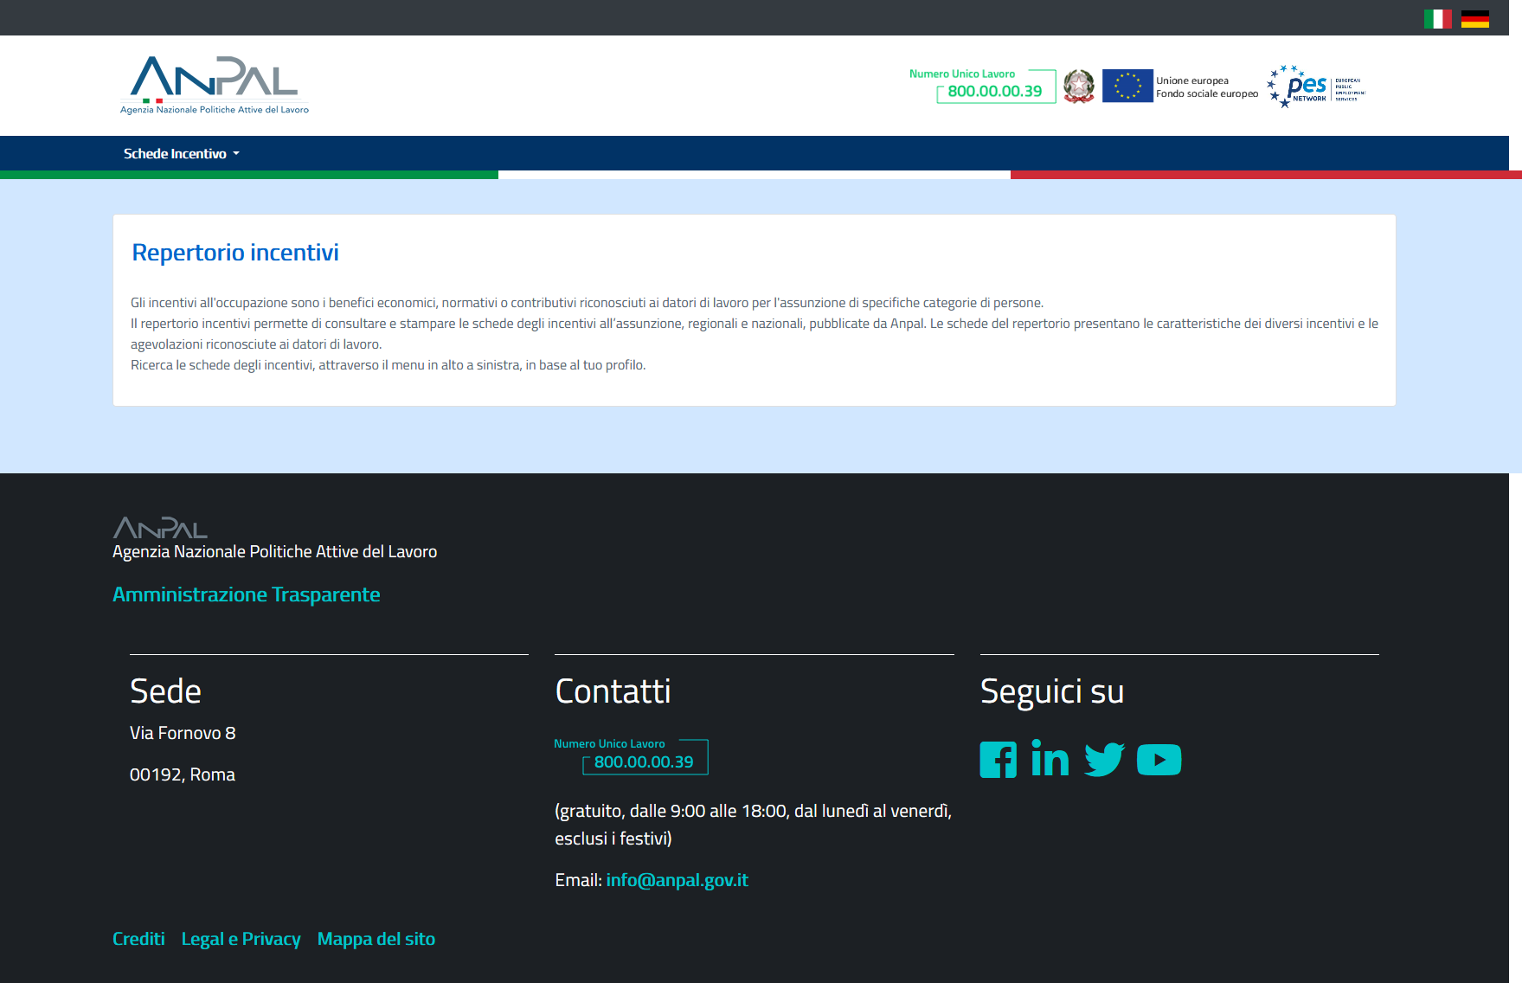
https://myanpal.anpal.gov.it/repertorio-incentivi/

Slide 32
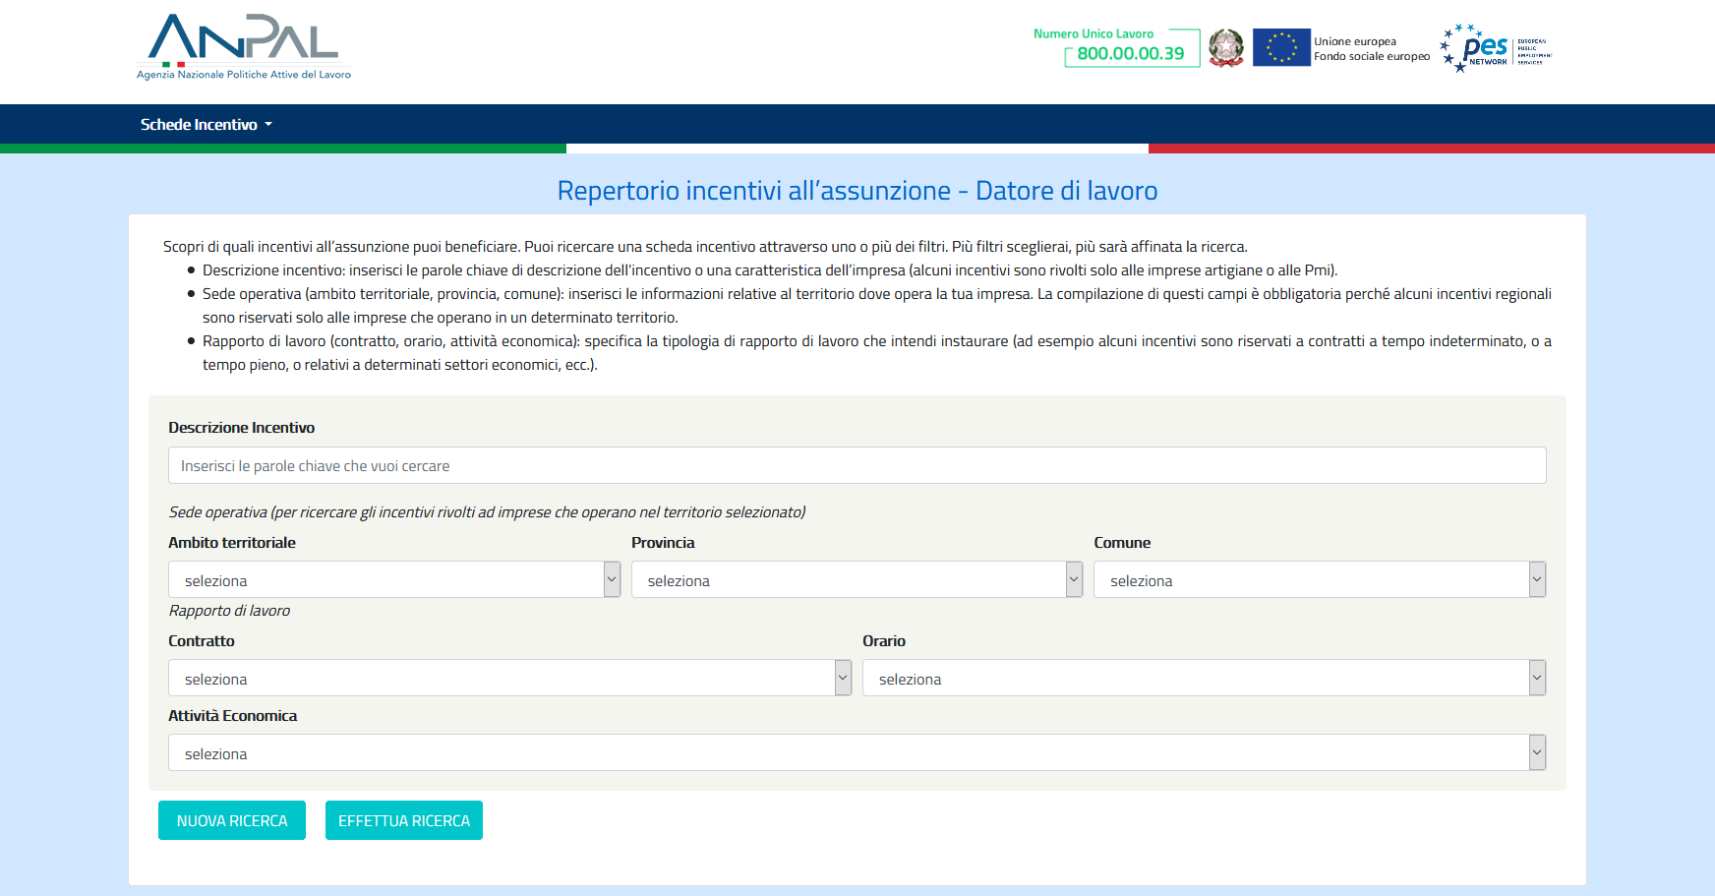
https://myanpal.anpal.gov.it/repertorio-incentivi/

Slide 33
Thank you for your attention!
Rosario De Luca EURES Adviser
rosario.deluca@eures-sicilia.eu

