Slide 1


Mechanical sector and Mechatronics
Lucilla Ricci, EURES Adviser
Notes:
1

Slide 2



MECHANIC/MECHATRONICS sector
40 HANDS ON TECHNICIAN
tSempre Technology BV - Netherlands
Business service provider dealing with technical staffing and recruiting; they offer solution to the shortage of high skilled engineers;
Hands on technician duties: assemble complex machines; he/she must assemble modules and systems on the basis of drawings or production documentation.
Requirements:
Graduation or max 2 years experience;
Bachelor level in Mechanical Engineering, Mechatronics, Manifacturing
Affinity with technology
Willingness to fulfil a hands-on tecnichian job for at least 2 years.
Fluent English
To apply: e.oosterbosch@sempre-technology.com or via platform
Notes:
2

Slide 3
MECHANIC/MECHATRONICS sector
5 Software PLC Engineer
Sempre Technology BV
Business service provider dealing with technical staffing and recruiting; they offer solution to the shortage of high skilled engineers;
Company placed in the south east part of the Netherlands (close to Maastricht)
Key software engineer for automated machines and paper converting equipment;
Responsible for the design, development, and documentation associated with the project software systems and must be able to solve machine control problems
What does the company need?
Bachelor degree in Computer Science, Controls/Mechatronics or Electrical Engineering Technology.
• 3-5 years of related electrical engineering experience and machine development
• PLC programming experience (PLC systems such as Beckhoff, Allen Bradley, Siemens, Mitsubishi, Omron, etc.).
• Knowledge of production processes and automation technology
• Familiarity with design and application of various sensor technologies.
• Creative spirit that strives for innovation
• Good knowledge of the Dutch and English language (German is an advantage)
• Willing to travel up to 30% of the time
Notes:
3

Slide 4
MECHANIC/MECHATRONICS sector
5 Installation Engineer
Sempre Technology BV
Company is placed in Enschede (Netherland)
Design house providing a wide range of integrated OEM product solutions in the Wind/Energy and High-tech/Systems markets on a global scale.
Duties:
produce and assembly the Machine Support Frames together with other colleagues
Manufacturing and assembly of Machine Support Frames
deal with both coarse and finer mechanical assembly
What does the company need?
Preferably experiences in mechanical engineering (assembly, installation, troubleshooting and repairs);
Bachelor in Mechanical- or Energy Engineering
Fluent english
• Willingness to work in a 2 shift pattern;
• You can deal with unexpected situations in which you have to anticipate
Notes:
4

Slide 5
MECHANIC/MECHATRONICS sector
3 Failure mode mechanic
Sempre Technology BV
Company is placed in Rijnsburg the Netherlands (South East)
Design house providing a wide range of integrated OEM product solutions in the Wind/Energy and High-tech/Systems markets on a global scale.
Duties:
independently solve all technical and mechanical malfunctions
support preventive maintenance work
What does the company need?
University studies (Electrical Engineering / WTB / Mechatronics, Mechanical)
Fluent English or Dutch
At least 2 years of work experience as a malfunction/service technician in a production company
Flexible use according to a 4 or 5 shift sche
.
Notes:
5

Slide 6
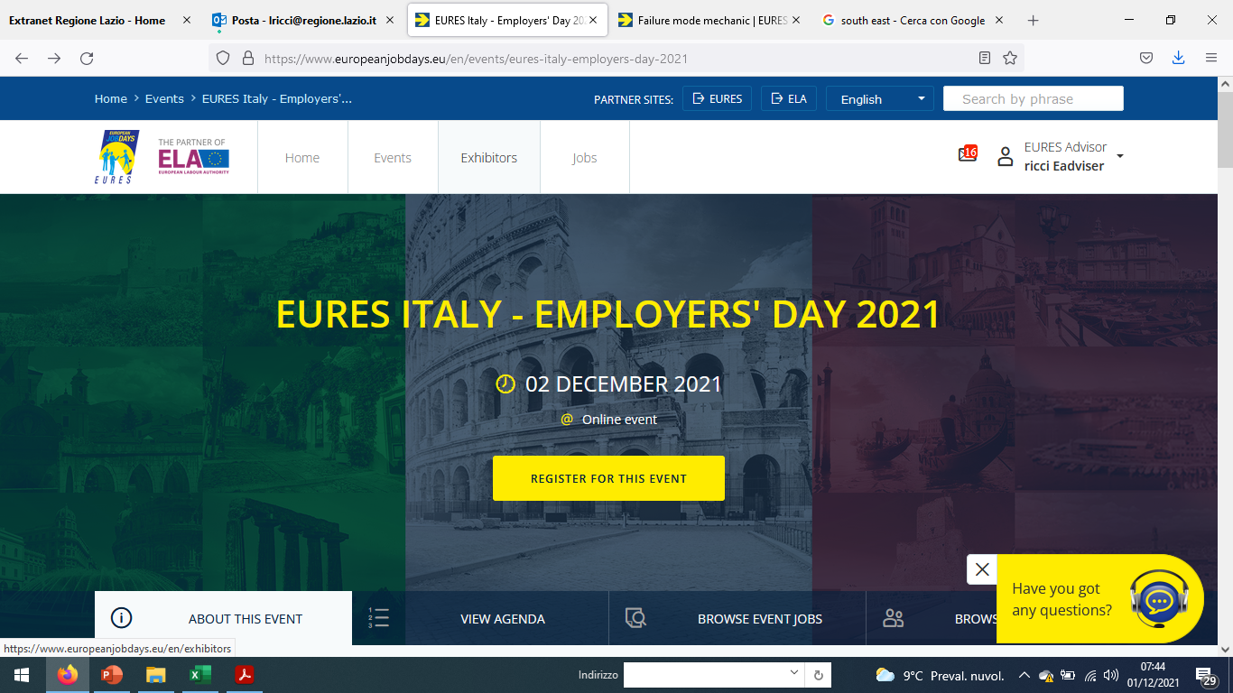
Exhibitor
Exhibitor
Notes:
6

Slide 7
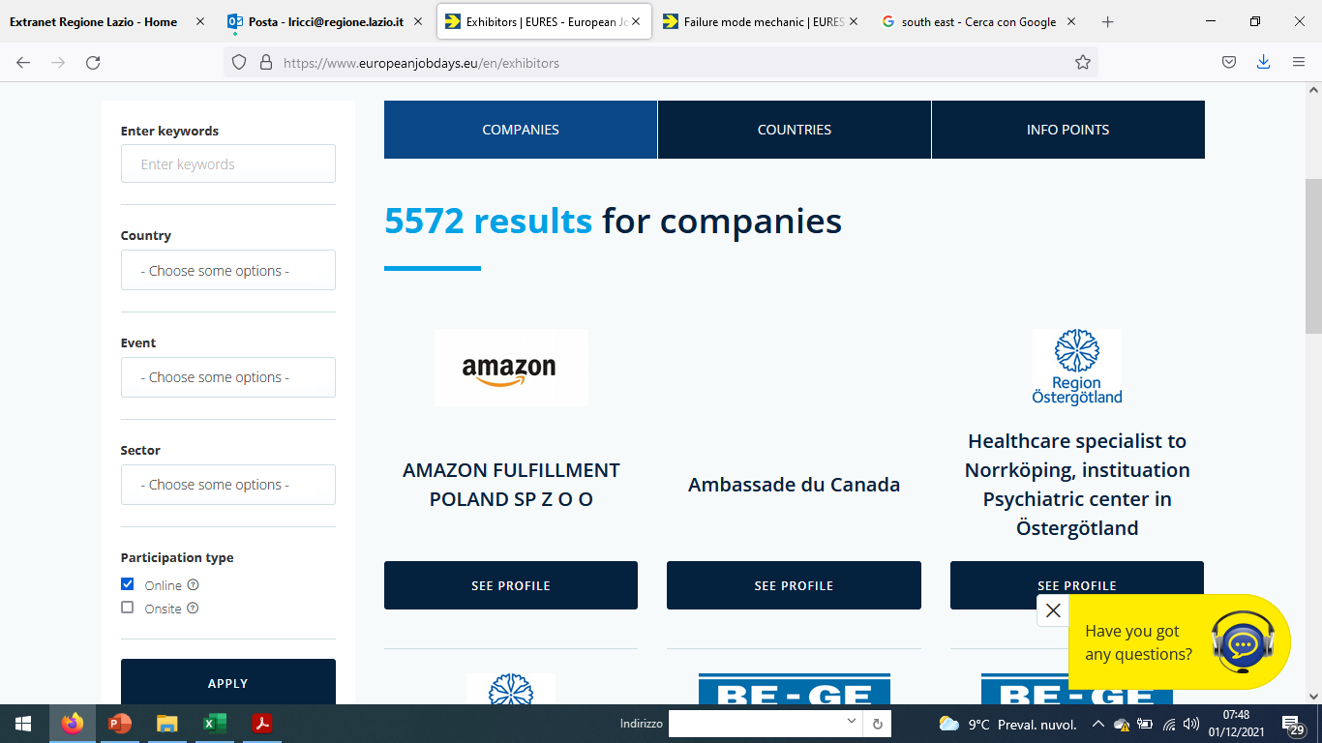
Companies
Company
Notes:
7

Slide 8

MECHANIC/MECHATRONICS sector
Clone of CNC bending machine operator/programmer,
JAWS International is part of JAWS, a technical intermediary for clients and job seekers in the machine building and manufacturing industry. It focuses on the recruitment of international technical talents who want to establish themselves permanently in the Netherlands
Company placed in Gaanderen (Netherlands)
Duties:
Setting up and operating the CNC bending machine
Ensuring the process goes well and check up on the end products
Fix malfunctions and ensuring daily maintenance. It is important that you are a good planner and that you prepare your activities to ensure the sheet metal department runs as smoothly as possible
What does the company need?
Vocational technical degree OR university (of applied sciences) degree, with a strong interest in CNC machining and the sheet metal industry
experience as a CNC operator or programmer and willingness to work on a CNC bending machine for the next few years, developing into a programmer
looking to move to the Netherlands for the long term
Fluent English and are willing to learn Dutch
info@jawsinternational.eu
Notes:
8

Slide 9
MECHANIC/MECHATRONICS sector
Clone of CNC lathe operator
JAWS International is part of JAWS, a technical intermediary for clients and job seekers in the machine building and manufacturing industry. It focuses on the recruitment of international technical talents who want to establish themselves permanently in the Netherlands
Company placed in Gaanderen, near the JAWS office in Terborg (Netherlands) and it is specialized i in the machining of axis, wheels, rings, castings, and machine parts
Duties:
working on new products continuously and willing to think about solutions;
Able to read drawings very well;
Choosing the tools, setting up the machine, and checking the product after machining;
Working in a 2-shift system (06.00 – 14:30 and 14.30 – 00.00)
What does the company need?
Experience with CNC lathe machines (Okuma)
ork on conventional lathes with a diameter of up until 3 metres
Very good English
Info: rtewinkel@jaw-s.nl
Notes:
9

Slide 10
MECHANIC/MECHATRONICS sector
JOB DESCRIPTION
1 CNC LASER OPERATOR/PROGRAMMER
JAWS International is part of JAWS, a technical intermediary for clients and job seekers in the machine building and manufacturing industry. It focuses on the recruitment of international technical talents who want to establish themselves permanently in the Netherlands
Company placed in Gaanderen (Netherlands)
Full time position
Duties:
Setting up and operating the punch laser machine;
Working with different programs;
Small periodic maintenance on the laser machine;
If you are experienced in CNC punch laser programming, this can become part of your job;
If you are not familiar with it, you should be open to learning it.
What does the company need?
technical vocational degree, in the metal industry area;
experienced as a CNC punch laser or laser cutter operator;
You take initiative and are willing to learn and improve;
Knowledge of Amada/ Cam is a plus;
willing to work in a 2-shift system (first shift: 06.00 – 14:00, second shift: 14:00 – 22:00);
Willing to move to the Netherlands for the long term;
fluent English.
Info: rtewinkel@jaw-s.nl
Notes:
10

Slide 11

)
MECHANIC/MECHATRONICS sector
1 Worker for CNC Machines- Wood
Tempi Moderni is an italian private employment agency
Duties: manage independently CNC machine for woodworking
What does the company need:
Experience and autonomy in the use of CNC machinery
Willingness to work on shift and any overtime
Full hour time shift
An initial fixed term contract
Place of work: Codogno (Treviso)
Notes:
11

Slide 12
)
MECHANIC/MECHATRONICS sector
1 Worker for CNC (blende and CNC assemble
Tempi Moderni is an italian private employment agency
Duties: measuring, cutting and bending sheet metal (stainless steel, iron and aluminum of thin thicknesses) with latest generation numerical control machinery. As well as assembly and assembly with the use of screwdrivers and bench tools.
What does the company need:
technical / mechanical diploma,
If possible previous experience in a similar role (bending, assembly /
ability to read the technical drawing;
Familiar with bench tools;
Working place: Conegliano (Treviso) Italy
Notes:
12

Slide 13
)
MECHANIC/MECHATRONICS sector
1Senior Mechanical Designer – Project manager
Tempi Moderni is an italian private employment agency
What does the company need:
Master degree in Mechanical engineering
Expertise in mechanical design aimed at the realization of mechatronic products
Expertise in mechanical design aimed at the realization of mechatronic products
Expertise in mechanical design aimed at the realization of mechatronic products
Working place: Albano Laziale
Working place:
Notes:
13

Slide 14
CONTINUOUS WIRE WELDER
)
MECHANIC/MECHATRONICS sector
1 Continuous wire welder
Tempi Moderni is an italian private employment agency
Duties:
work independently, dealing with precision welding;
able to control the quality of the welds made and the size of the pieces produced,
What does the company need:
Autonomy, responsibility and ability to manage and organize one own work
Ability to work in a team, creating a good atmosphere with departmental colleagues
Previous experience is not requires
Italian language
Place of work .Lecce (Italy)
Working place:
Notes:
14

Slide 15
)
MECHANIC/MECHATRONICS sector
1 Worker for CNC (blende and CNC assemble
Tempi Moderni is an italian private employment agency
Duties: measuring, cutting and bending sheet metal (stainless steel, iron and aluminum of thin thicknesses) with latest generation numerical control machinery. As well as assemble with the use of screwdrivers and bench tools.
What does the company need:
technical / mechanical diploma,
If possible previous experience in a similar role (bending, assembling)
ability to read the technical drawing;
Familiar with bench tools;
Working place: Conegliano (Treviso) Italy
Notes:
15

Slide 16
)
MECHANIC/MECHATRONICS sector
1 R&D Officer – research and development
Tempi Moderni is an italian private employment agency
No previous experience in the role is required;
Short experience in organized industrial contexts is welcome
Languages: Basic English
Place of work: Piemonte (Italy)
Notes:
16

Slide 17
)
MECHANIC/MECHATRONICS sector
1 Installer of Photovoltaic systems
Tempi Moderni is an italian private employment agency
Duties: Installation of photovoltaic systems
What does the company need?
Previous experience in the electrotechnical field in the installation and repair of electrical systems, wiring and reading drawing / wiring diagram;
Language: Italian
Place of work: Latina (Italy
Notes:
17

Slide 18

MECHANIC/MECHATRONICS sector
2 Automated machinery operator
The local employment office of Senigalia is a public office supporting candidates in their job search activities and companies in their search for staff
Duties:
Must use automatic equipment
What does the company need?
Post secondary technical education and experience in mechanichal assembly are necessary
Driving licence and own car.
Three work shifts (morning - afternoon - night).
Languages: fluent Italian, basic English
?
Notes:
18

Slide 19
)
MECHANIC/MECHATRONICS sector
1 construction site electrician
The local employment office of Ancona is a public office supporting candidates in their job search activities and companies in their search for staff
A company placed in Osimo (Ancona) and operating in the metalworking sector is looking for an experienced electrician for the installation of photovoltaic systems.
Duties:
Installation of photovoltaic systems
Reading wiring diagrams
Maintenance with troubleshooting on medium voltage at customer sites of the company.
Electromechanical maintenance at height
What does the company need:
high school qualification in the technical / field –
Willingness to travel within the national territory
Enabling the use of PLE (elevating / aerial work platforms)
Working place: Willingness to travel within the national territory
Notes:
19

Slide 20
MECHANIC/MECHATRONICS sector
1 Mechanical expert
The local employment office of Urbino is a public office supporting candidates in their job search activities and companies in their search for staff
MECHANICAL EXPERT: The professional profile is required by a company in Urbania (PU) which operates in the precision mechanics sector.
Fixed-term and full-time contracts are offered.
Full time position
FOR APPLICATION SEND EMAIL TO: centroimpiegourbino@regione.marche.it
Write in the subject: Candidatura Eures Perito Meccanico Codice offerta: 37182/24
?
Notes:
20

Slide 21

MECHANIC/MECHATRONICS sector
1 Machine tool operator
The local employment office of Milano a is a public office supporting candidates in their job search activities and companies in their search for staff
CNC MECHANICAL PROCESSING company placed in PADERNO DUGNANO (Milano) Italy
needs 1 machine tool operator
Duties:
production of mechanical parts on customer request, CNC machine tooling, editing of FANUC programs, dimensional checks for the start of production.
?
Notes:
21

Slide 22
THANK YOU FOR YOUR ATTENTION AND.....CHECK OUT OUR PLATFORM !!!!
https://www.europeanjobdays.eu/en/taxonomy/term/48565/jobs
Notes:
22

