Slide 1


- HEALTHCARE sector -
Overview of vacancies
Anna Bongiovanni, EURES Adviser

Slide 2


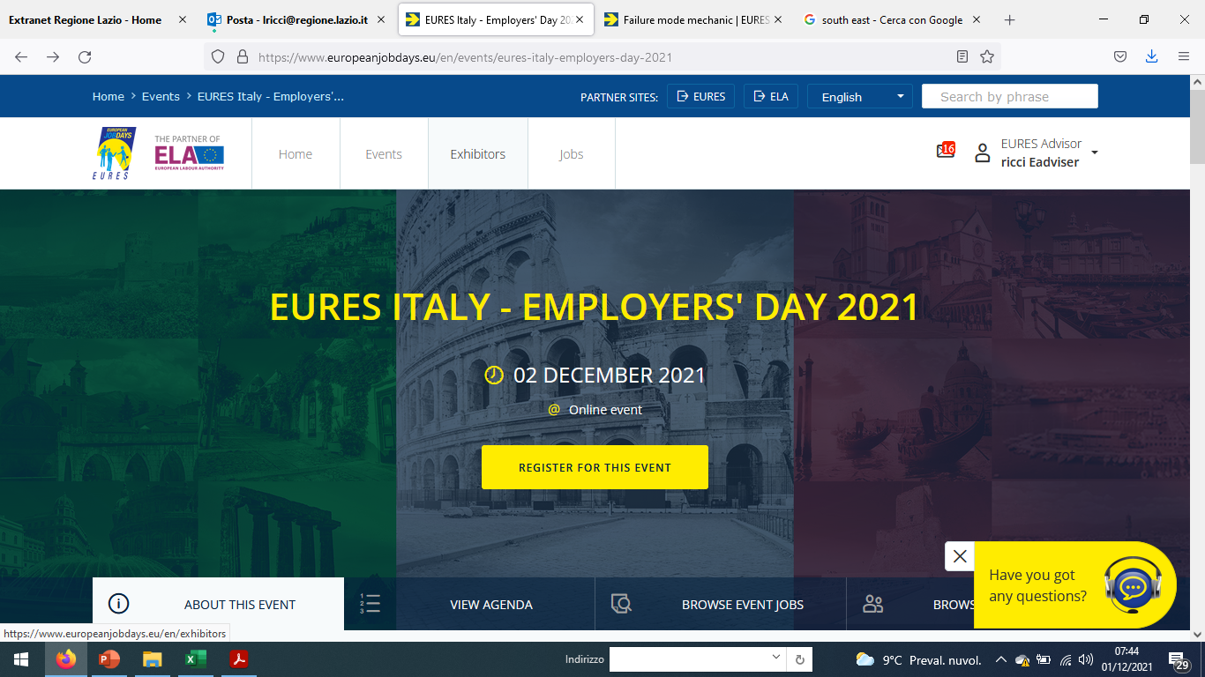
HEALTHCARE sector
In this session, we present job vacancies in the Healthcare sector, in Italy and in some EU countries.
You can independently visit all the job offers presented here, on the EOJD platform by:
going from the home page
of the event and select
the Exhibitors section
Exhibitor

Slide 3
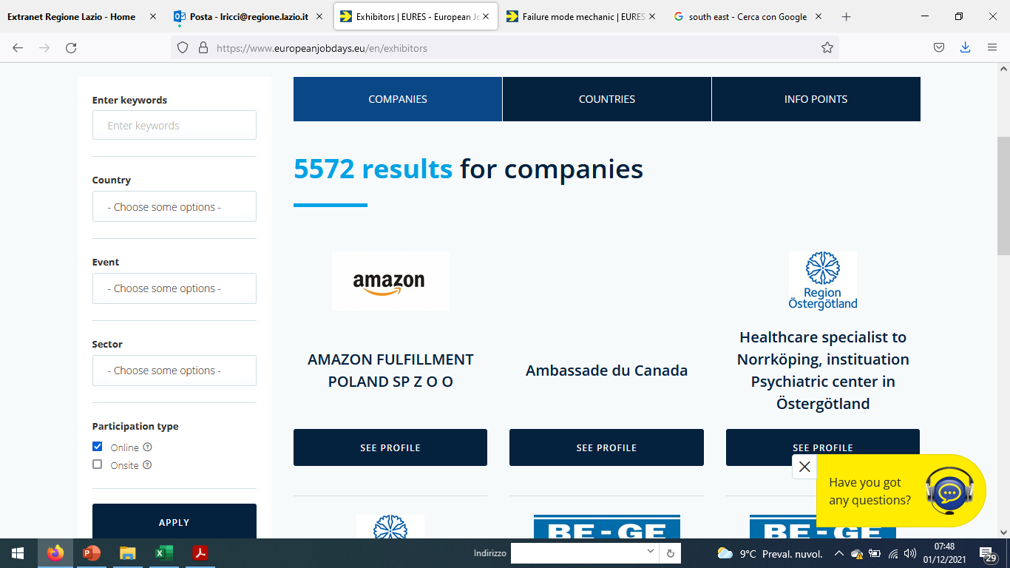
HEALTHCARE sector
and then looking for offers
by keyword, by country
or sector…

Slide 4


ITALY – VENETO REGION
INSIEME SI PUO’ Società Cooperativa Sociale
Social cooperative based in northeastern Italy (based in Treviso, Venice, Vicenza and Padua) is looking for Social care assistants and Nurses
https://www.europeanjobdays.eu/node/309847
Social Care Assistant – Positions: 20
Education: Qualification obtained following an accredited official course or other title enabling to work in the same position in Italy.
Date of expiry: January 28, 2022
https://www.europeanjobdays.eu/node/309239
Nurses – Positions: 20
Education: degree in nursing or other title enabling to work as nurse in Italy.
-----------
Collective labour agreement for social cooperatives. The entrance fee may be paid in instalments and will be entirely restored at the end of the business.
Permanent contract. Full time / part time position, min. 30 hours/week.
Language course and accommodation provided for the first period; later they will help in finding an independent accommodation.
Language course and accommodation provided for the first period; later we will help in finding an independent accommodation.

Slide 5

ITALY
JOB ITALIA
Job Italia is a joint-stock company, present throughout Italy, authorised to carry out the following activities: training, search & selection, intermediation, agency work, outsourcing, outplacement and support for professional placement.
FRIULI VENEZIA GIULIA REGION - PORDENONE
https://www.europeanjobdays.eu/node/313172
Nurses - 50 positions
https://www.europeanjobdays.eu/node/315559
Healthcare Social Worker - 50 positions
PUGLIA REGION - BARI
https://www.europeanjobdays.eu/node/316634
Nurses - 10 positions
Requirements for nurses: Degree in Nursing Science Registration with Ordini Professori Infermieristiche (OPI, Order of Nursing Professions)
Requirements for Healtcare social worker: 1000-hour certificate as a Healthcare Social Worker + Minimum work experience
What they offer:
fixed-term contract aimed at a future permanent employment

Slide 6

ITALY
TEMPI MODERNI SpA
This agency is one of the most recent and efficient realities in the sector of employment agencies – They offer: fixed term contract and as working hours: full time with shifts
https://www.europeanjobdays.eu/node/313158
LAZIO REGION - LATINA - Nurse - 1 position
https://www.europeanjobdays.eu/node/313156
PUGLIA REGION – FOGGIA - Social Care Assistant - 1 position
https://www.europeanjobdays.eu/node/313152
VENETO REGION – CONEGLIANO - Social Care Assistant - 1 position
https://www.europeanjobdays.eu/node/313139
BOLOGNA – Social Care Assistant - 1 position
https://www.europeanjobdays.eu/node/313138
PIEMONTE REGION - ASTI - Psychiatric rehabilitation technician - 1 position
https://www.europeanjobdays.eu/node/313135
PIEMONTE REGION - ASTI - Social-Health Professional Educator - 1 position
https://www.europeanjobdays.eu/node/312825
POZZUOLI (NAPLES) - Nurse - 1 position

Slide 7

ITALY - LOMBARDY REGION
FONDAZIONE POLIAMBULANZA
Istituto Ospedaliero
Fondazione Poliambulanza is a private non-profit hospital accredited with the Regional Health System in Lombardy.
It is a multi-specialist center with four areas of excellence: treatment of cancer and cardiovascular diseases, orthopedic operations and management of every phase related to childbirth thanks to one of the most modern and advanced Neonatal Intensive Care Unit in the area. Fondazione Poliambulanza is also a University training center in partnership with Università Cattolica.
https://www.europeanjobdays.eu/node/314419
Emergency Medicine Specialist - 1 Position
Requirements: advanced university studie (Phd) + Work experience up to 1 year
Offered contract: Fix term – 12 months with perspective of permanent contract
https://www.europeanjobdays.eu/node/314417
Lung Specialist - 1 position
Requirements: advanced university studie (Phd) + Work experience up to 1 year
Offered contract: Fix term – 12 months with perspective of permanent contract

Slide 8

ITALY – SARDEGNA REGION
CASA DI RIPOSO (REST HOME)
The Rest Home hosts old and not self-sufficient people, providing treatments food and other services.
Place: Monti ( Sassari )
https://www.europeanjobdays.eu/node/314983
Specialized Social Worker - 1 position
https://www.europeanjobdays.eu/node/314982
Nurse - 1 position
For contacts and application: casadiriposomonti@yahoo.it

Slide 9

ITALY – VENETO REGION
FARMACY COMELICO
Pharmacy of the Province of Belluno in the heart of the Dolomites
has been looking for a pharmacist (even a recent graduate) since December to be part of its staff.
https://www.europeanjobdays.eu/node/314708
PHARMACIST - 1 Position
Requirements
Candidates with no previous experience are also taken into consideration, a good knowledge of the Italian language and the possession of a driving license B with availability of one's own vehicle are required.
The ideal candidate has a practical sense and a discrete propensity for self-management.
The company offers an initial training period and free accommodation for the first 6 months.
Permanent contract with full time hours (5 1/2 days)

Slide 10

ITALY – MARCHE REGION
AXL SpA - HEALTH PROFESSIONALS
AxL is the employment agency created for the search and selection of personnel and to contribute to the growth of companies.
https://www.europeanjobdays.eu/it/node/312951
NURSES – 2 POSITIONS
for daily therapy administration service, assistance and care in a protected residence located in the Jesi area (AN).
Requirements required:
- Degree in Nursing with relative registration with the OPI
- availability in the short term
Place of work: Jesi (AN)
Working hours: part time 30/35 hours per week from Monday to Sunday
Contract offered: PERMANENT PERIOD
Date of expiry: Monday, January 31, 2022
Link for more information: www.insiemesipuo.eu

Slide 11

ITALY - TUSCANY REGION
GIOCOLARE Cooperativa Sociale
Giocolare is a Social Cooperative specialized in providing socio-health, educational and cultural services in several italian regions such as Tuscany, Veneto and Lombardy.
https://www.europeanjobdays.eu/node/312145
Nurses - 3 positions
They are selecting NURSES to be included in their health facilities.
They offer:
- a permanent contract and remuneration of certain interest
- a temporary ACCOMMODATION and Italian language course
To Apply:
send an email to: risorse.umane@giocolare.net
Workplace:
- Grosseto
- Florence

Slide 12

ITALY - LIGURIA REGION
ASSOCIATED VETERINARY PRACTICE
https://www.europeanjobdays.eu/node/308272
Veterinarian - 1 position
Associated Veterinary Practice with structures both in Sestri Levante and Rapallo is looking for a Veterinarian, even with first experience, to be included in the staff. The two structures offer the candidate an interesting professional growth both for case studies and for collaboration with colleagues specialized in different disciplines.
Requirements
Autonomy is required in the management of visits in order to be included in night shifts and weekends. A degree is required - old or new system (veterinary medicine) and previous experience in the role is not required.
Application
To apply, send your CV in Italian to: eures.tigullio@regione.liguria.it

Slide 13

NORWAY
APOTEK 1
Apotek 1 is currently seeking highly motivated pharmacists looking to make a career move.
https://www.europeanjobdays.eu/node/311640
PHARMACISTS – 1 POSITION
THEY OFFER
Good working conditions, individual development and career plans. To meet our language requirements they offer language courses, and are willing to assist with some financial support during the course, and also general relocation support.
Apotek 1 has pharmacies all over Norway, and you must be willing to move to remote parts of the country.
REQUIREMENTS
For candidates with a University or Master degree in Pharmacy, Apotek 1 in Norway offers a career in a well-known company with a high reputation.
Excellent English skills - highly motivated to learn, speak and write the Norwegian language
HOW TO APPLY/CONTACT INFORMATION
If you want to know more about working in Norway, or wish to send your application and Cv in English send an e-mail to the Recruitment advisor: nina.florholmen@apotek1.no

Slide 14

DENMARK
WORKINDENMARK
Workindenmark under the Danish Agency of Labour Market and Recruitment
is specialized in assisting Danish companies in recruiting highly qualified candidates in skills-shortage sectors.
Workindenmark’s website www.workindenmark.dk is Denmark’s official portal for international recruitment. Candidates can search among vacant positions from a wide range of Danish companies. All jobs are in English.
https://www.europeanjobdays.eu/node/313042
Nurses – 5 Positions (no experience required)
https://www.europeanjobdays.eu/node/313041
Skilled and dedicated psychiatrists – 1 position (experience required 2-5 years)
https://www.europeanjobdays.eu/node/313040
Skilled pulmonologists for Region Zealand – 1 position (experience required 2-5 years)
https://www.europeanjobdays.eu/node/316299
Specialized medical doctor in pulmonology – 1 position (experience required 2-5 years)
They offer very good contract and intensive introduction to the language

Slide 15


AUSTRIA
GRAZ RAGNITZ PRIVATE CLINIC
Graz Ragnitz Private Clinic, a PremiQaMed Group company, is a leading private clinic in Austria. Patients and doctors appreciate the professional competence, team-oriented leadership and technical standards that the house offers its guests.
https://www.europeanjobdays.eu/node/316658
Surgical Assistant – 1 Position
https://www.europeanjobdays.eu/node/316650
Specialist in anesthesiology and intensive medicine – 1 position
https://www.europeanjobdays.eu/node/313718
Nurse – 1 Position
https://www.europeanjobdays.eu/node/315073
Midwife – 1 Position
https://www.europeanjobdays.eu/node/315072
Assistant Nurse – 1 Position
Requirements
The speific qualification + experience is required
German very good

Slide 16


IRELAND
CLARITY RECRUITMENT
Clarity Group recruits temporary and permanent healthcare professionals for Ireland and the UK.
https://www.europeanjobdays.eu/node/301491 Pharmacists - 10 positions
Requirements
Qualified Pharmacist who studied in the EU and is registered as a pharmacist in the EU
Good level of English or the motivation to learn
Preferably experience in retail or community pharmacy
https://www.europeanjobdays.eu/node/301503 Nurses - 10 positions
Requirements
Qualified Nurses who studied in the EU and is registered as a nurse in the EU
Good level of English or the motivation to learn
Good communication skills
What they offer
Permanent contracts available - contracts before coming to Ireland
Full time jobs - Interviews and offers online
Competitive salary

Slide 17

Thank you for your attention!

