Slide 1

This is where we save and sustain lives
Boost Your Career with EURES, June 5th, 2025
Lars Nelsen
Senior Manager Talent Acquisition
DACH & Southern Europe
Notes:
Hello everyone, and a warm welcome from my side!
My name is Lars Nelsen, I am managing the Talent Acquisition function at Baxter for the German-speaking region, so Germany, Austria, Switzerland as well as Southern Europe. I am based in Munich, Germany, where our commercial headquarters are located. We also have two TA Partners from our team in Germany in this call, Teresa Feilhuber and Sebastian Lange.
It’s a pleasure to have you here today – and thank you for your interest in Baxter.
Today, I want to give you an inside look at who we are as a company, what drives us, and why so many people find Baxter to be a meaningful place to grow their careers.
We’re a global healthcare leader, but at our core, we’re united by one powerful mission: to save and sustain lives. And that’s not just a slogan. It’s also in our day to day recruiting activities what we live by – and it’s the reason for thousands of our employees across Europe to go to work everyday.
So, let’s dive in.

Slide 2



Making An Impact Around the World
90+
YEARS OF EXPERIENCE (FOUNDED IN 1931)
100+
COUNTRIES WITH BAXTER PRODUCTS
35K+
GLOBAL EMPLOYEES
~350M+
Global Headquarters Chicago
PATIENTS TREATED ANNUALLY
Manufacturing Location(s)
Notes:
Let me take a moment to tell you who we are — not just in numbers, but in values and purpose.
Baxter was founded over 90 years ago, in 1931, with a clear idea: that access to safe, effective healthcare should never depend on geography. Since then, we’ve grown from a small operation into a truly global company.
Today, Baxter sells our products in more than 100 countries, with over 35,000 employees worldwide — and round about a third of us are based right here in Europe.
Each year, our therapies, technologies, and medications reach more than 350 million patients. These aren’t just statistics — they represent lives saved in emergency rooms, recoveries supported in hospitals, and long-term care made possible at home. And behind all of this is one simple mission: to save and sustain lives. That purpose is what drives our innovation, our operations, and our people.
I believe that healthcare is one of the most meaningful industries you can work in. Because no matter your role — whether you’re in R&D, Manufacturing, IT, marketing, logistics, or finance — your work contributes to something larger. Something with a direct impact on patients, families, and entire communities.
So yes, we are a large, global healthcare leader. But what makes us truly special is the heart behind that scale — a shared commitment to creating a healthier, more connected world for everyone.”

Slide 3
Our European footprint
Austria
Belgium*
Czech Republik
Denmark
Finland
France*
Germany*
Greece
Hungary
Italy*
Ireland*
Malta*
Poland
Portugal
Romania
Slovenia
Spain*
Sweden*
Switzerland
Turkey
Ukraine
UK*
* Manufacturing & R&D Sites
Notes:
And Europe plays a uniquely important role in Baxter’s success. We’re proud to operate in more than 20 countries across the continent.
Including several Manufacturing plants in Germany, UK, France, Belgium, Spain, Sweden, Switzerland and Malta where we produce our products from hospital beds, over IV Solutions to high complex pharmaceuticals like oncology drugs.
We run Innovation Centers all over Europe where we are doing Research & Development to create the next generation of healthcare products.
And we have Commercial Offices in nearly every European country where our Sales, Marketing and Technical Service teams support hospitals, clinics, and patients directly.
This diversity of roles, expertise, and cultures all over Europe creates a dynamic and cross boarder workplace full of opportunities to grow and learn.

Slide 4

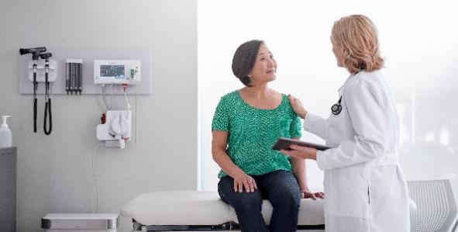
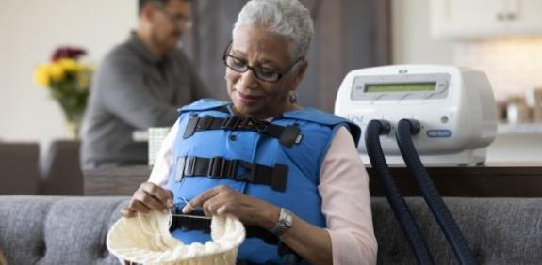
Supporting Patients & Clinicians across the care journey
HOSPITAL CARE
MEDICAL OFFICE
HOME CARE
40.000 different products in medical devices, medicines
and connected solutions that aid in the journey to good health
Rx Only. For safe and proper use of products mentioned herein, please see the appropriate Operator’s Manual or Instructions for Use.
Notes:
I mentioned earlier our mission to save and sustain lives, and this doesn’t live in one place – it lives in all the places where care happens.
In hospitals, where our technologies support life-saving treatment
In medical offices, where our devices assist in diagnosis and therapy
And on people’s homes, where our solutions empower patients to manage their treatments on their own.
Baxter has nearly 40.000 different products under several brands and if you ever were a patient in a hospital, it is very likely that you benefited from our products.

Slide 5
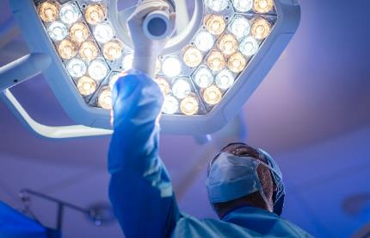
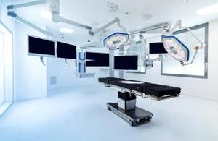
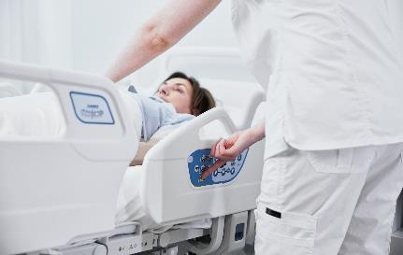
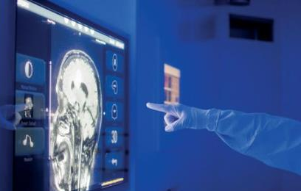
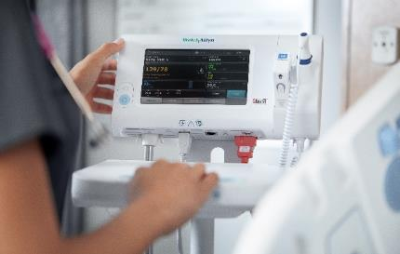
Where Progress Meets Purpose in Medical Technology
Surgical Lights and Booms
Surgical Tables and Accessories
Smart Beds and Surfaces
Infusion Systems
OR Integration Technology
Patient Monitoring
Rx Only. For safe and proper use of products mentioned herein, please see the appropriate Operator’s Manual or Instructions for Use.
Notes:
Let me show you only some of the products our employees are developing, producing and selling:
Let’s begin where it often matters most – the operating room. In this high-pressure environment, every second counts, and precision is key. That’s where Baxter comes in. We offer a wide range of medical technologies that support better, safer outcomes for patients and clinicians.
Like operating room tables and surgical lights that ensure visibility and flexibility.
Smart beds and monitoring systems to keep patients comfortable and care teams informed.
Infusion pumps for precise medication delivery.
Digital integration systems that help surgeons monitor patients and data in real-time.
These tools don’t just improve processes – they support lives. That’s what makes working at Baxter so fulfilling. You’re not just building or selling equipment – you’re contributing to a moment that can change someone’s life.”

Slide 6

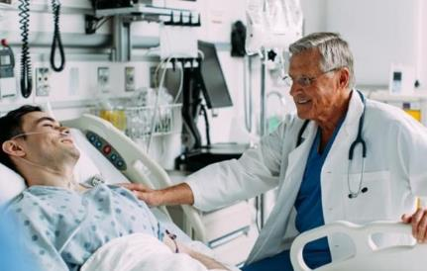
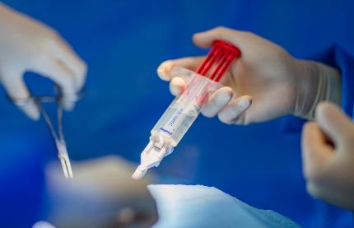
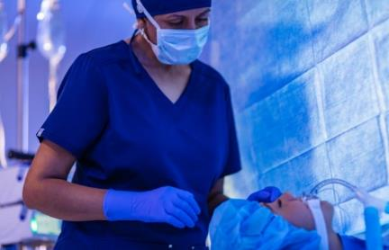
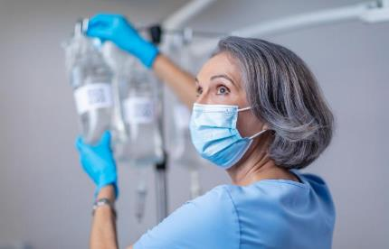
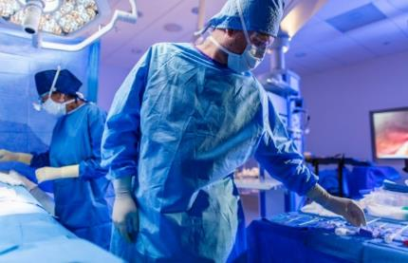
Where Progress Meets Purpose in Pharma
Injectables
Clinical Nutrition
Hemostats and Sealants
Anesthesia
Premixes and IV Solutions
Tissue and Bone Repair
Rx Only. For safe and proper use of products mentioned herein, please see the appropriate Operator’s Manual or Instructions for Use.
Notes:
But we don’t stop in the Operation Room. Baxter supports the full patient journey – from intensive care to recovery at home not only with medical devices but also with pharmaceuticals
As example, IV solutions and injectables improving safety and health conditions from acute care, over several diseases, to the treatment of serious forms of Cancer.
Clinical nutrition for patients who cannot eat normally.
Hemostats and Sealants which are basically natural glue to stop heavy bleedings in surgeries.
Anesthesia products that support safe sedation and recovery.
Or Tissue sealants and bone repair kits that make even complex procedures safer and more efficient
When you work on these solutions, you’re not just joining a company or a team – you’re really joining a fulfilling mission to improve how healthcare is delivered.

Slide 7
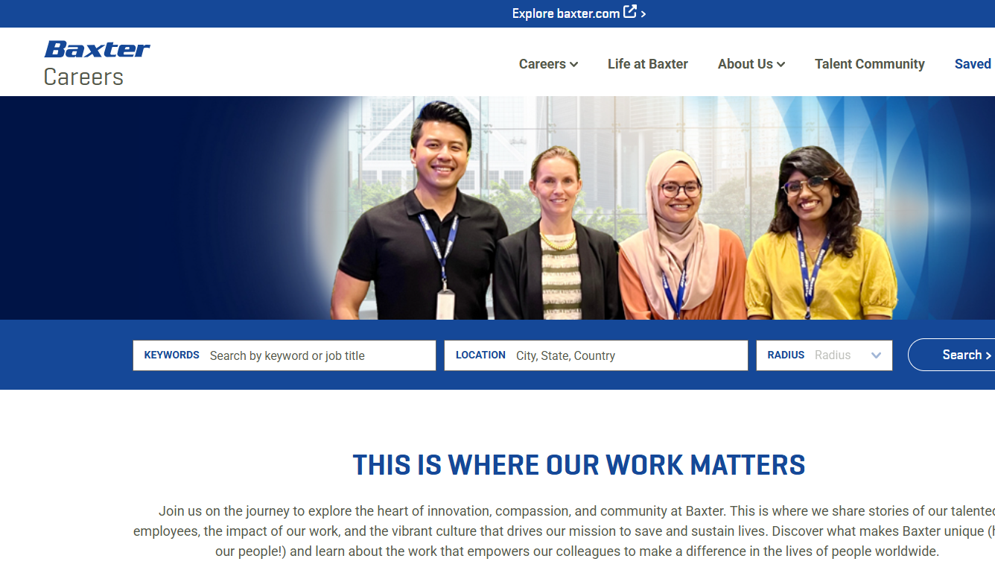









This is where your work matters
How to apply
Research & Development
Sales & Marketing
Manufacturing
Field Services
Engineering
Finance
Quality
Legal
IT
jobs.baxter.com
Notes:
As mentioned, Baxter is more than a medical company – we’re a community of professionals united by a purpose. And this purpose you can find in hundreds of different roles across Europe.
We offer roles in:
Research and Development – creating future treatments
Engineering & Manufacturing – building high-quality products
Sales & Marketing – bringing our products to those who need them
Quality, Regulatory, Compliance – ensuring safety and excellence
IT & Digital Health – designing smarter, connected solutions
Corporate Functions – from Finance and Legal to HR and Procurement
Whatever your expertise, you’ll find meaningful work at Baxter – work that saves and sustain lives.
Visit our careers portal at jobs.baxter.com. It’s easy to search by country, keyword, or function.
You’ll also find information about internships, graduate programs, and cross-functional opportunities in over 20 European countries.

Slide 8
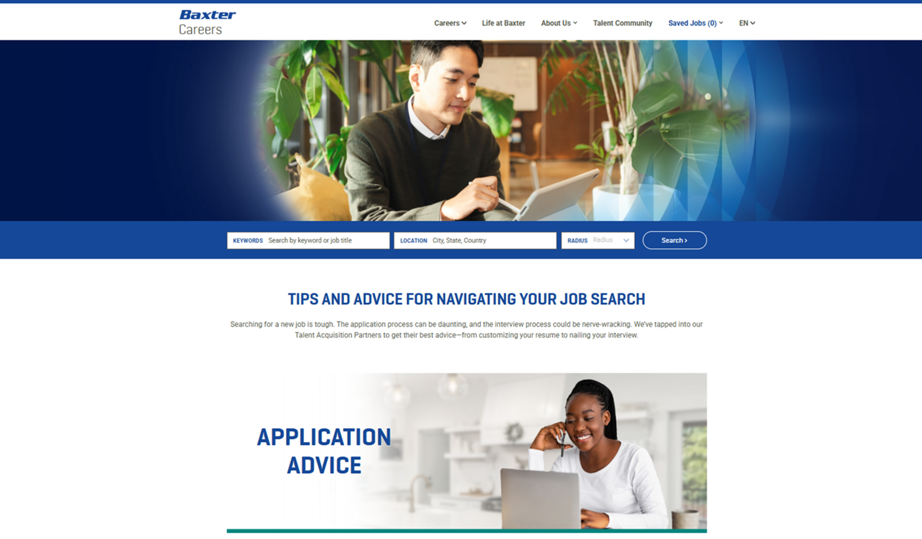
How to apply
Navigating a job search can be challenging. We’ve got you covered with tips and advice, from optimizing your personal brand to leveling up your interview.
jobs.baxter.com
Notes:
And if you navigate through our career pages, we understand that applying for a job can be overwhelming – especially if you’re exploring opportunities in another country. The application process can be daunting, and the interview process could be nerve-wracking.
Therefore, we’ve tapped into our Talent Acquisition Partners to get their best advice—from customizing your resume, nailing your interview to FAQ.
So, if you go on our website with your smartphone or your computer you'll find
- Tips for your resume and interviews
- Insights into our hiring process
- Onboarding and career development opportunities
But also, dozens of answers to frequently asked questions what candidates ask us most
Still have questions? We’re happy to help, usually every job requisitions names the responsible TA Partner with their email address – just reach out.”

Slide 9
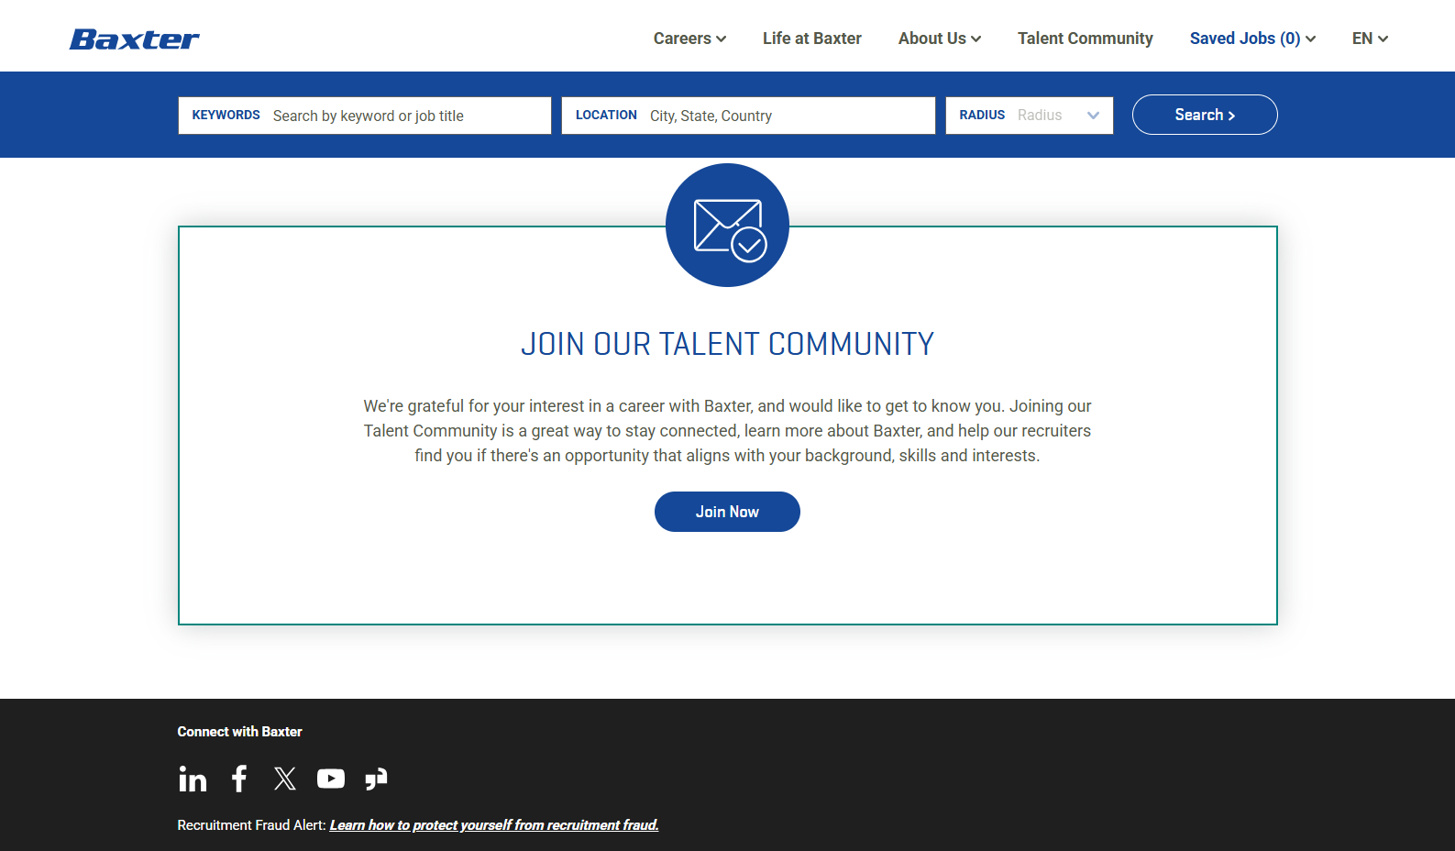
How to apply
Joining our Talent Community is a great way to stay connected, learn more about Baxter, and help our recruiters find you if there's an opportunity that aligns with your background, skills and interests.
jobs.baxter.com/talent-community
Notes:
And if now’s not the right moment to apply or you don’t find a suitable role – that’s totally fine!
But don’t lose touch.
Join our Baxter Talent Community to:
Get notified about new openings.
Learn more about life at Baxter.
Be invited to events, webinars, and info sessions.
And stay connected with our recruitment team.
Just sign up at jobs.baxter.com/talent-community – and we’ll keep you in the loop.

Slide 10

Senior Manager TA DACH & Southern Europe
Lars Nelsen
Thank you.
Thank you.
Notes:
Thank you so much for attending this presentation.
If you take one thing away from this session, let it be this: working in healthcare industry, ideally at Baxter means having a career that truly matters, because our industry and our products matter. You’ll help patients across Europe and around the world live longer, healthier lives. You’ll grow professionally. And you’ll be part of a company that puts purpose at the center of everything.
Please explore our careers site, join our Talent Community, and reach out if you’d like to learn more.
Thank you!

