Slide 1


EURADRIA 2020/2021
EURADRIA 2020-2021
CBP ITALY-SLOVENIA
Cross-border partnerships and support
to cooperation on intra-EU mobility
for EEA countries and social partners
VP/2019/006
16 December 2021
EOJD EURES ITALY EMPLOYERS’ DAY

Slide 2
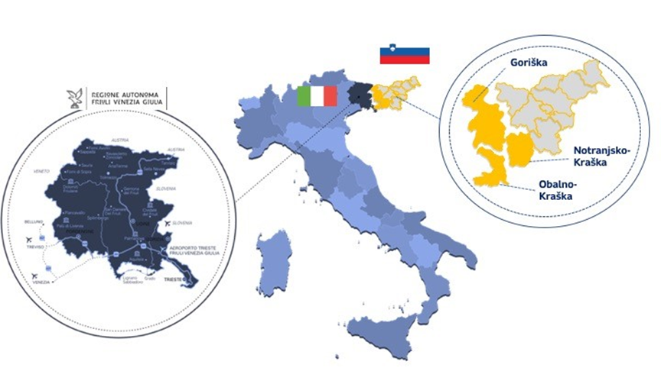
EURADRIA 20/21
The GEOGRAPHICAL SCOPE:
the cross-border region
between Italy and Slovenia
Friuli Venezia Giulia (IT)
and Slovenia, specifically:
the region Friuli Venezia Giulia in Italy (NUTS 2 ITD4)
the statistical region of Goriška (NUTS 3 SI023) in Slovenia
the statistical region of Obalno-kraška (NUTS 3 SI024) in Slovenia
the statistical region of Notranjsko-kraška(NUTS 3 SI018) in Slovenia
as identified in the Grant Agreement VS/2019/0398,
by NUTS (Nomenclature of territorial units for statistics)

Slide 3

EURADRIA 20/21
The COMPOSITION of the
Cross-Border PARTNERSHIPS IT/SLO
A multi-level partership composed by relevant stakeholders
in the field of CB job mobility and labour market
PES – Public Employment Services
EURES National Coordination Offices and
EURES local Advisers
Trade Unions and Patronages
Associations of Employers

Slide 4
EURADRIA 20/21
The main OBJECTIVES
Offer information and guidance to frontier workers, employers, trainees, apprentices, job seekers in the project’s area
Facilitate and increase the job matching, placement and recruitment process with the goal on the project’s cross-border area
Deepen information on CB Labour Market and on Active Labour Market Policy Tools, as e.g. apprenticeships and traineeships
Minimize specific obstacles to cross-border employment in the CB project’s area through the InfoDesks network
Analyze data and evidence to the flows in the area
Make services more accessible through the
online EURADRIA one-stop-shop portal
http://www.euradria.eu/

Slide 5
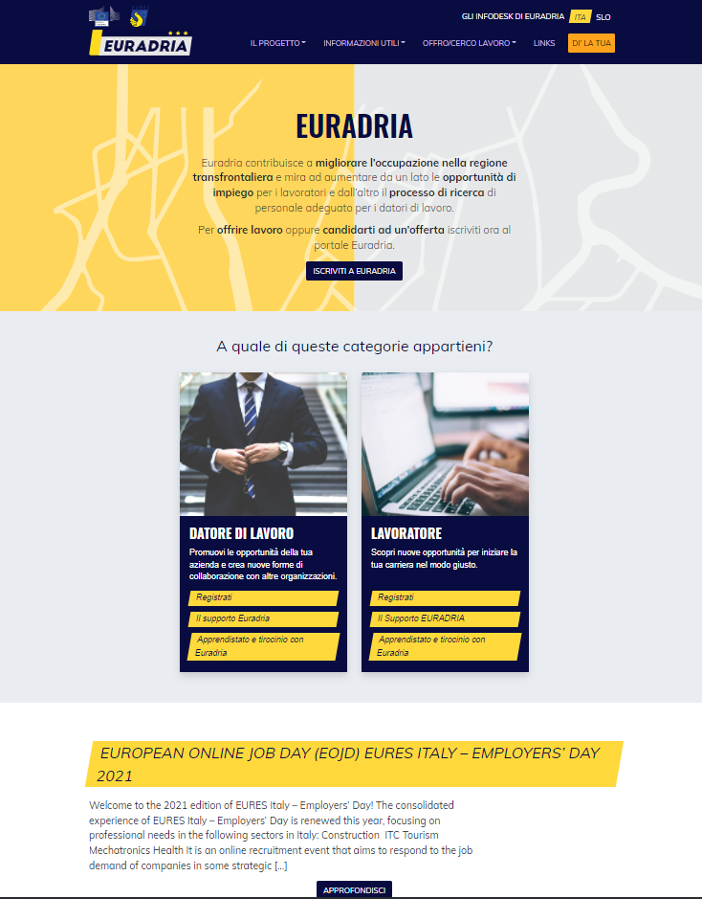

EURADRIA 20/21
The EURADRIA One-Stop-Shop portal
www.euradria.eu
Visit us online!
Through the portal we deliver info on onsite and online
services and opportunities.
Accessing the portal, you can:
CONTACT THE INFODESKS NETWORK
REGISTER YOUR PROFILE AS A JOBSEEKER AVAILABLE IN THE CB AREA
REGISTER YOUR COMPANY AS AN EMPLOYER IN SEARCH OF PERSONNEL WITHIN THE CB REGION and UPLOAD YOUR JOB VACANCIES
STAY UPDATE ON LATEST CB NEWS
PARTICIPATE TO OUR «HAVE YOUR SAYS» on relevant CB and labour market issues
Already available languages ITALIAN and SLOVENIAN!
The ENGLISH version is coming soon!

Slide 6

EURADRIA 20/21
Thanks for your attention!
For queries and information, please contact
euradria@regione.fvg.it
Follow @Euradria on
Euradria 20/21
16 December 2021
EOJD EURES ITALY EMPLOYERS’ DAY

