Slide 1
The project
YfEj 6.0
1/02/2019 - 31/01/2021
Roberta Cupertino Project coordinator assistant EURES National Coordination Office - Italy

Slide 2
The project
YfEj promotes the youth professional mobility
It is characterized by 3 important features
Quality
Circularity
Voluntariness
It is carried out with the support of the European Commission

Slide 3
Geographical dimension
EU Member States, Iceland and Norway

Slide 4
Who can participate
Jobseekers
Employers
18-35 years
Citizens and resident in EU member States + Norway e Iceland
Wishing to live a mobility experience in another Country different from the residence one
Profit and non-profit organizations, small, medium and large companies with a focus on SMEs
All sectors are included (e.g. health, engineering, logistics and ICT, tourism and related services, etc.)
Eligible contracts:
paid traineeship (minimum duration 3 months)
Job or apprenticeship contract (min duration 6 months)

Slide 5
What the project offers
Jobseekers
Information
Services and
personalized
advisory
Financial
benefit
Employers

Slide 6
What the project offers
Project services
For JS:
YfEj helps to find job, traineeship or apprenticeship opportunities in an European country other than their country of residence
Supports JS from the selection to the post-placement phases and in the management of the project procedures to apply for project financial benefits
For Employer:
YfEj supports employers in the process of selection and recruitment of professional profiles, through a large database of jobseekers CVs

Slide 7
What the project offers
Financial Benefits for JS
Special
Needs
Up to 500 euro
Reimbursement
Integration to subsistence allowance for trainees
Up to 600 euro
Flat rate (max 3 months)
Interview allowance
Up to 600 euro
Flat rate
Language
course
Up to 2000 euro
Reimbursement
Relocation
allowance
Up to 1400 euro
Flat rate
Recognition of
qualifications
Up to 400 euro
Flat rate

Slide 8
How to participate: only 3 steps!

Slide 9
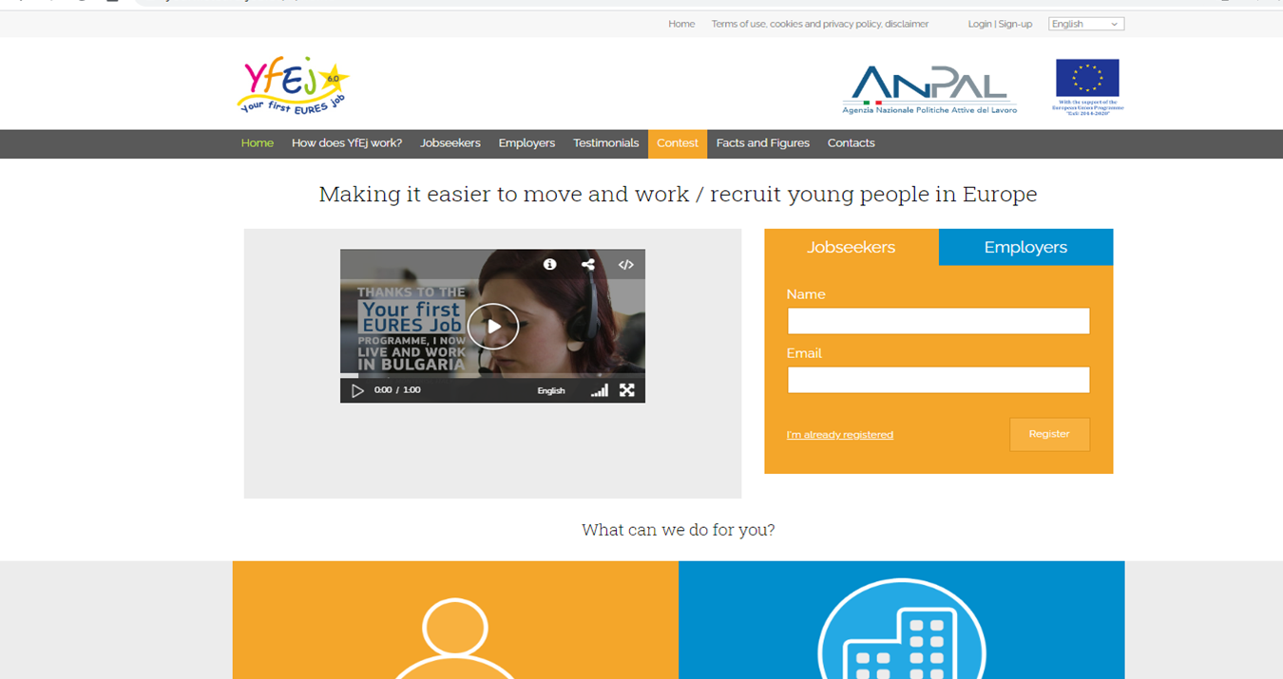
Step 1: registering in the project
www.yourfirsteuresjob.eu

Slide 10
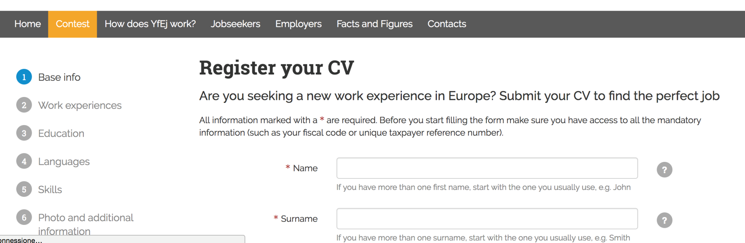
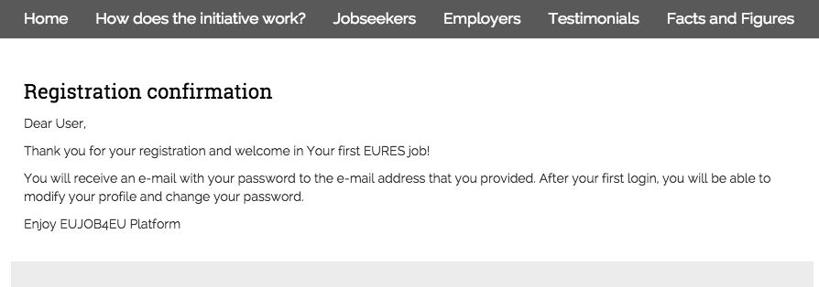
Step 2: filling in your CV
All information is important!
Fill in the whole form!

Slide 11
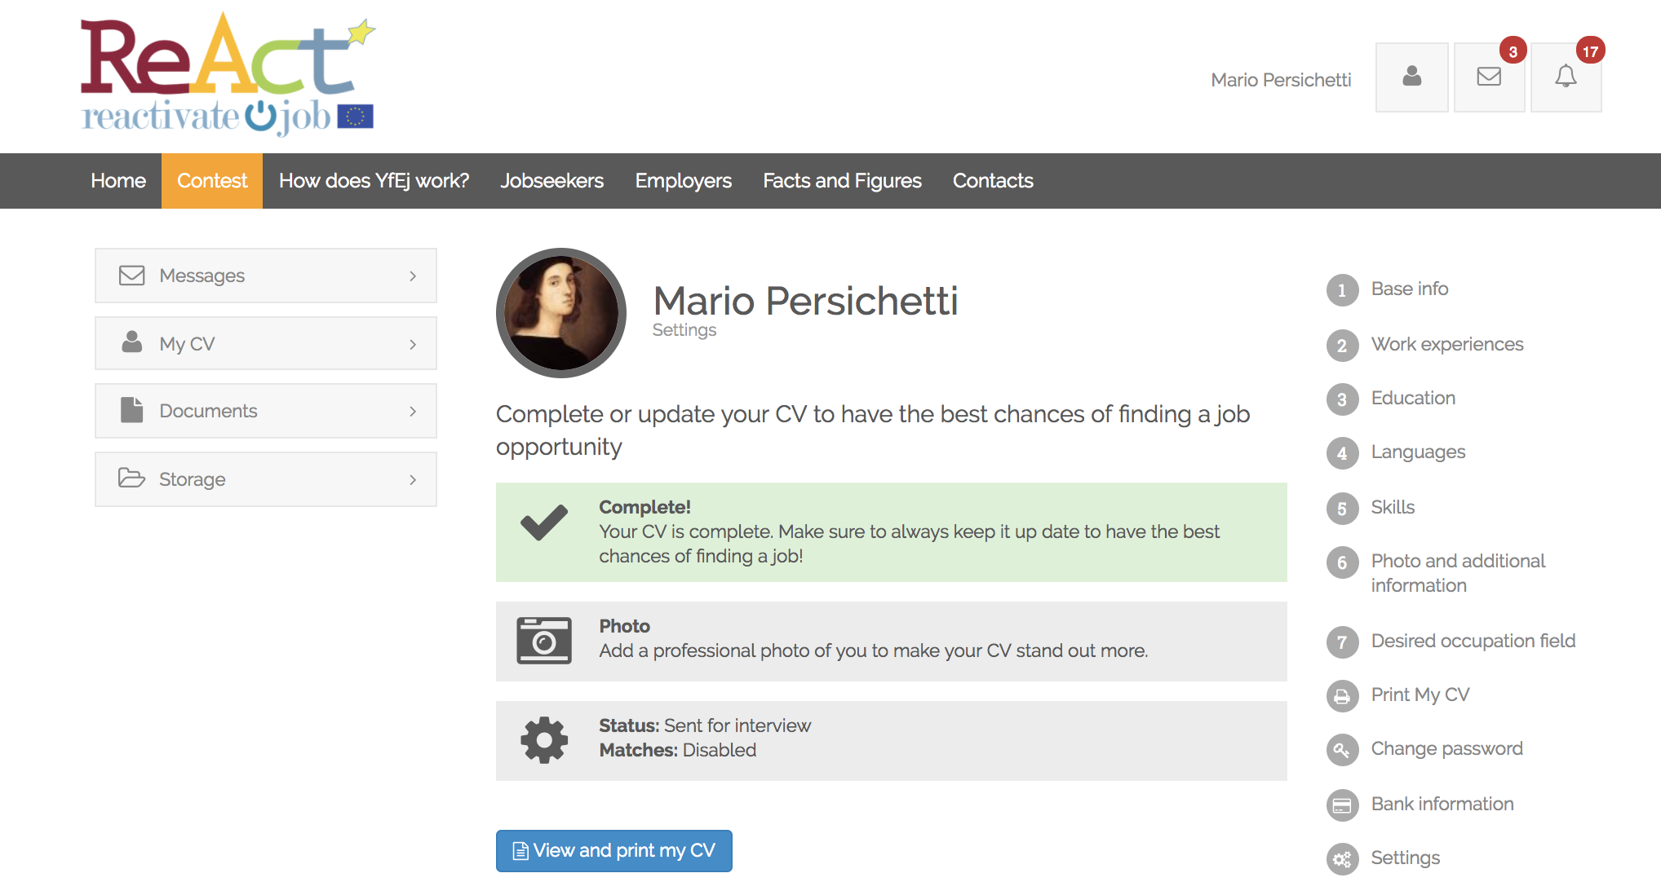
Step 3: entering in your dashboard
Mind that you can update your CV whenever you want. Just enter in your dashboard and add new experiences and new skills…

Slide 12
What happens after the registration?
3 ways to find a job

Slide 13
1. Receiving a job offer by the project adviser
Primary mode for selecting
YfEj Employer
YfEj project Adviser
Vacancy
1. checks and validates the vacancy
2. searches in the project platform JS profiles for the job proposal
3. contacts you for an interview or even to offer the job (If employer agrees)
…Are you ready?

Slide 14
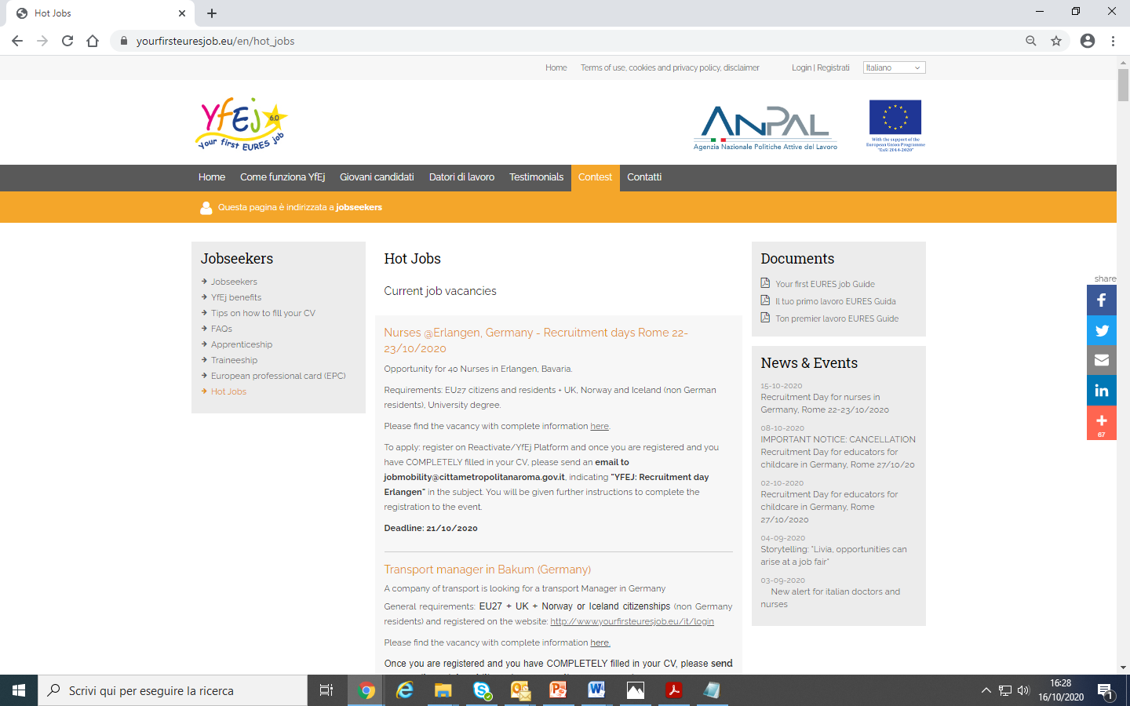
2. Searching a job offer by myself in the project website
The “hot jobs” are vacancies requiring a high number of workers
If you find “hot job” suitable for you, please contact the responsible adviser and apply for the job!

Slide 15
3. Being in contact with an unregistered employer
Jobseekers
Employer (not yet registered)
yfej@anpal.gov.it
YfEj project adviser

Slide 16
Brief summary
YfEj project Adviser
YfEj Employer
YfEj jobseekers
Vacancy
Selection phase
Relocation
Language course
Special needs
(Relocation)
Interview allowance
Integration to subsistence allowance for trainees
Special needs
(Interview)
Recruitment phase
Recognition of qualification

Slide 17
Contacts
Contact us and join our social media!
yourfirsteuresjob.eu
@YfEj Italia
Your first EURES Job
@YfEURESjob
yourfirsteuresjob.eu

Slide 18
Thanks for your attention
EURES National Coordination Office - Italy
_________
yfej@anpal.gov.it

