Slide 1




The project
YfEj 6.0
1/02/2019 – 31/01/2021
EURES National Coordination Office – Italy
Germana Monaldi

Slide 2



The project
Your first EURES job is a project financed by the European Commission,
EaSI program
OFFERS
Free services and financial
benefis to young jobseekers and employers
TO FOSTER
professional mobility, overcoming language and cultural barriers and filling in skill shortages!
Please note:
the geographical dimension of the project covers EU Member States,
Iceland and Norway !
Contributing to building up a European society

Slide 3

Who we are: the International Consortium
Lead Applicant
EURES NCO – Italy
(ANPAL)
A free, multilingual, human network of Advisers offering information, advice and recruitment services since 2015!
12
Co-applicants
(FGB, CMRC, Eurodesk Italy, Sapienza University, RO, HR, BG, GR, NL, PT,
ES, CY
14
Associated Partners (FI, PL, PL, IT)

Slide 4




Added value for …
Information
Young People
Tailored services
and guidance
Financial Benefits
Employers

Slide 5







All economic sectors
Health
(doctors, nurses, health assistants)
Logistic and construction
Information and Communication
Engineering
(different sector/profiles)
Tourism and related services
Wholesale-customer care

Slide 6
Who can participate
Young people
Employers
Aged 18-35
National and legally resident in a EU country, Iceland or Norway
Willing to move to another EU country for work, apprenticeship or traineeship
Small, medium and large companies, profit and no-profit, operating in all sectors established in an EU Member State, Iceland and Norway, looking for European workers, trainees or apprentices and offering:
Traineeship experiences (at least 3 months duration)
Job contract/apprenticeship (at least 6 months duration)

Slide 7
What kind of services
and benefits YfEj 6 offers

Slide 8
Services for Employers
Large database of CV from all over Europe
Information, workshop, Career and recruitment days
Identification of needs and support in the definition of the vacancy
(one company /one expert)
Support in the registration process (possibility to delegate the adviser by filling a form, to operate in the platform)
Pre-selection and matching of candidates
Organisation of interviews with the candidates
Support in the definition of the integration programme

Slide 9



Benefits for Employers
Only for SMEs (up to 250 workers)
Don’t forget!
Young JS might benefit from: language course, Interview trip, relocation, a trainee and recognition of qualification allowances! Also extra-benefits if they face economic difficulties!!
Financial support to deliver
integration training programmes
(basic, just one technical module or comprehensive, including administrative support)
to young recruited candidates
up to €2.000
per recruited candidate

Slide 10

Benefits Young people
Integration is never easy and/or immediate. Very often, the language barrier is a problem - the Coordinator of the Human Resources Development Unit reminded us - and many young Europeans struggle to integrate at first. For us, among the benefits made available by YfEj, it has been of primary importance to make the financing of language courses possible for every new hired worker
(www.yourfirsteuresjob.eu/storytelling_the_mobility_of_ideas)
Interview trip
Up to 600 euro
Specific Needs
Up to 600 euro
Allowance for trainees
Up to 600 euro/m
Complementary fee
Language
Course
Up to 2000 euro
Real costs
Country relocation
Up to 1400 euro
Recognition of qualification
Up to 400 euro

Slide 11
How to join the project

Slide 12
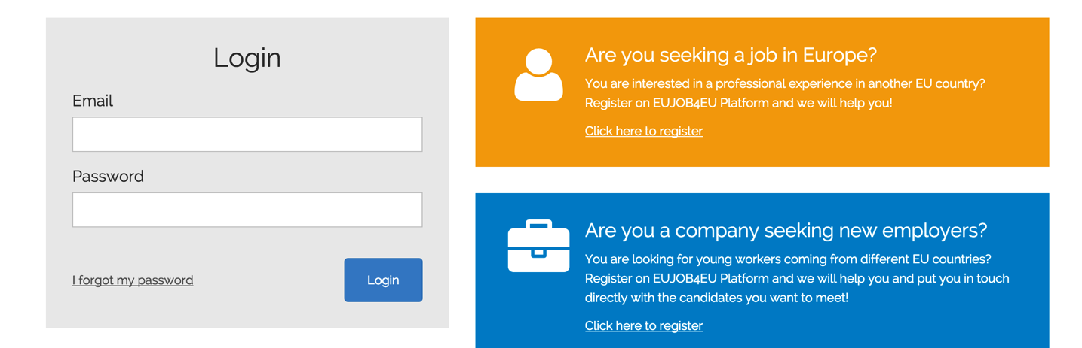
How to participate
Register to Yourfirsteuresjob.eu
To have access
to services and benefits!

Slide 13

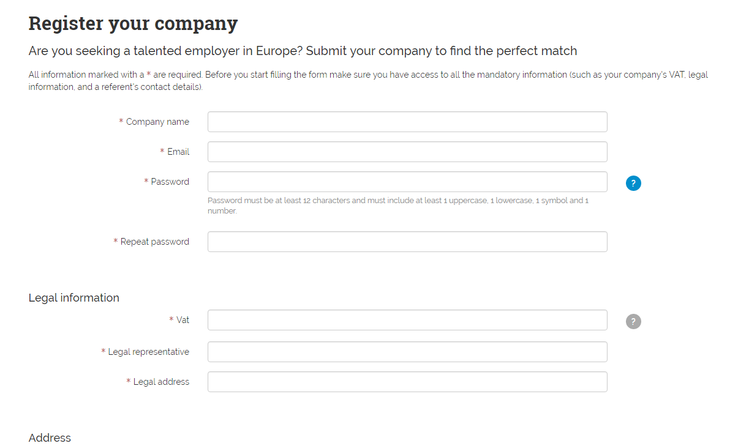

How to participate
Follow the instructions ...
It’s easy ☺
Employer registration process (1/4)

Slide 14
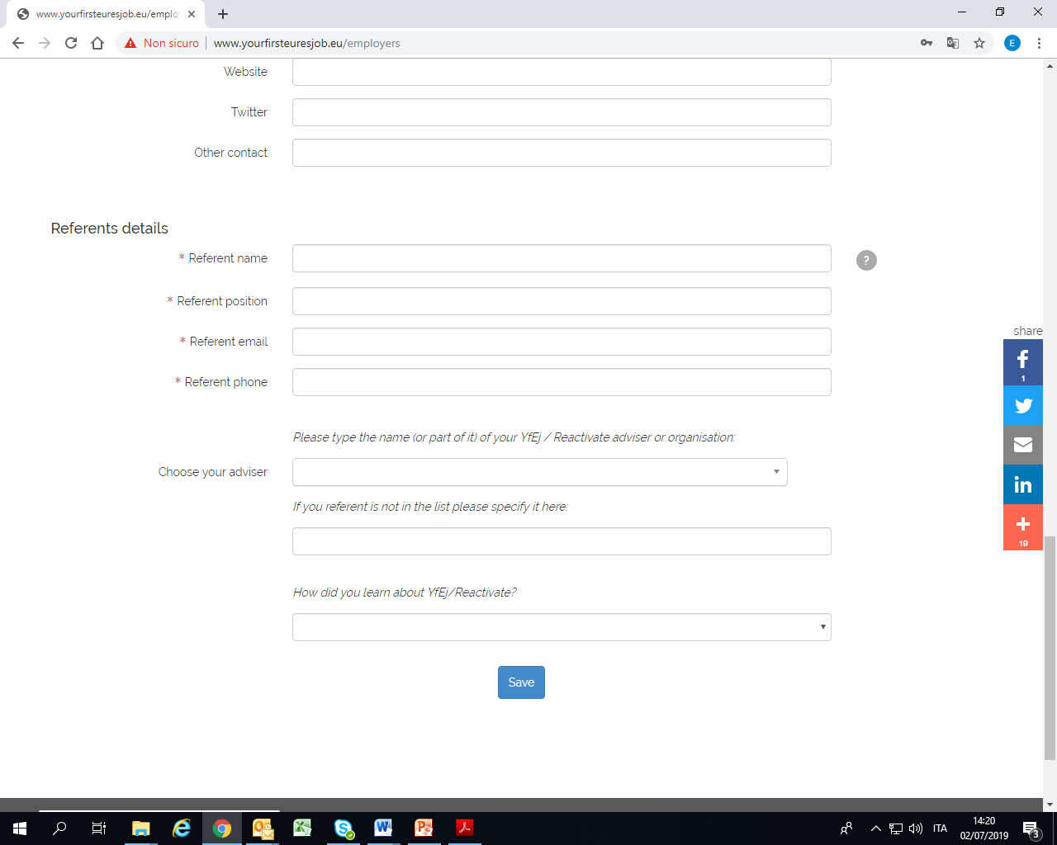

How to participate
Employer registration process (2/4)
The referent is the person that will eventually be contacted by the YfEj staff (does not need to be the legal representative)
Please select your EURES Adviser. If you don’t have one, the YfEj staff will provide you with one shortly

Slide 15

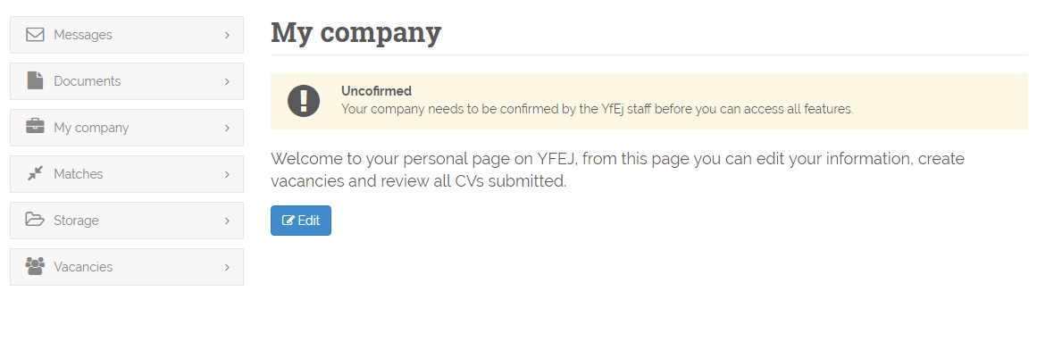
How to participate
Employer registration process (3/4)
1) Once you have filled out your online application …
2) … you need to wait for confirmation of your registration (normally it takes few days) from YfEj 6.0 staff

Slide 16
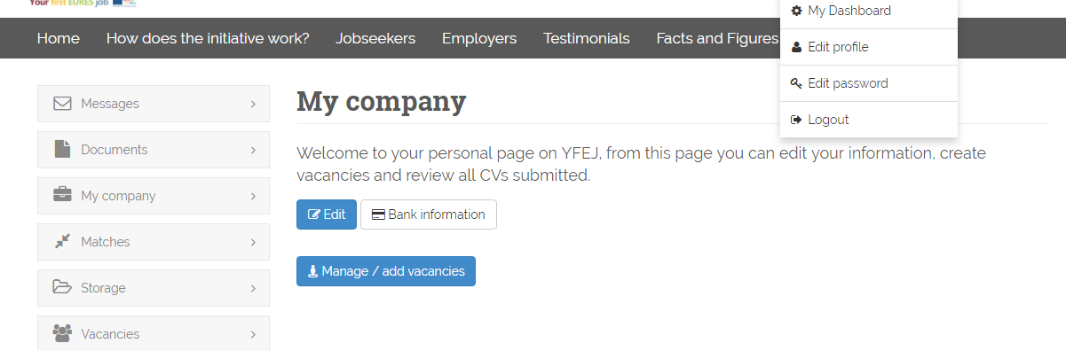
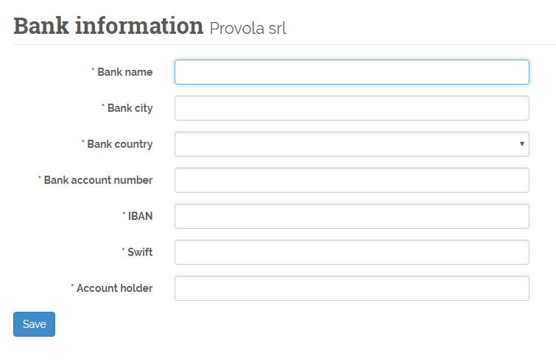
How to participate
Employer registration process 5/5
Now your company is validated and has full access to the Dashboard: manage/add vacancies, view candidates profiles (matched with the vacancy)
Please provide your bank information (necessary to reimburse the Integration Programme)

Slide 17

It can be even easier…
If time-consuming the Employer can delegate the registration and procedure to the Adviser!
In this last case the Employer representative is required to sign a mandate, according to the instructions indicated

Slide 18

Good reasons to join YfEj6
EU wide, multilingual, human network of Advisers offering a quality mobility package combining information, recruitment, matching and placement services with EU financial incentives
EU wide CV database
Mobility of workers is mobility of ideas
No sector limitation
Filling hard to fill vacancies and addressing labor market imbalances!
Getting information, advice and support to host European young trainees!
Networking with EU level employers and facing together the pandemic crisis

Slide 19




To reach us
yourfirsteuresjob.eu
@YfEj Italia
Your first EURES Job
@YfEURESjob
yourfirsteuresjob.eu

Slide 20

Thanks for your attention
EURES National Coordination Office - Italy
_________
yfej@anpal.gov.it

