Slide 1



Welcome to
Your TRAINEESHIP in Europe!
First part
Italy – Alessia Vetere

Slide 2
Your TRAINEESHIP in Europe!
WHAT and WHY ?
First part
Definition of Traineeship & types
Benefits for Trainees
Benefits for Employers

Slide 3
WHAT
a traineeship is?
Internship ≠ Traineeship
Internships are usually included in your curricula as a part of your formal education and have usually a brief duration (few weeks). Its recognition is usually directly related to your studies.
Traineeships are experiences outside the formal education, their duration usually goes from a few weeks to six months.
(EC-EURES - Policies, information & services, https://bit.ly/3ja9Go5 )

Slide 4
WHAT
a traineeship is?
Traineeships as ALMP-type tools
Active Labour Market Policiy Traineeships are work-based experiences, formally regulated and included in the Labour Legislation/Employment Acts of a Country
Traineeships within the Open Market
Open market traineeships, are present in certain Countries, as direct agreements between the trainee and the employer
“Traineeships are understood as a limited period of work practice,
which includes a learning and/or a training component”
(EC-DG Empl Policies & Activities, https://ec.europa.eu/social/main.jsp?catId=1045&langId=en)

Slide 5
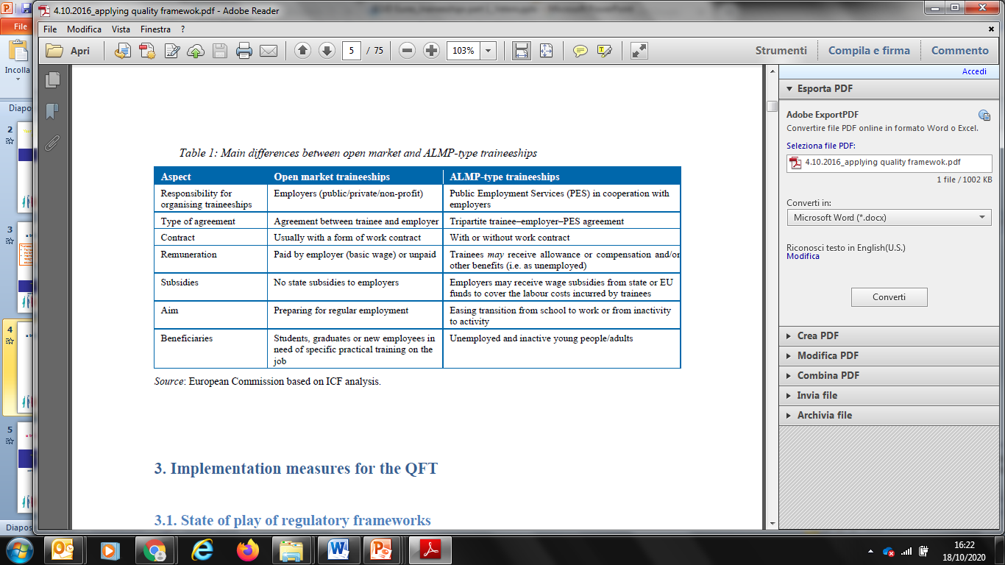
WHAT
a traineeship is?
(COMMISSION STAFF WORKING DOCUMENT Applying the Quality Framework for Traineeships,
Strasbourg, 4.10.2016, https://eur-lex.europa.eu/legal-content/DA/TXT/?uri=CELEX:52016SC0324)

Slide 6
WHY
to start a traineeship ?
By the side of Trainees
are a valuable way for young people to gain necessary work experience before entering regular jobs
help young people gain practical and professional experience, improving employability and facilitating transition into regular employment
give the chance to approach companies all around Europe, in many different sectors

Slide 7
WHY
to start a traineeship ?
By the side of Employers
traineeships give to employers access to a pool of talented young people all around Europe
traineeships can also help to give employers a positive image on the labour market
are well-known and well-accepted by the employers as a tool to “verify mutual professional expectations”

Slide 8

Thank you for your attention!
alessia.vetere@regione.fvg.it

