Slide 1



New Europass portal
and E-Portfolio
10th November, 2020
Valeria Scalmato
Responsible for National Europass Centre - NEC Italy
valeria.scalmato@anpal.gov.it

Slide 2




July 2020
New Europass portal is directly managed by the European Commission, free of charge, sicure and available in 29 languages

Slide 3
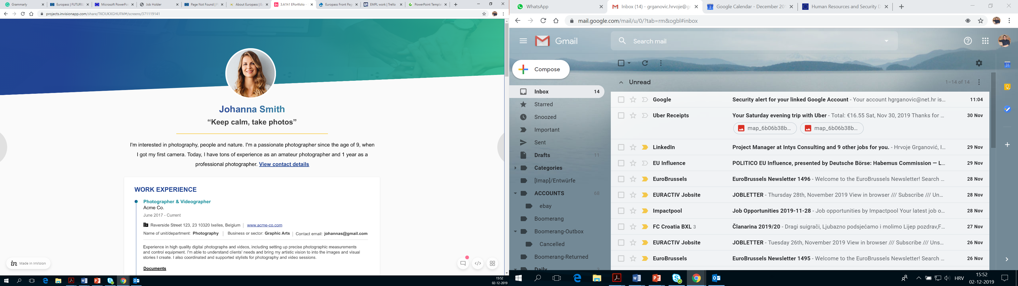
We are going to deal with…
New Europass Portal: the main components
E Portfolio: E profile, CVs and Library
Notes:
This means that with Europass, users can
share their Europass e-portfolio with other platforms instead of re-filling all their data into online forms,
use their e-portfolio to apply online for jobs or further training and
find opportunities that are relevant for them.
Users will always control the personal data in their e-portfolio and decide with whom they would like to share their profile and how their data is used.

Slide 4
New Europass portal
A single entry-point for a set of web-based tools
E-Portfolio (A free online profile), an online Editor to create and edit CVs and cover letters and a Library to save personal documents
Information provision sections (STUDY IN EUROPE and WORK IN EUROPE) to find tailored information on learning and job opportunities (via EURES Portal)
Trustworthy digitally-signed credentials.
Notes:
The Europass e-portfolio will enable users to display, document and share their skills, qualifications and experience gathered in the course of every stage of their life. It will support them to identify their goals and develop their careers from a lifelong learning perspective. It will also present them with personalized learning and job opportunities and enable them to prepare, submit and keep track of their learning and job applications.

Slide 5
E-Portfolio: users will be able to…
Record their skills and qualifications in an E-Profile;
Create different CVs in different templates and cover letters
Collect relevant documents such as diploma, reference letters, motivation letters, CVs and digital credentials in a Library;
Explore and configure how Europass analyses their skills;
Controll their personal data in their e-portfolio
Notes:
This means that with Europass, users can
share their Europass e-portfolio with other platforms instead of re-filling all their data into online forms,
use their e-portfolio to apply online for jobs or further training and
find opportunities that are relevant for them.
Users will always control the personal data in their e-portfolio and decide with whom they would like to share their profile and how their data is used.

Slide 6
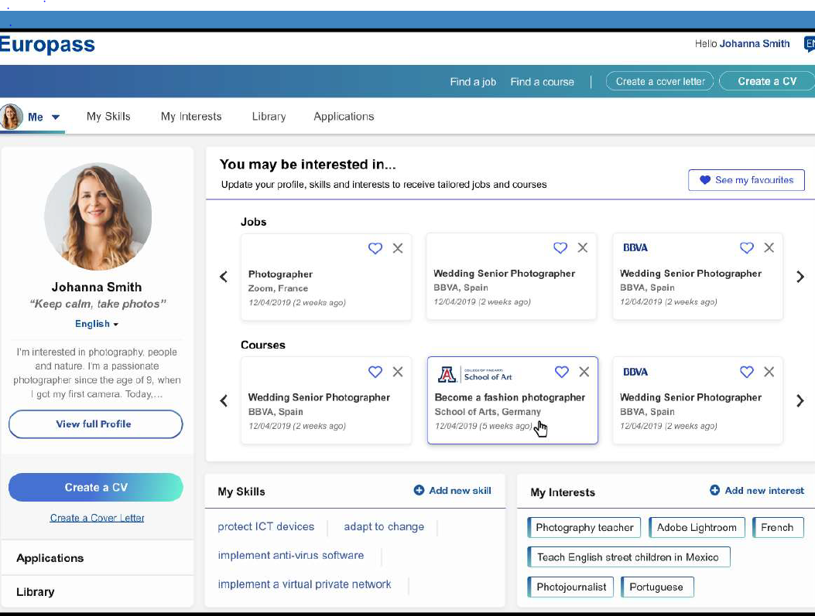
E-Profile: users can enter personal information, work, education and training experiences, skills (linguistic, digital, organizational etc), interests and everything that fully describes them
Notes:
After the initial input, the users will be forwarded to the My profile page where they can find all the information they just supplied.

Slide 7
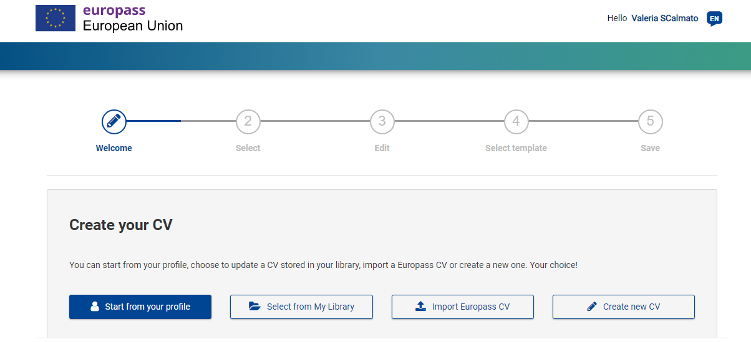
Users can create their own CV without starting from scratch every time. Based on their profile, they can create a Europass CV whenever needed, personalizing it. A CV can also be created separately, without creating a profile.
Notes:
Based on their Europass profile users can generate a Europass CV whenever needed. A CV can even be created separately without creating a profile.

Slide 8
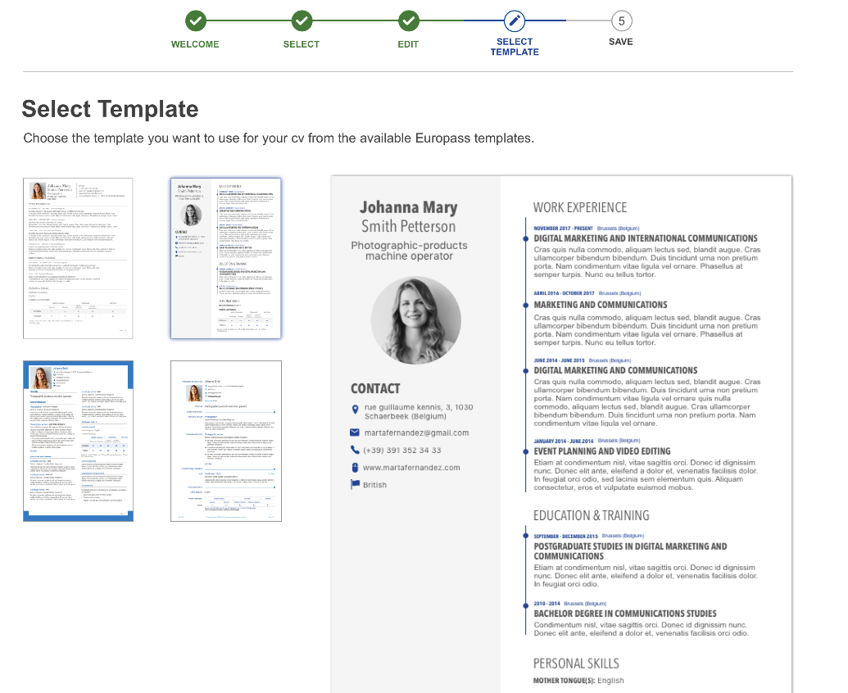
New templates.
Users can select the CV template that best suits their needs.
Other CV templates will be available on the platform in the future
Notes:
The list shown on the slide is not the final list of templates that will be available

Slide 9
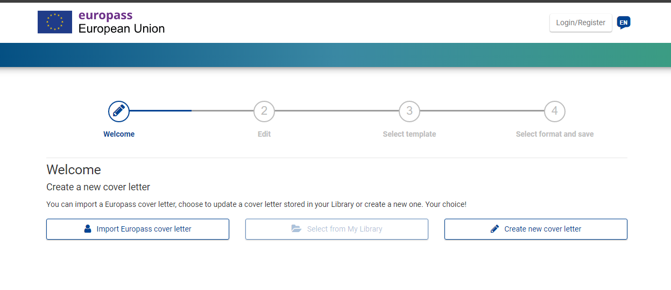
Users can also create cover letters, update old ones, personalize them, save them keeping track.
Notes:
Users can prepare their application documents, including cover letters on the platform.

Slide 10

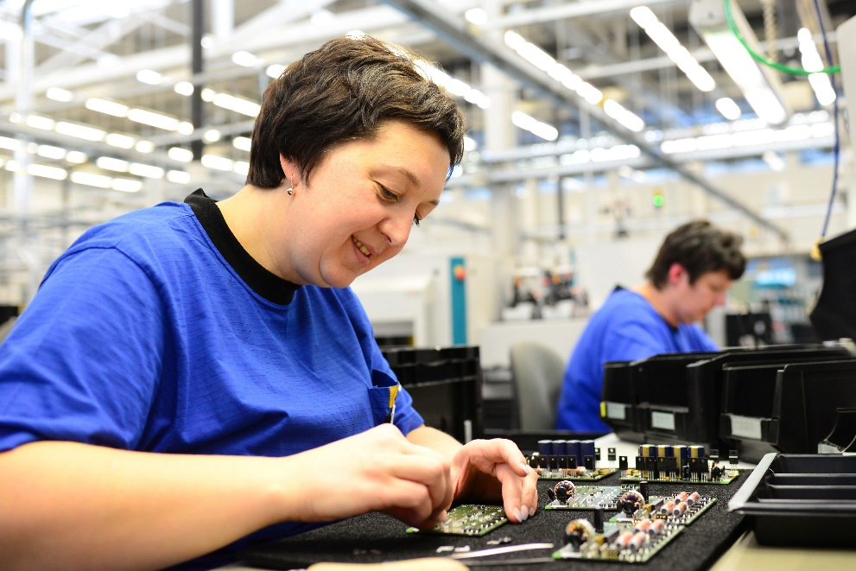

Access all Europass tools and information, through the new European Commission portal, to manage your learning and career in 29 languages ​​of European countries
Easily design CVs and cover letters using the data stored in your Europass profile.
Manage your career with Europass tools, starting with your first job or looking for new opportunities
Create your free Europass profile to manage learning and work in Europe.

Slide 11

To become more familiar with New Europass….
Contact us page (FAQ and queries): https://europa.eu/europass/en/contact-us
EC videotutorial:
https://audiovisual.ec.europa.eu/en/video/I-193054
ANPAL website: https://www.anpal.gov.it/europass
Europass Italy video on ANPAL Youtube:
https://www.youtube.com/watch?v=Uel2DuSprUA&feature=emb_logo
● Europass Italy social media:
fb SkillON_it e twitter SkillON_it

Slide 12
Thanks for your attention!

