Slide 1



Erasmus for Young Entrepreneurs
10-11 November 2020
International Career & Employers’days
Fabrizio Rossetto Eures Adviser

Slide 2


Erasmus for Young Entrepreneurs
What is it?
Erasmus for Young Entrepreneurs is a cross-border exchange programme which gives new entrepreneurs the chance to learn from experienced entrepreneurs running small businesses in other Participating Countries.
It takes place during a stay with the host entrepreneur, which helps the new entrepreneur acquire the skills needed to run a small company.
The duration of the exchange may be from 1 to 6 months with the possibility of dividing the stay into weekly slots (the time span must not exceed a total of 12 months).
The stay abroad is partly financed by the European Commission.

Slide 3
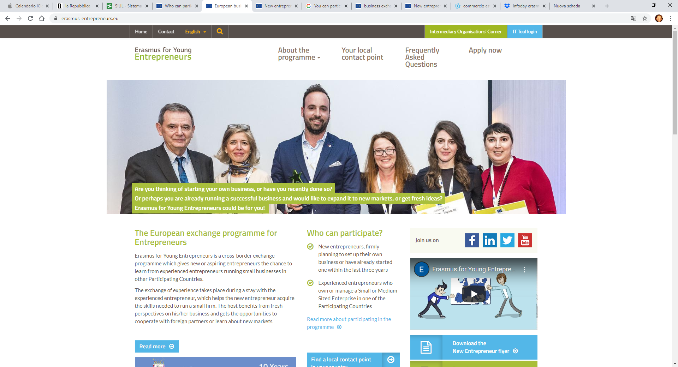
Erasmus for Young Entrepreneurs
Website

Slide 4
Erasmus for Young Entrepreneurs
New Entrepreneur profile
He can participate in the programme if:
He is planning to start a business, based on a concrete business plan;
He has less than 3 years of total experience as entrepreneur.
The (future) company or activity can be in any sector and there is no age limit but all participants must be over 18 years old.
He must also:
Be a permanent resident in one of the Participating Countries;
Have a concrete project or business idea, reflected in a business plan;
Be motivated and committed to collaborate during the stay and to contribute to the development of the host entrepreneur's business
Be ready to complement the programme funds as needed to cover the costs of the stay abroad.
The new entrepreneur can only take part in the programme once.

Slide 5
Erasmus for Young Entrepreneurs
New Entrepreneur benefit
Stay up to six months with a host entrepreneur with experience in another European country to gain relevant business start-up knowledge in areas like marketing, financial accounting, customer relations, business finance
Refine and improve his business ideas/plan
Knowledge about foreign markets
Collaborate and develop cross-border business co-operation
Improve language skills
Receive practical and financial assistance, logistical and local support during the stay, and a grant covering the travel and other costs during the stay abroad.

Slide 6
Erasmus for Young Entrepreneurs
Responsibilities and activities for new entrepreneur
Responsibilities
Draft and sign a "Commitment to Quality” about working relationship between him/her and host entrepreneur. It will also set out the objectives of the stay and a proposed plan of activities during the stay
Sign an agreement with a local contact point for the payment of the grant for the stay, specifying the tasks, responsibilities, financial conditions and legal implications of the project within the agreed timetable
Submit a feedback questionnaire after his/her stay abroad
Activities
Shadow and work with an experienced host entrepreneur;
Conduct market research and develop new business opportunities;
Understand business finance;
Discover the branding, sales and marketing strategies of the host entrepreneur's company.

Slide 7
Erasmus for Young Entrepreneurs
Host entrepreneur profile
He/she can participate in the programme if:
is a permanent resident in one of the Participating Countries and his/her company is registered in that country
is the owner-manager of a small or medium enterprise (he/she can’t be an employee)
has been running a company as an entrepreneur for more than 3 years
is willing to share his knowledge and experience with a new entrepreneur and act as a mentor.
The programme does not foresee any European funding for host entrepreneurs.
He/she can partecipate in the programme more than once

Slide 8
Erasmus for Young Entrepreneurs
Host entrepreneur benefits and responsibilities
Benefits
Work with a motivated new entrepreneur who could contribute with innovative views, new skills and knowledge to the his/her business;
Learn about foreign markets, expand business opportunities and engage in cross-border activities;
Improve the growth potential of the company by establishing a business partnership with a new entrepreneur from another European country;
Increase the visibility and prestige of your business (e.g. via interviews with the media);
Tasks and responsibilities
He/she must ensure the high quality of the learning experience.
He/she is asked to sign an online "Commitment to Quality” document,
He/she must fill in an online feedback questionnaire after the exchange.

Slide 9
Erasmus for Young Entrepreneurs
Local contact points: what are they?
They are selected by the European Commission and they will guide both new and host entrepreneurs throughout the exchange.
They help the new entrepreneur with the application form in the website, the search of suitable host entrepreneur, the creation of a successful relationship and the definition of the financial support
In the website it is possible to find a local contact point active in a specific region or in the country of residence; but it is also possible to register with a local contact point located in another European country if they aren’t available.
A local contact point can also organize an induction course to prepare the new entrepreneur for the exchange (but it’s not mandatory)
A host entrepreneur's local contact point will also offer local assistance to visiting new entrepreneurs during their stay.

Slide 10
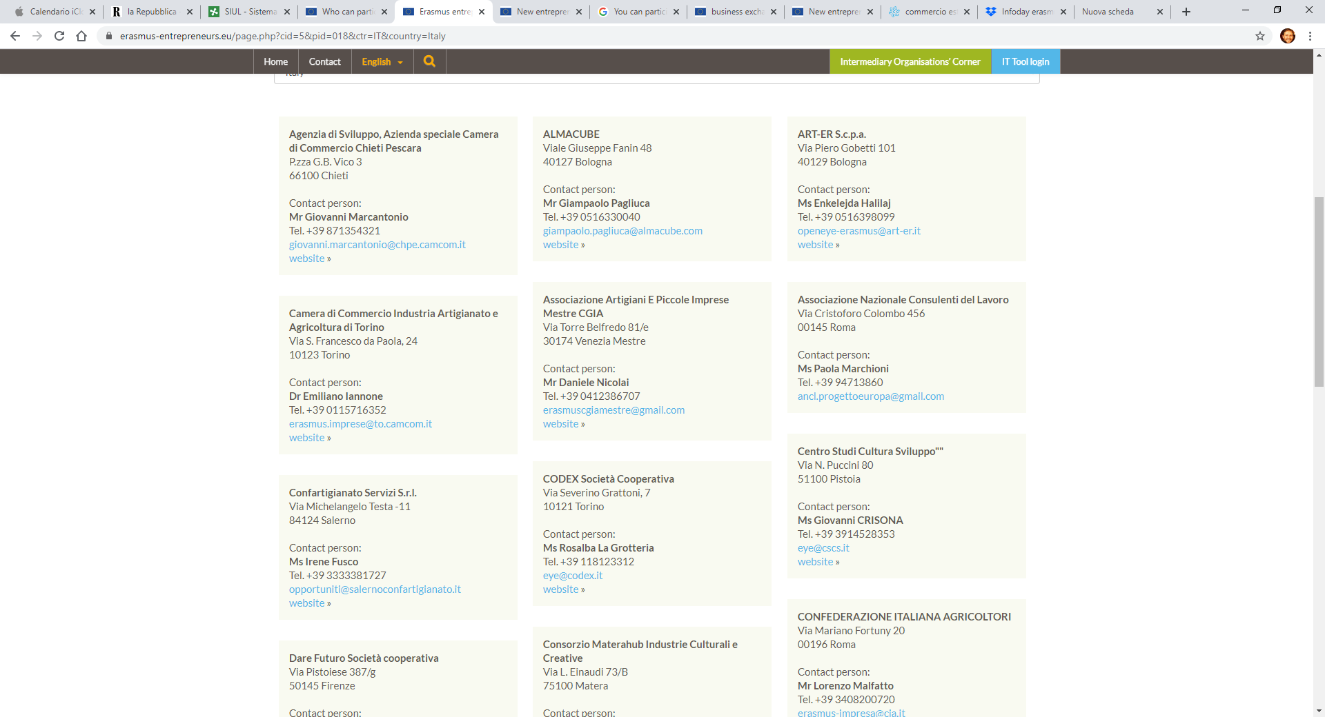
Erasmus for Young Entrepreneurs
Italian local contact points: an example

Slide 11
Erasmus for Young Entrepreneurs
Which countries can participate?
The programme is accessible to new and host entrepreneurs who have their permanent residence in the 27 European Member States, but also in countries like Albania, Armenia, Bosnia-Herzegovina, Montenegro, Serbia, Iceland, Turkey, and Kosovo.
It is important to note that participation in the programme is not based on nationality but on fulfilling the programme's eligibility criteria.
Be aware that these criteria must be complied with for the entire duration of the grant.
If the United Kingdom withdraws from the EU during the grant period without concluding an agreement with the EU, any new entrepreneur coming from the UK, or entrepreneur on an exchange with a UK-based host entrepreneur, will cease to receive EU funding and will be required to leave the project.

Slide 12
Erasmus for Young Entrepreneurs
Financial support
The financial support to new entrepreneurs contributes to travel and other costs during the visit.
The grant is paid by the local contact point chosen by the new entrepreneur.
The new entrepreneur and the local contact point sign an agreement which determines the funding granted during his/her stay, and how it will be paid in practice.
The financial support is calculated monthly, is based on the monthly lump sum for the relevant country and is provided only for the time spent abroad collaborating with the host.

Slide 13
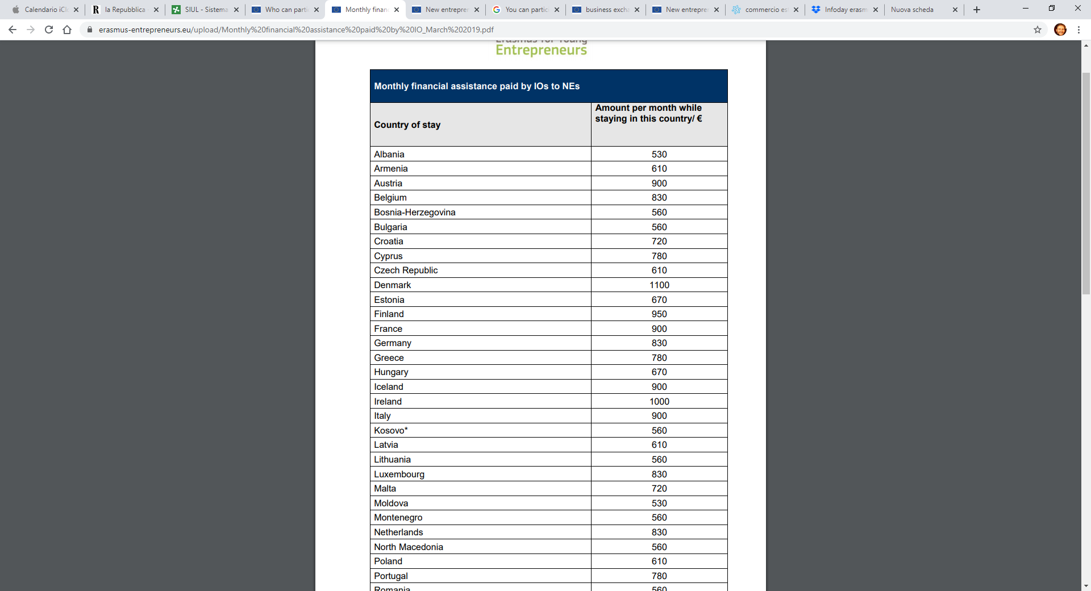

Slide 14
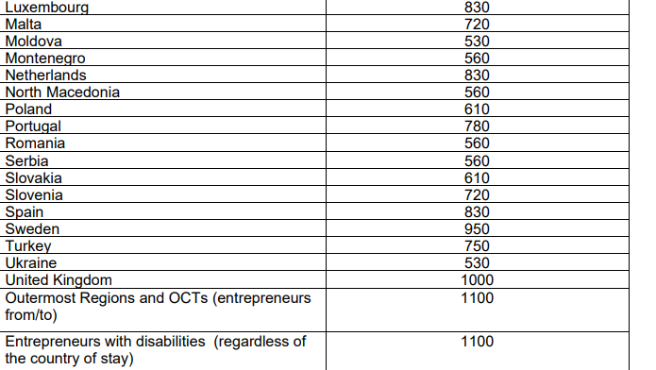

Slide 15
Erasmus for Young Entrepreneurs
How to participate
Step-by-step
Once you have found a local contact point you have to:
1. Prepare application documents: CV, motivation and, for the new entrepreneurs, a business plan;
2. Register via the online form and submit CV and business plan;
3. Once accepted, build a relationship with a host entrepreneur abroad.
Two options:
a) You suggest to your local contact point a host entrepreneur with whom you are already in contact , or
b) You look for a host entrepreneur in the online catalogue with the help of the local contact point.
4. Reach an agreement with the host entrepreneur about the work and learning project (i.e. about the dates, objectives and activity plan of the exchange)
It is important to keep in mind that the programme does not support internships or work placements- only collaborations between to the individual entrepreneurs.
5. Start of the stay abroad: the duration of the exchange, financial support, how many payments according to the agreement signed with the local contact point, etc.

Slide 16
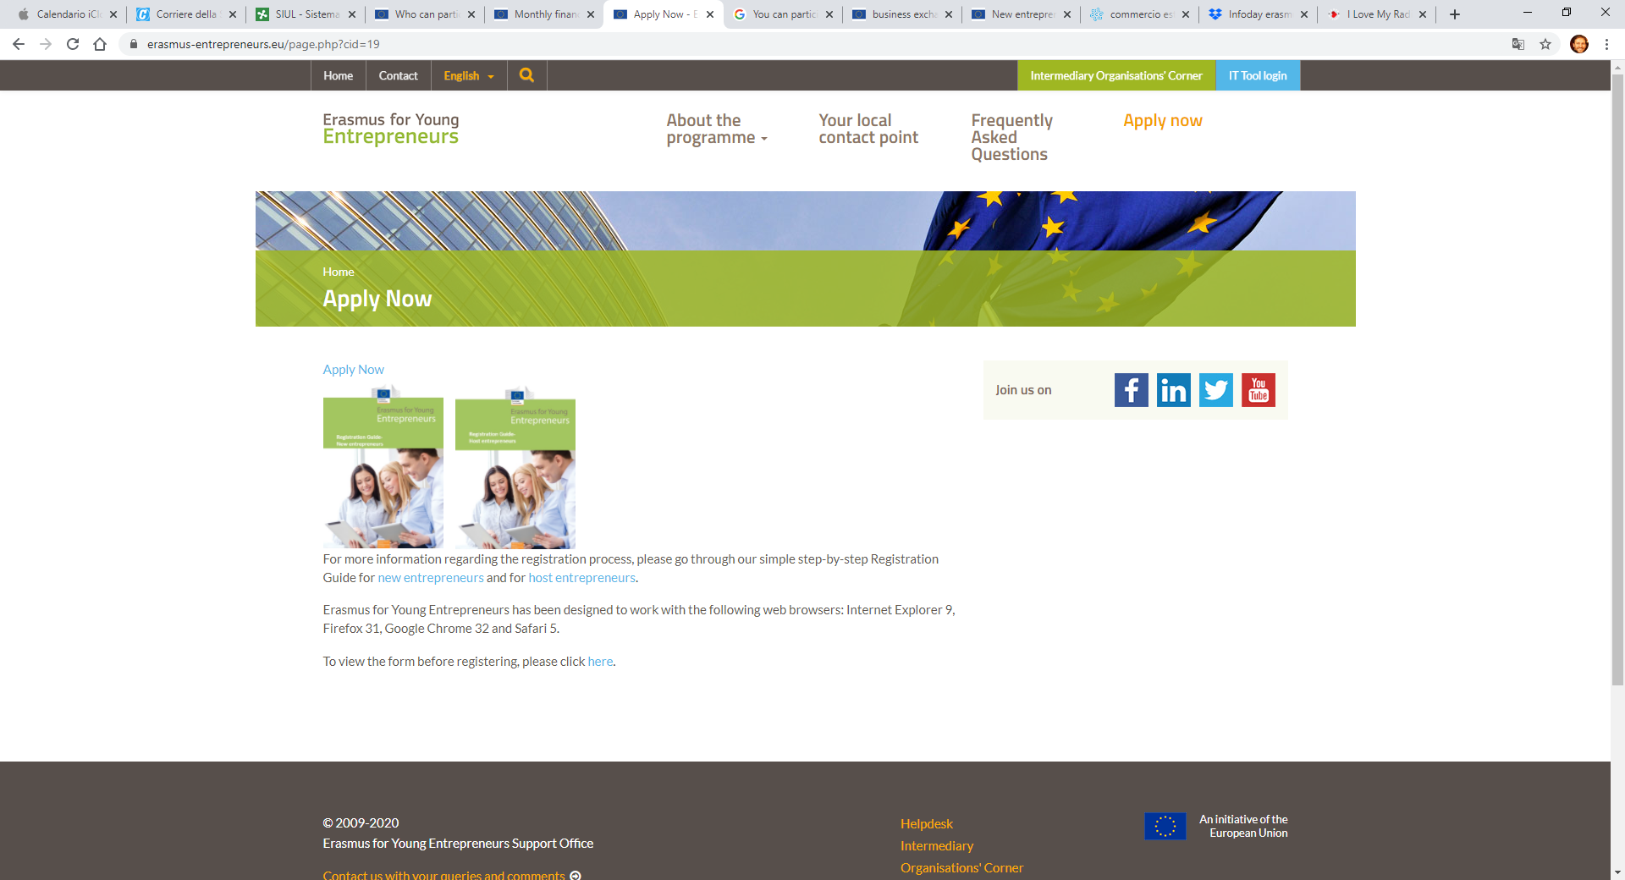
Erasmus for Young Entrepreneurs
Online application form

Slide 17
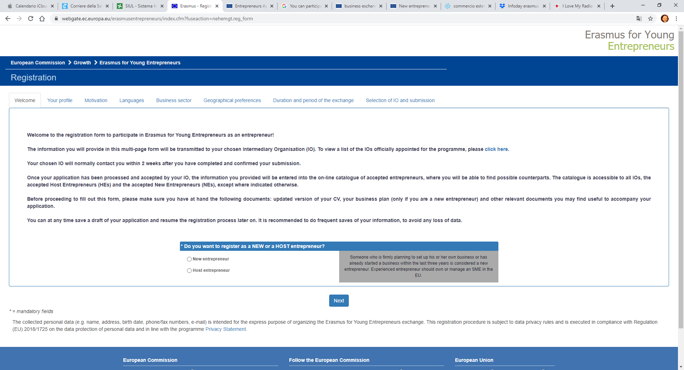

Slide 18
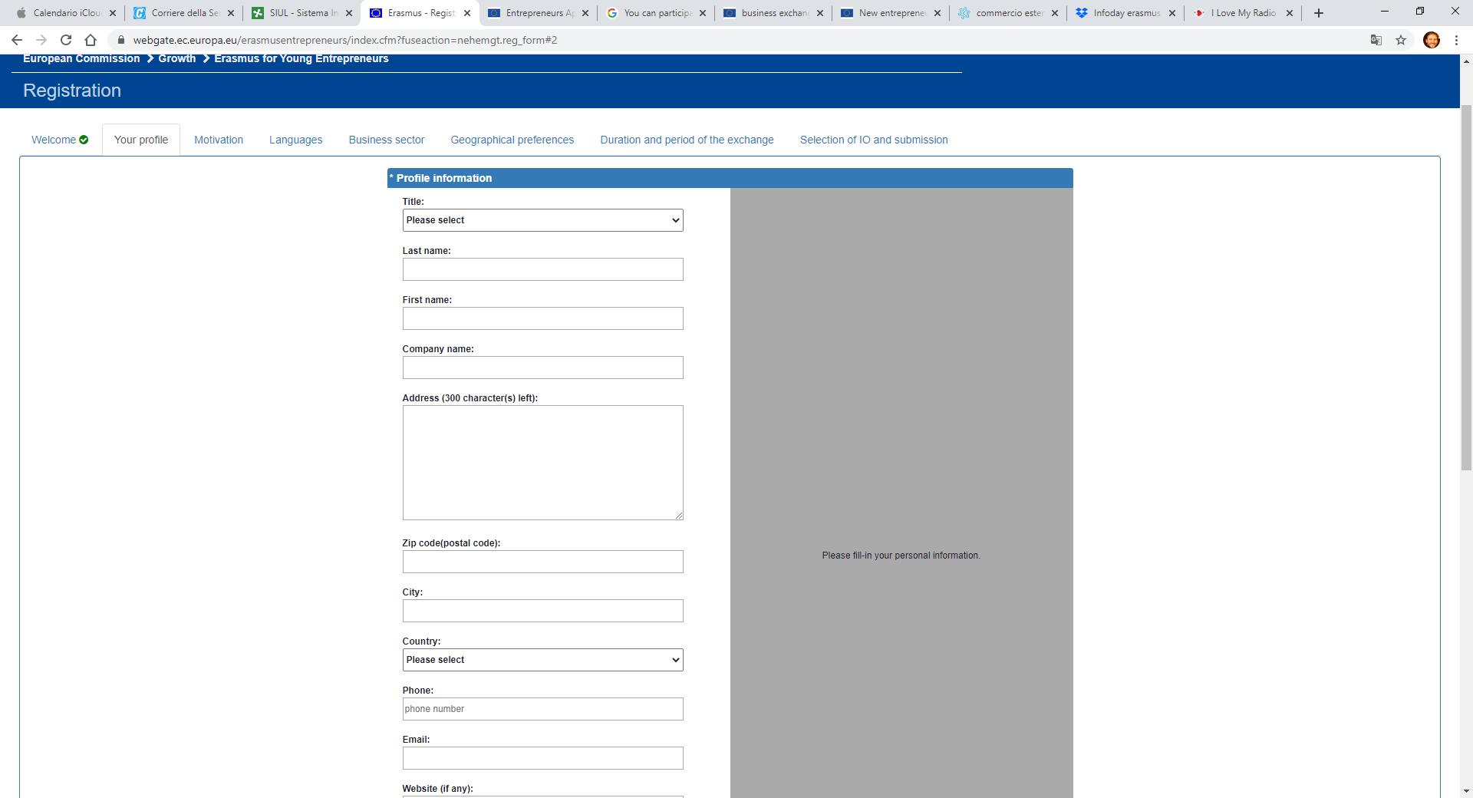

Slide 19
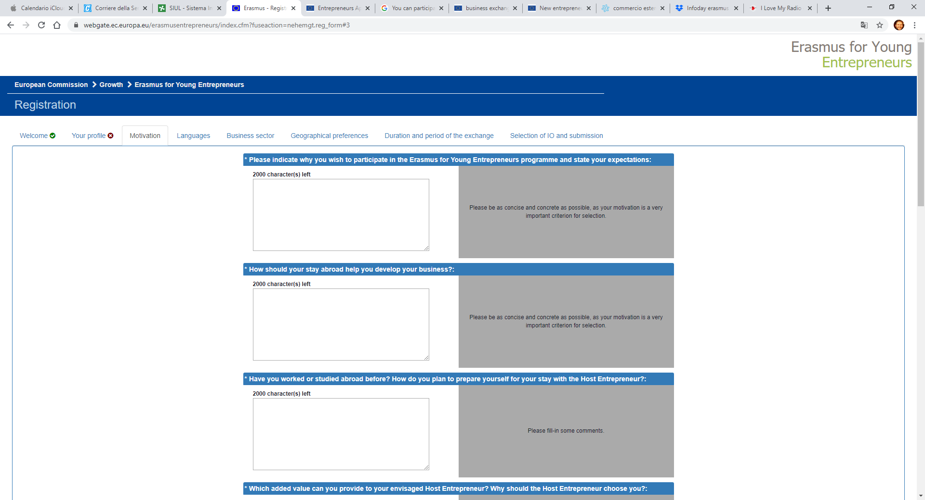

Slide 20
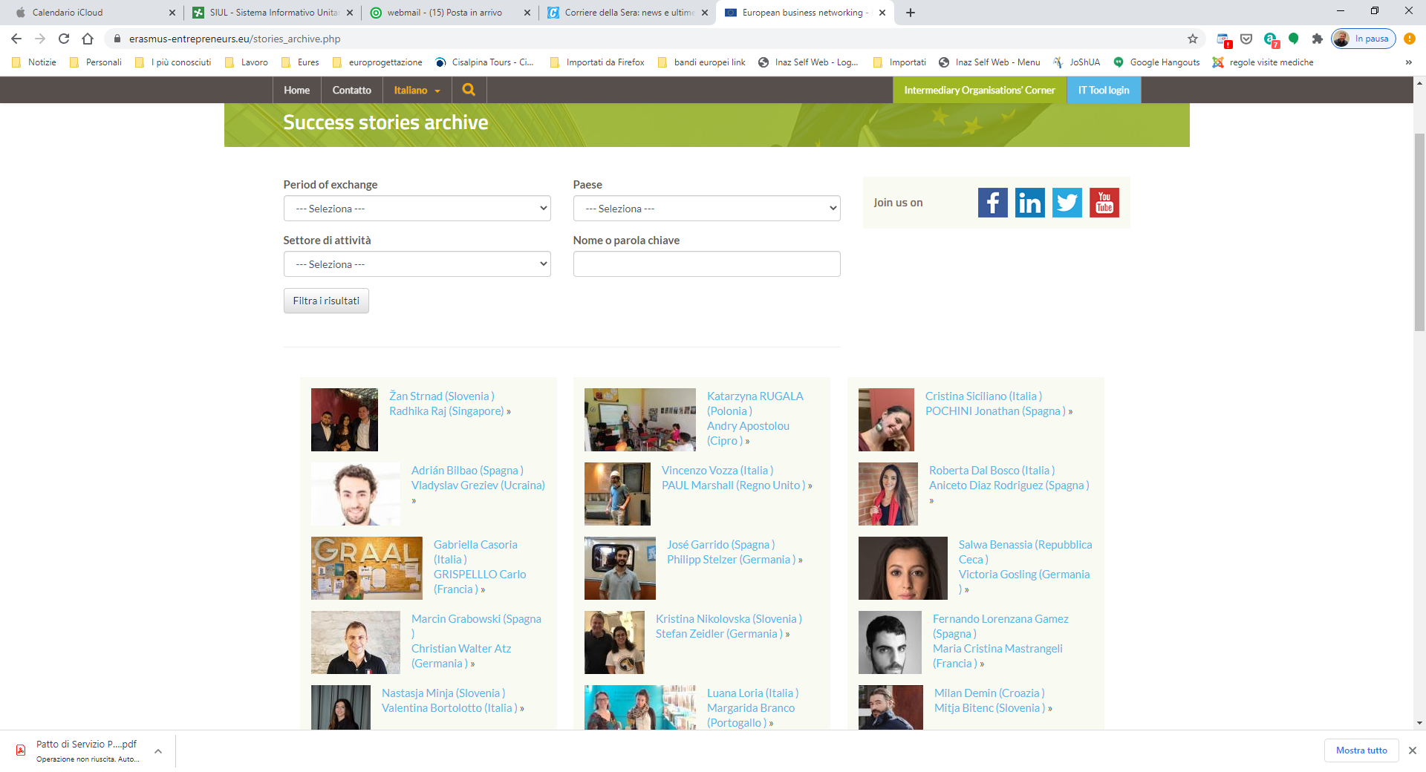

Slide 21
Thank you for your attention!

