Slide 1
EURADRIA 2020/2021
EURADRIA INFO-DESK NETWORK:
SUPPORT FOR EMPLOYERS IN THE ITALIAN SLOVENIAN BORDER REGION
Euradria 20/21
2 December 2021
EOJD EURES ITALY EMPLOYERS DAY

Slide 2

EURADRIA 20/21
THE RATIONALE:
Support entrepreneurs operating
(or willing to operate) across the border
Located in the Italian - Slovenian border
region by 3 Associations of Employers
Trieste, Friuli Venezia Giulia in Italy (NUTS 2 ITD4) (partner SDGZ-URES)
Nova Gorica, Goriška statistical region (NUTS 3 SI023) (partner OOZ Nova Gorica)
Koper, Obalno-kraška statistical region (NUTS 3 SI024) in Slovenia (partner PGZ)
as identified in the Grant Agreement VS/2019/0398,
by NUTS (Nomenclature of territorial units for statistics)

Slide 3

EURADRIA 20/21
SUPPORT PROVIDED:
Information, admin. procedures, counseling
Typical user of the Info desk:
SME or self-employed (sp, lavoratore autonomo)
Comes to Info Desk after securing a deal across the border and need to understand the ins and outs
Or needs to solve already occurred problem (fines, inspections)
Sometimes just curios about practical implications of moving the business entirely (taxation, space)

Slide 4
EURADRIA 20/21
WHY ARE INFO DESK NECESSARY?
Typical obstacles to cross-border business
Small business lack the structure that would allow them to deal with all bureaucratic procedures
Available information (online) is not detailed, not up to date, or unreliable
Language barriers still constitute a major problem when dealing with specific topics (labour, tax, etc.)
Fast changing rules and regulations
Some prefer personal interaction rather than using available online material

Slide 5
EURADRIA 20/21
SOME EXAMPLES OF ISSUES FACED BY CB COMPANIES
Typical issues addressed by Info Desks
Taxation and social security
Posting of non EU workers employed by SI or IT company
Recognition of professional qualifications of individuals
Recognition of company’s qualification needed to operate in regulated sectors (i.e. thermal hydraulics)
Labor issues and contracts

Slide 6
EURADRIA 20/21
THE ONE STOP SHOP PORTAL
https://euradria.eu/
Developed by EURADRIA, it aims at:
Acting as a HUB for specific requests, which are redicted to Info Desk according to needed expertise
Providing detailed information for CB workers and entrepreneurs for obtaining benefits (unemployment, maternity leave, compensations etc.)
Recruitment services (matching of demand and offer) and support for posting vacancies
Any other useful information

Slide 7
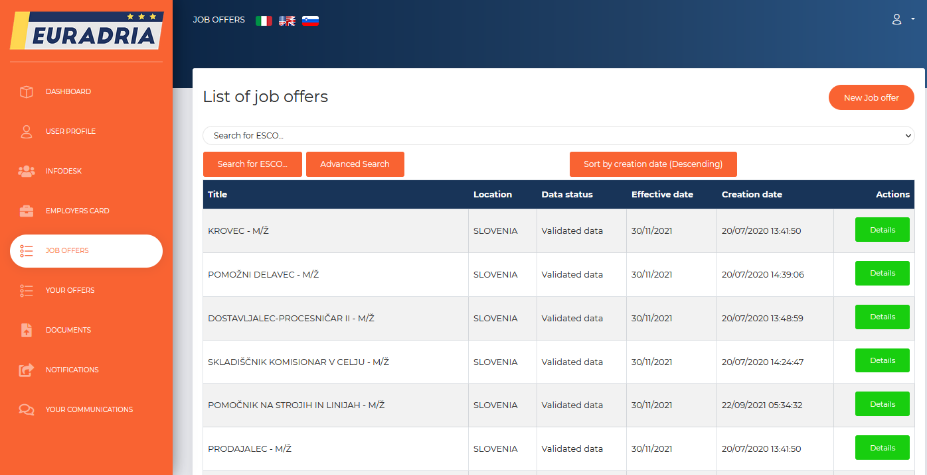
EURADRIA 20/21
THE ONE STOP SHOP PORTAL
https://euradria.eu/

Slide 8
EURADRIA 20/21
Thanks for your attention!
MATTEO FERUGLIO
SDGZ - URES
+39 040 67248 23
matteo.feruglio@servis.it
Euradria 20/21
Trieste, 8 April 2019
Partner meeting

