Slide 1


Returning to Ireland
Practical Information and an overview of the Irish immigration process for non-EU Spouses and Partners of Irish citizens.

Slide 2

AGENDA
TITLE
1
2
3
4
5
6
About Us
Immigration Process
Visas and Preclearance
Arrival in Ireland
Practical Tips
Q & A Session
Learn about Crosscare Irish Diaspora Support Project's services for Irish citizens returning to Ireland.
Overview of the Republic of Ireland’s immigration process for partners and spouses of Irish citizens.
What your de-facto partner or visa-required spouse need to know and prepare prior to moving to Ireland.
Navigating border control upon entry to the Republic of Ireland, and how to register for residency permission after arrival.
Tips, resources and sources of information for prospective returnees.
Please ask any questions using the Q&A button at the bottom of your screen.
FÁILTE BACK: RETURNING TO IRELAND

Slide 3
CROSSCARE IRISH DIASPORA SUPPORT PROJECT
TITLE
We provide specialised information and advocacy supports to Irish citizens moving abroad and those returning to Ireland, particularly people in vulnerable situations. Our areas of expertise include:
  Access to Irish statutory services – social welfare, healthcare, housing/homeless supports
  Navigating the Irish immigration system with non-Irish partners and family, working closely with Crosscare Migrant Project
  Linking with Irish emigrant and other supports in Ireland and abroad
We are a Dublin based non-profit organisation funded by the Government of Ireland's Emigrant Support Programme.
See diasporasupport.ie for more on returning to Ireland and to contact us.
FÁILTE BACK: RETURNING TO IRELAND

Slide 4


IMMIGRATION PROCESS
TITLE
Two Key Questions
What is the nature of the relationship (spouse vs. de facto partner)?
The immigration process in Ireland for significant others of Irish citizens varies based off of the nature of the relationship and their nationality.
Visa vs. non-visa required?
FÁILTE BACK: RETURNING TO IRELAND

Slide 5
SPOUSE VS. DE FACTO PARTNER
Spouse:
Legal commitment (marriage, registered with a civil authority)
De Facto Partner:
  Mutual commitment to shared life to exclusion of all others, similar to marriage (though not in law)
  Genuine and continuing relationship
  Two years cohabitation (minimum)
  Not related by family
FÁILTE BACK: RETURNING TO IRELAND

Slide 6
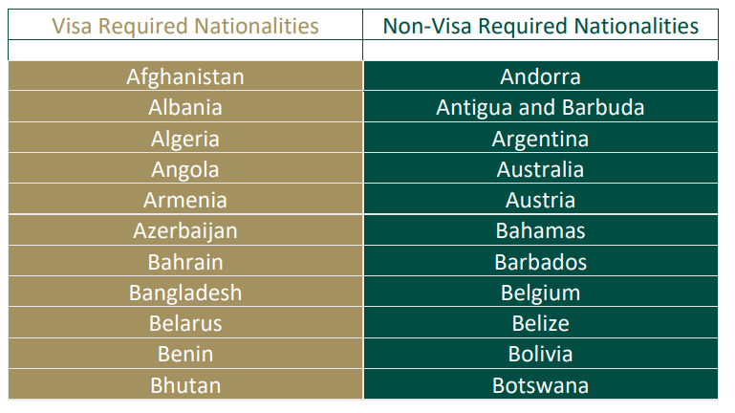
VISA VS. NON VISA REQUIRED
TITLE
Always refer to irishimmigration.ie (official Department of Justice site) for a list of nationalities that are visa required for travel to Ireland.
NOTE: Visa requirements are based on applicant nationality - not necessarily country of residence.
Visa vs. non-visa required?
FÁILTE BACK: RETURNING TO IRELAND

Slide 7



OVERVIEW OF REQUIREMENTS
TITLE
VISA?
PRECLEARANCE?
PROOF OF RELATIONSHIP
PROOF OF FINANCES
REGISTER FOR RESIDENCY
Spouse, visa required
Spouse, non-visa required
De facto partner, visa required
Visa vs. non-visa required?
De facto partner, non-visa required
FÁILTE BACK: RETURNING TO IRELAND

Slide 8
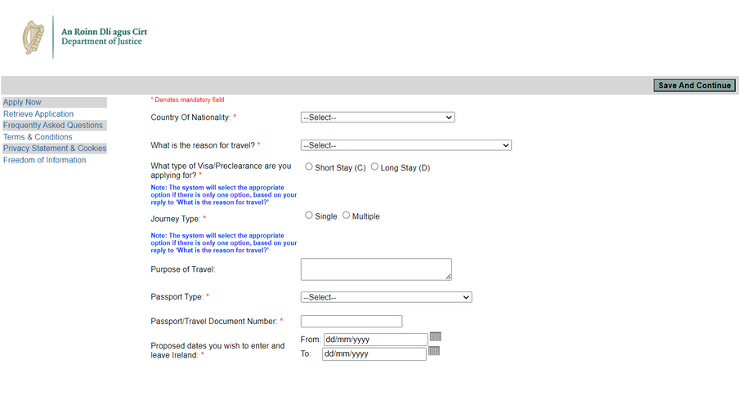
VISA & PRECLEARANCE APPLICATIONS
TITLE
  Instructions available online at irishimmigration.ie and application via the 'AVATS Online visa system'
    You can save and exit form and return within 30 days to complete
  Visa required spouse: apply for 'D Family Join Visa'
  De facto partners: ALL de facto partners apply for preclearance through the AVATS system
    Non-visa required partners choose the 'Pre-clearance-Join Family-(IrishNat)(de facto partner)' option
    Visa required partners choose the 'Join Family-(IrishNat)(de facto partner)' option
Visa vs. non-visa required?
FÁILTE BACK: RETURNING TO IRELAND

Slide 9
SUPPORTING DOCUMENTATION
TITLE
After submitting an application, a summary application form is generated which contains instructions on how to submit supporting documentation.
  Supporting documentation submission varies by where the applicant applies from: check the local embassy or consular website for instructions and requirements
    Applications are processed by local embassies, visa application centres, or in Dublin depending on applicant's location (not necessarily nationality)
    Contact local embassy or consulate with questions on specific requirements
  Typically, applicants need to submit:
    Passport and Irish passport-sized colour photographs
    Fee (if applicable)
    Proof of finances, proof of relationship, cohabitation (de facto partners), health insurance
      FINANCE: €40,000 income (pre-tax) over past three years (approx. €13,333.33 per year)
Visa vs. non-visa required?
FÁILTE BACK: RETURNING TO IRELAND

Slide 10
PROCESSING TIMES AND APPEALS
TITLE
  Processing times are variable and depend on where the application is being processed
  Factor in plenty of time to apply prior to your desired travel date to Ireland (process can take upwards of 9 months-year)
  Current processing times in Dublin for visas and appeals can be found here or check the local embassy/consulate for information
  If application is refused, applicants have 2 months from the date on the refusal to submit an appeal
Visa vs. non-visa required?
RETURNING TO IRELAND: IMMIGRATION 101
FÁILTE BACK: RETURNING TO IRELAND

Slide 11
ARRIVAL IN IRELAND - AT BORDER CONTROL
TITLE
  Arrive and go through immigration together, if possible - go to the 'Non-EU' queue
    If not travelling together, make sure your partner or spouse has your contact details. Picture of your passport can be helpful!
  Have supporting documentation ready to present
  Non-EU spouse/partner: must state intention to register for residency as spouse/partner. This will generate an 'entry stamp' that will let you then register
Visa vs. non-visa required?
FÁILTE BACK: RETURNING TO IRELAND

Slide 12
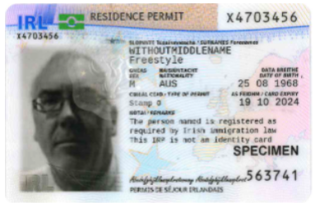
REGISTERING FOR RESIDENCY PERMISSION
TITLE
After arrival, every non-EU/EEA citizen must register for residency permission with immigration within 90 days, or before entry stamp expires (whichever is first).
There are currently delays in getting registration appointments, and this is taking longer than 90 days at present - so if possible, make the appointment before returning. Using their own personal Digital Contact Centre account, they must make an appointment online to register in-person at the Registration Office, 13-14 Burgh Quay, Dublin 2
NOTE: Irish spouse or partner must attend registration with applicant. Docs to bring include passports, proof of address, proof of finances, and marriage cert/preclearance letter.
FÁILTE BACK: RETURNING TO IRELAND

Slide 13
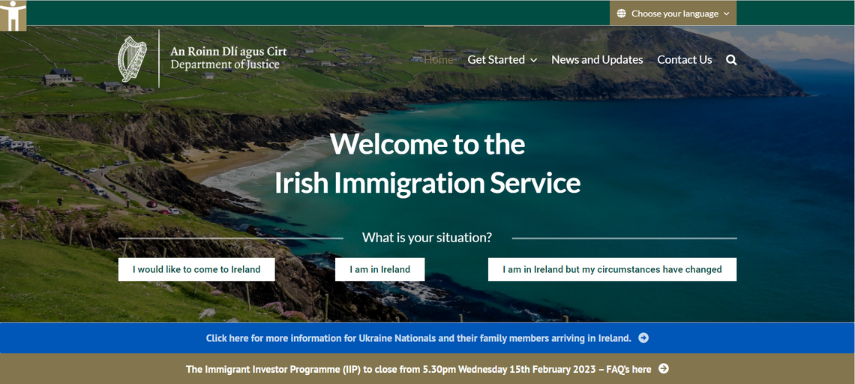
REMEMBER...
TITLE
  The applicant is the non-Irish citizen
  The Irish citizen plays a supporting role for spouse or de facto partner
  Always check irishimmigration.ie and local embassy/consulate sites for the latest official information
Visa vs. non-visa required?
FÁILTE BACK: RETURNING TO IRELAND

Slide 14
PRACTICAL TIPS
TITLE
  Weigh up the pros and cons - make the right decision for you
  Think of return as re-emigration, and plan accordingly (finances, accommodation, employment, documentation, etc.)
  Do your research before you return using reliable sources of information - download our essential document checklist
  Have a realistic timeline and know it may take longer depending on your own personal situation
  Ireland may have changed since you left so get to know the country a new
  Prepare emotionally and give yourself time to adjust to the emotional impact
  Take time to rebuild your social and professional networks
  If returning with children, involve them in the move and consider the impact on their education and social network
  Mind yourself and reach out for support if you need it
FÁILTE BACK: RETURNING TO IRELAND

Slide 15
HELPFUL RESOURCES
TITLE
IMMIGRATION RELATED
INFORMATION / SUPPORT
OTHER
  irishimmigration.ie
  Visa vs. non-visa required
  Online application FAQ
  Visa processing times
  Digital contact centre
  Returning to Ireland portal at citizensinformation.ie
  Crosscare Irish Diaspora Support Project at diasporasupport.ie
  Safe Home Ireland at safehomeireland.com
  Irish Expats Returning to Ireland Facebook Group
  Irish Times Abroad
  Abhaile Returning to Ireland conference at diasporasupport.ie/abhaile-2024-recap/
FÁILTE BACK: RETURNING TO IRELAND

Slide 16









CONTACT US
TITLE
Website
Find us online:
diasporasupport.ie
Email
irishdiasporasupport@crosscare.ie
Office
2 St. Mary’s Pl N, Dublin 7
FÁILTE BACK: RETURNING TO IRELAND

