Slide 1
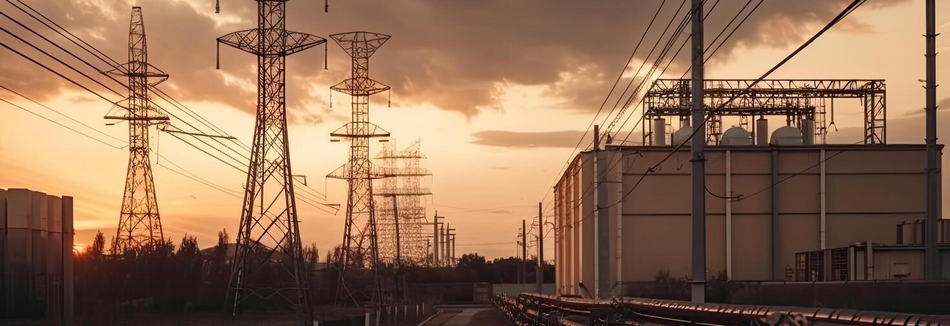

Current Career Opportunities at Reach Active
Specialists in Power, Construction, Multi-Utility Diversions, Telecoms, Rail & Building Management Services

Slide 2
About Reach Active
Reach Active is a dynamic, high-growth contractor specialising in power, construction, and multi-utility diversions across the UK and Ireland.
We deliver full-turnkey solutions across:
Power & Utilities - including high-voltage substations and electrical installations
Our strength lies in technical expertise, agility, and deep sector knowledge. We are proud of our ability to deliver complex projects on time and to a high standard, collaborating closely with clients, consultants, and subcontractors
At Reach Active, we prioritise:
Safety - in every aspect of our work
Quality - delivering to the highest standards
Innovation - constantly finding smarter ways to build
Collaboration - working together to solve challenges
Sustainability - building infrastructure for a low-carbon future
We are constantly looking for talented, motivated people with technical skill and ambition to join us and help shape the future of infrastructure delivery.

Slide 3
Substations
Cable Jointer
Substation Technician
Electrical Engineering NVQ/Diploma.
More than 2 years experienced in the power industry on HV, MV and LV live Substations (minimum 33Kv).
Knowledge of hazards involved with working on and around energized electrical systems (lines and equipment/high and low voltage).
Proven experience within a similar role on major projects.
Ability to perform strenuous work in all types of weather conditions.
Full valid Irish/EU driving license
Qualified Electrician.
Strong practical experience in MV/HV cable jointing, termination, and testing.
Good understanding of substation operations and electrical safety standards.
Ability to interpret technical drawings .
Candidates should hold certifications in Pfisterer CONNEX, Nexans, and Raychem termination types, or similar, and have proven experience.
Cable jointing and testing experience up to 52 kV.
Hands-on experience with diverse termination systems and a solid background in electrical and substation environments.

Slide 4
Overhead Lines
Patroller
Overhead Lines Worker
Experience surveying OHL routes and carrying out visual inspections.
Able to identify defects and record accurate data to ESB standards.
Confident with mapping, documentation, and handheld data tools.
Comfortable working outdoors in all conditions and navigating terrain.
Strong customer interaction skills with landowners and the public.
Good organisation, attention to detail, and ability to work independently.
Full valid Irish/EU driving license (must-have)
Basic computer skills.
Experienced working on LV/MV OHL networks (38KV up to 220KV)
Skilled in climbing and working at height on poles and towers
Able to follow work instructions and operate within safety, ESB, and company standards
Competent in replacing/erecting equipment, splicing/terminating conductors, and fitting/removing earths
Capable of voltage testing, polarity checks, and basic quality control
Must provide training records and authorisations
Full valid Irish/EU driving license

Slide 5
Overhead Lines
Project Manager Overhead Lines
Proven experience delivering OHL projects (LV–400kV)
Strong understanding of OHL construction, design, and electrical equipment
Solid background in safety management and ESB/industry standards
Ability to manage project scope, budgets, risks, and timelines
Skilled in leading project teams and coordinating contractors
Confident communicating with clients, stakeholders, and site teams
Competent in site inspections, progress monitoring, and safety audits
Strong IT, reporting, and documentation skills
Full Irish/EU driving license
Desirable: Experience with ESB OHL networks

Slide 6
Civils
On site Project Manager
Site Engineer
Experienced in civils, utilities, trenching, ducting, and cable works
Proven track record managing projects up to €10M
Strong leadership, communication, and client-facing skills
Ensures full H&S compliance and maintains project standards
Commercially aware with solid cost and subcontract understanding
Full valid Irish/EU driving license
Experience in the power industry
Educated in Project Management or Civil Engineering
Civil Engineering–related qualification
Experienced in setting out using Trimble GPS or similar
Able to record accurate as-laid data and produce as-laid drawings
Monitors material and workmanship quality on site
Carries out daily checks, measurements, and updates using company apps
Ensures full compliance with Health & Safety standards
Strong IT skills, including Microsoft packages
Full Irish/EU driving license (must-have)
Utilities sector experience, AutoCAD skills, Total Station use, knowledge of roadworks & MapRoad system, civil engineering qualification.

Slide 7
Civils
Road Opening License Coordinator
Excavator Driver
Strong experience with Maproad Licensing & Public Roads Guidelines
Skilled in preparing, submitting, and managing Road Opening Licences
Able to review & coordinate Traffic Management Plans
Excellent client/stakeholder communication
Highly organised with ability to manage multiple projects
Proficient with IT systems & Excel
Desired RMO Advanced, SLG/CSCS, mapping systems, COINS, utility industry experience
Valid C Licence and Digital Tachograph Card
CPC certified with strong knowledge of driving/working time rules
Experienced in lorry-mounted crane & grab operation
Safe, competent driver in urban/city environments
Ability to complete vehicle checks and site risk assessments
Strong teamwork and communication skills
Preferred Safe Pass, Manual Handling, CE Licence, 360 Excavator experience

Slide 8
Plant, Transport and Procurement
Logistics Support Operative
Experience in industrial/construction or depot environments
Skilled in handling stock, materials, plant, and equipment
Strong accuracy in record-keeping and paperwork control
Confident with Microsoft Office
Able to maintain a safe, tidy, organised depot/work area
Supports deliveries, collections, and asset tracking
Full clean Irish/ EU driving license
Desired C/C1E licence, Safe Pass, CSCS

Slide 9
Why Choose Reach Active
Strong career progression, real opportunities to grow, and upskill.
Diverse engineering projects across power, utilities, substations, overhead lines & underground networks.
Industry-leading training & development, including mentorship and certification support.
Safety-first culture with a commitment to zero harm.
Supportive, collaborative teams built on respect, integrity, and excellence.
Stable, expanding business operating across Ireland & the UK with long-term project pipelines.

Slide 10
Your Next Opportunity
Contact information: recruitment@reachactive.com
Company website: Reachactive.com
LinkedIn: Reach Active Limited
Apply today to join exciting projects across Ireland

