Slide 1



Supporting EURES Fáilte Back
Remote Work In Ireland
25th November 2025, Virtual Event

Slide 2
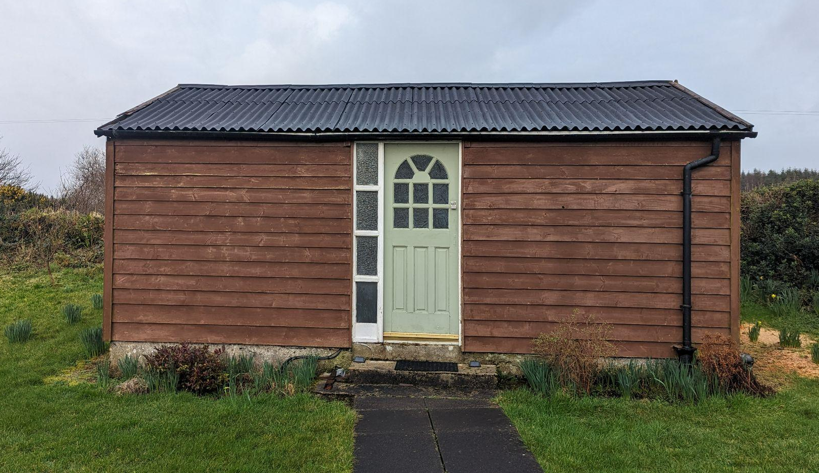

THE NEXT 25 MINS..
WORK IS NOT A PLACE, IT IS SOMETHING YOU DO!
1) Hello from Grow Remote 👋
2) State of Remote Work in I 3) Remote Employers in IE 💚 4) Finding Remote Jobs 5) Career Resources 📈

Slide 3
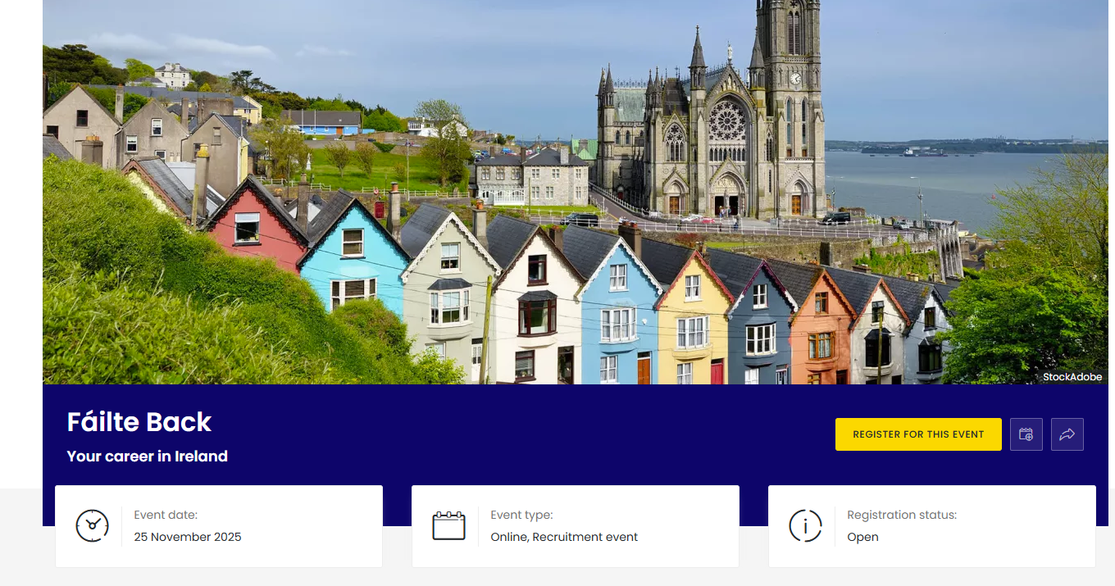
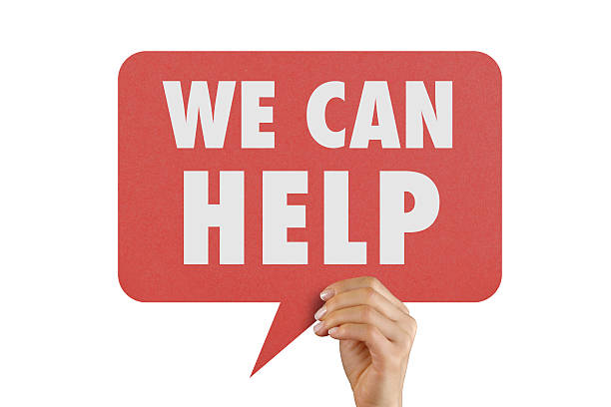
There has never been a better time to Fáilte Back
REMOTE WORK is an enabler..

Slide 4




The Work We Do At Grow Remote
Employer Services
We empower employers and individuals to transition and thrive remotely
Community
We build networks of remote workers for connection & help individuals land remote jobs locally
Policy & Advocacy
We contribute to and support national policy related to remote work in Ireland
Our mission is to solve the challenges of remote work in order to unlock social, economic and environmental change for individuals, employers and local communities

Slide 5
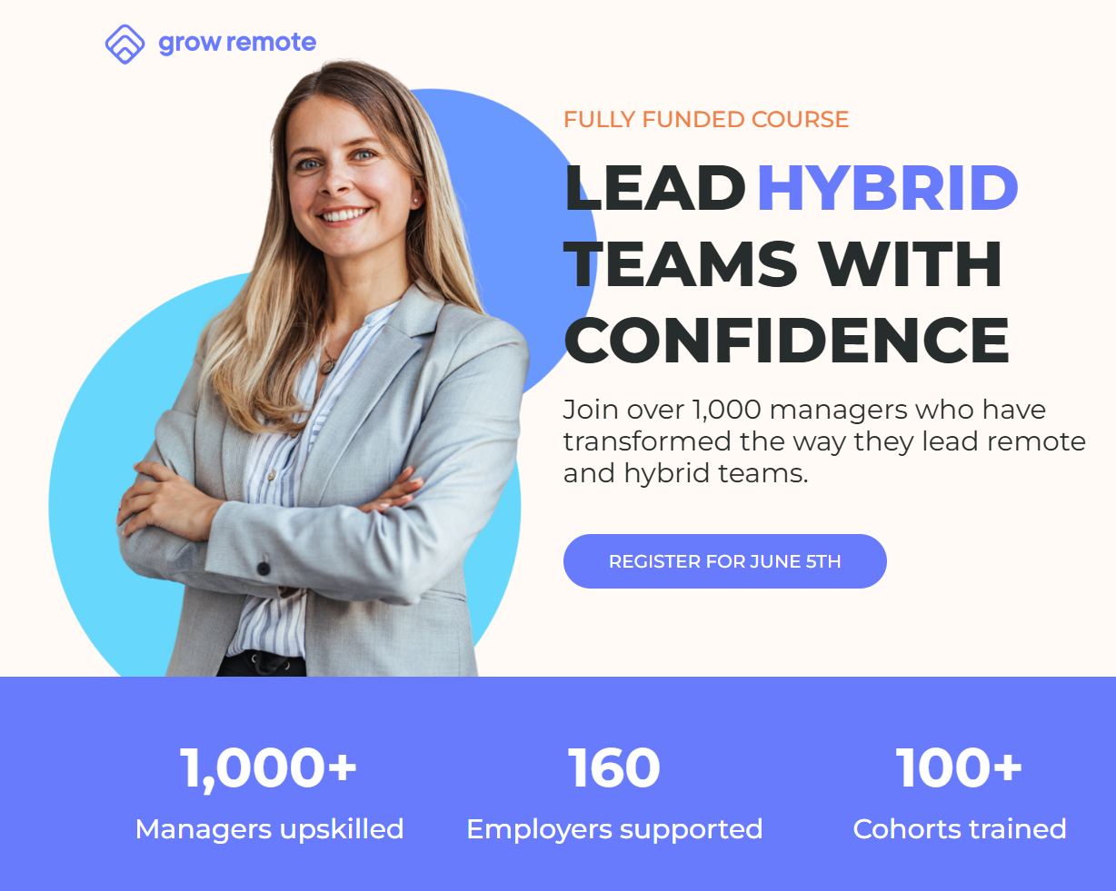
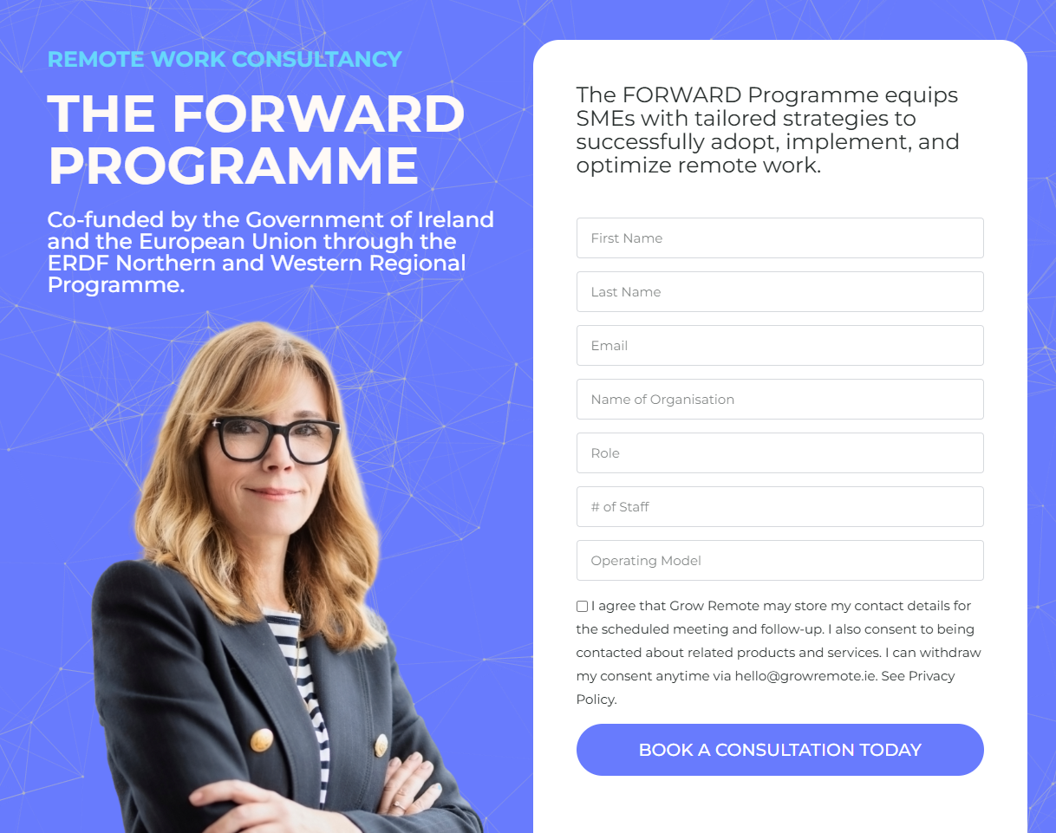


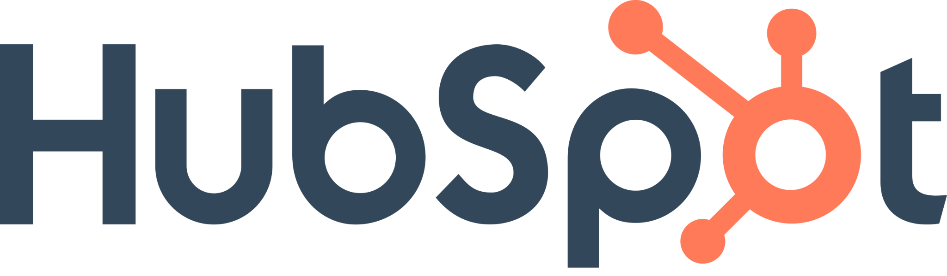

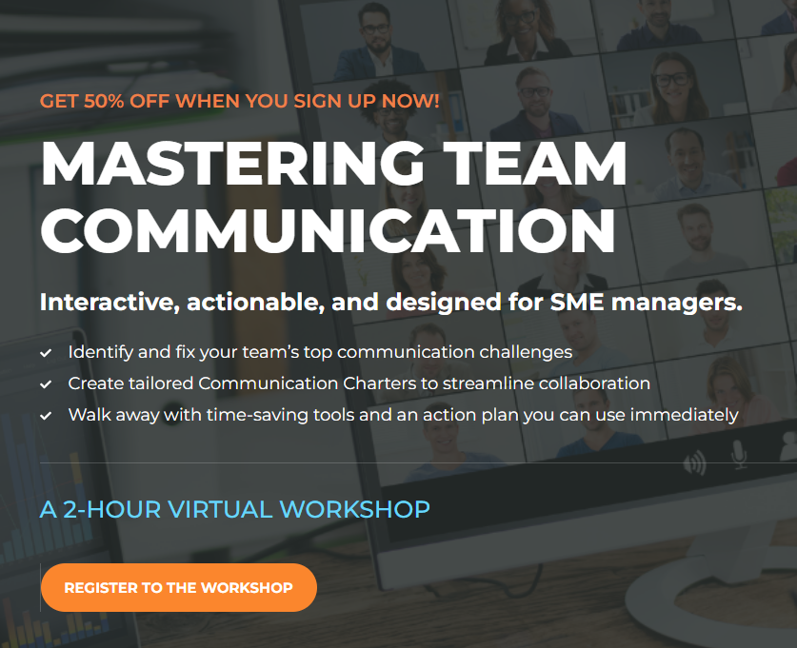

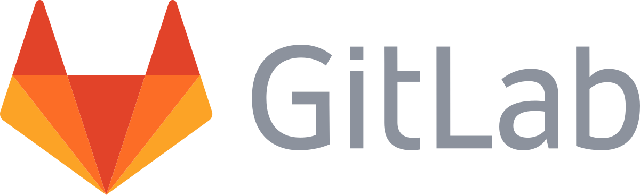
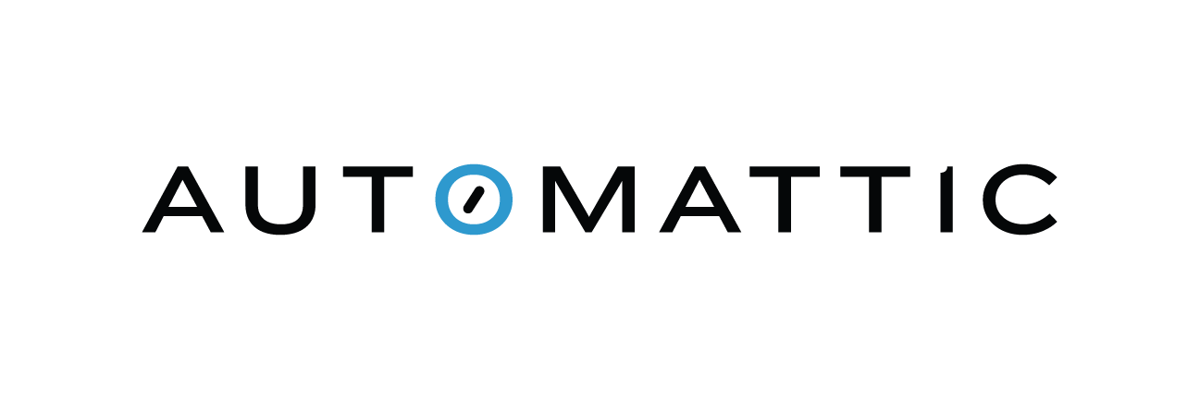
Grow Remote - Employer Services

Slide 6
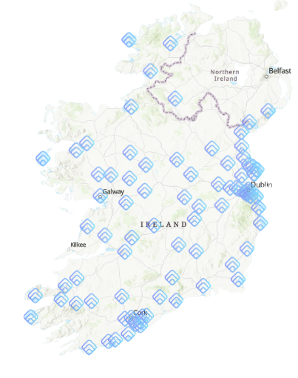
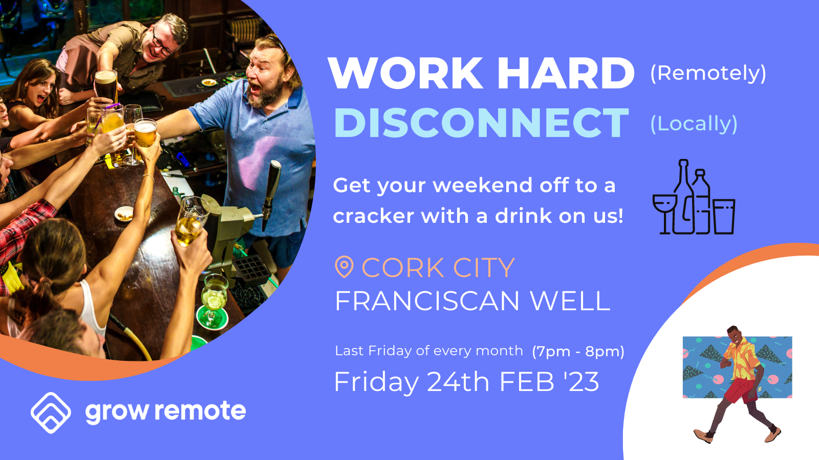
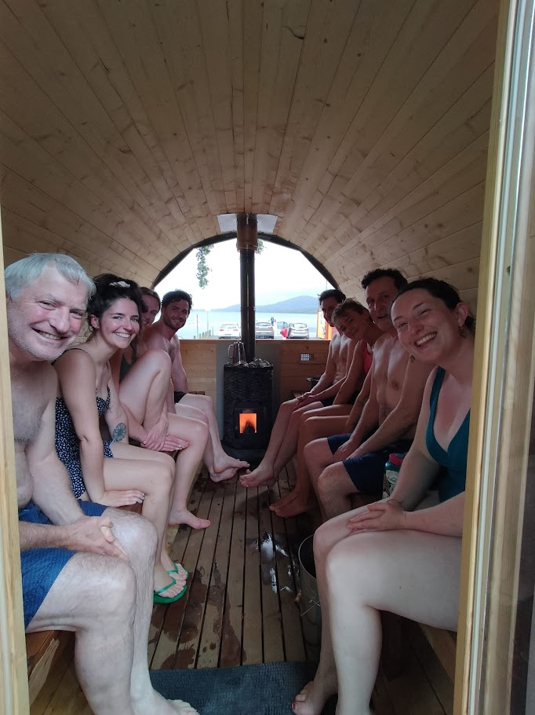
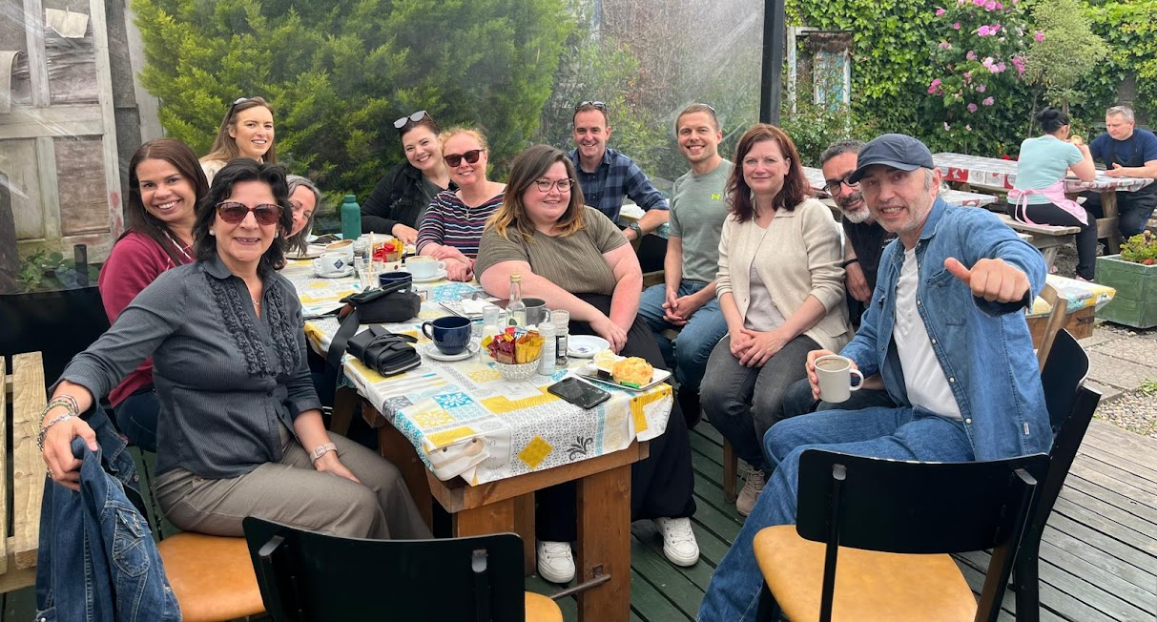
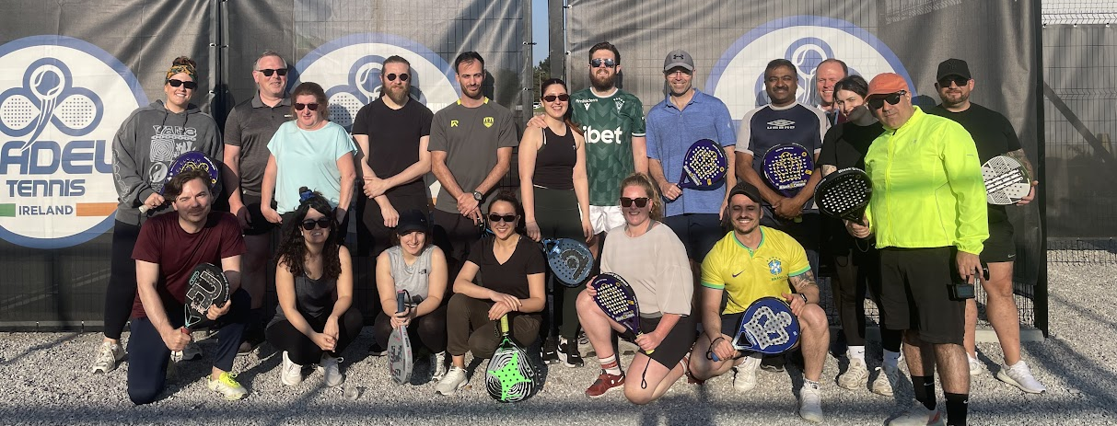
Grow Remote - Community
90% of event attendees met interesting people and have FUN! 70% feel more CONNECTED to their local community!

Slide 7
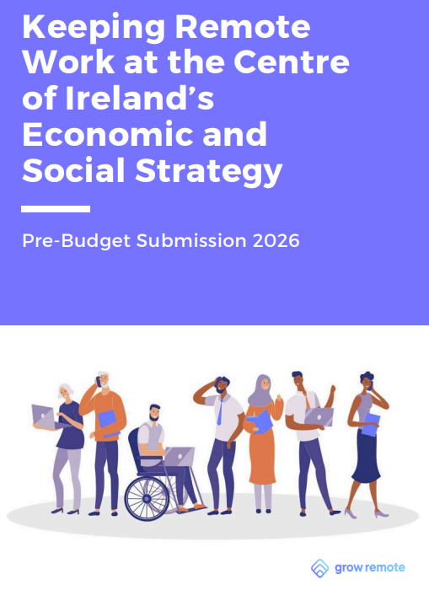
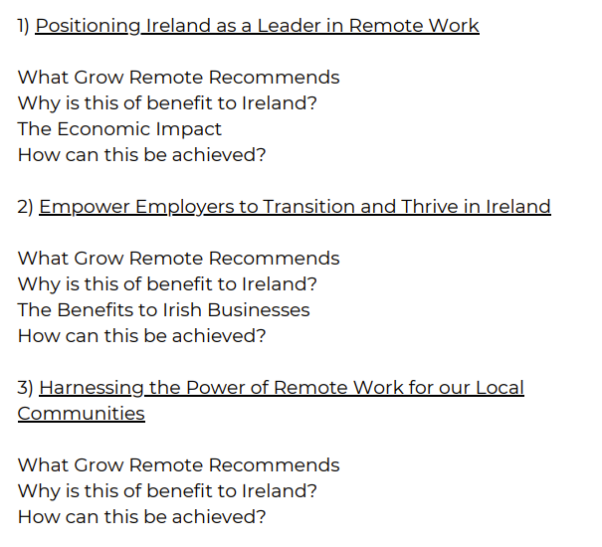
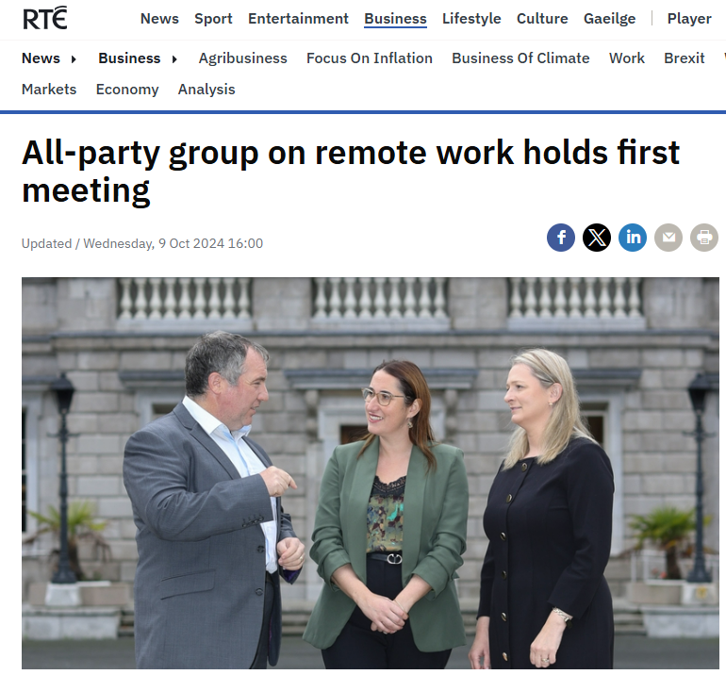
Grow Remote - Policy & Advocacy

Slide 8
The State of Remote in Ireland 2025
THE STATE OF REMOTE IN IRELAND
S
W
O
T
A national remote work policy with POG commitment
Investment and national network of remote working hubs
Ireland ranks 2nd in EU list of remote working nations
As per CSO data, 1m+ flexible workers - est. 250K remote. NBI Infrastructure
Companies are struggling to make the transition to remote and to hire remotely There are still up to 350K jobs that can be done remotely that are not Lack of awareness in local communities of remote work opportunities
Ireland does not yet have a national remote-ready skilled workforce
Increase remote work as a community development tool
Balance regional development though increased supply of remote work
Become an EU leader in remote work best practice
Increased usage of hubs network across Ireland National training programmes for remote work available
Unequal distribution of the benefits of remote work (rural vs urban as per CSO)
A challenging VUCA environment (international policy)
National supports for remote not used to drive societal change
Return To Office (inc hybrid) Fighting ghosts and narrative

Slide 9
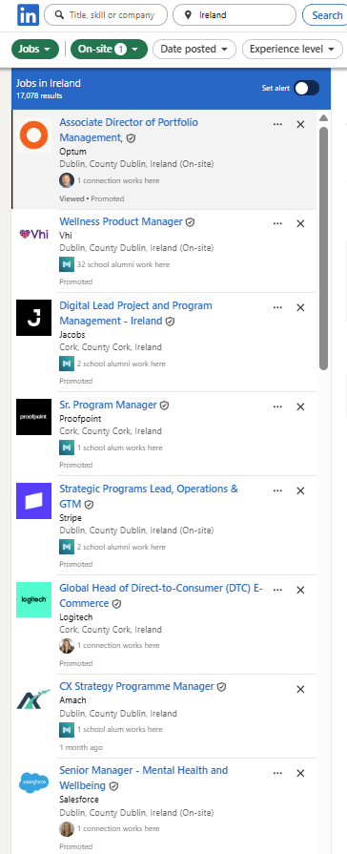
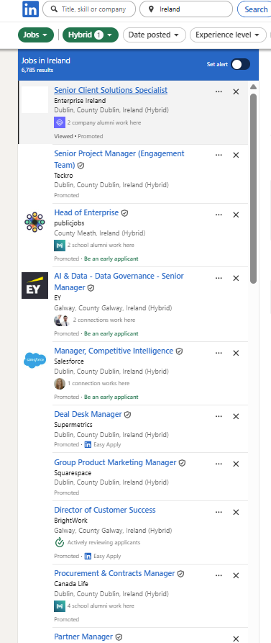
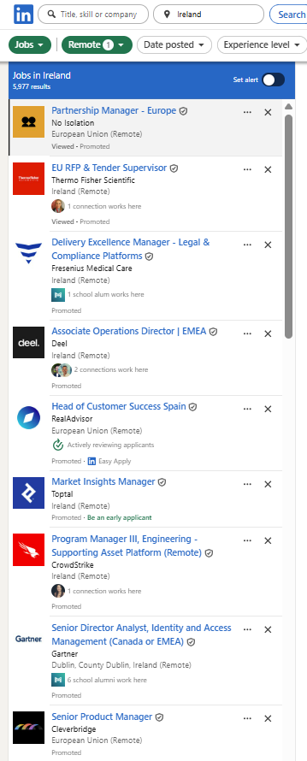
Remote Jobs in Ireland via LinkedIn Total Jobs = 30,070 Onsite Jobs = 17,038
Hybrid Jobs = 6,785
Remote Jobs = 5977 Onsite Jobs = 57%
Hybrid Jobs = 23%
Remote Jobs = 20%
Flexible Work = 43%
IE - 23/11/25

Slide 10
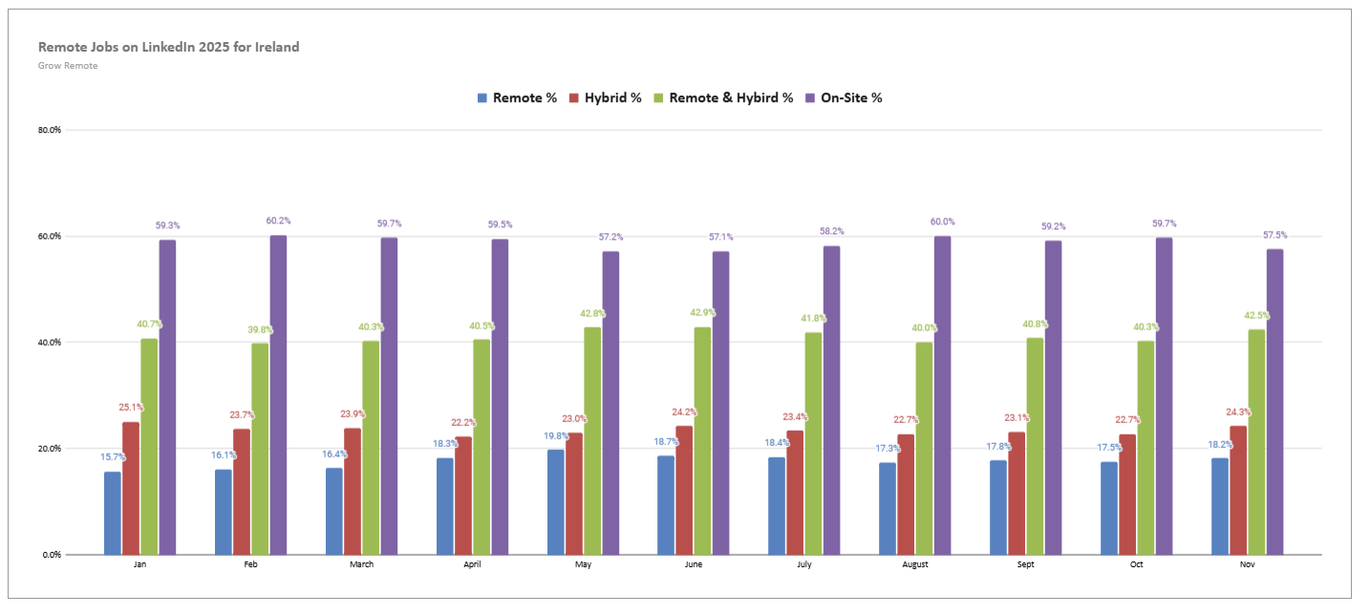
Remote Jobs on LinkedIn - Tracked Since Jan 2025

Slide 11
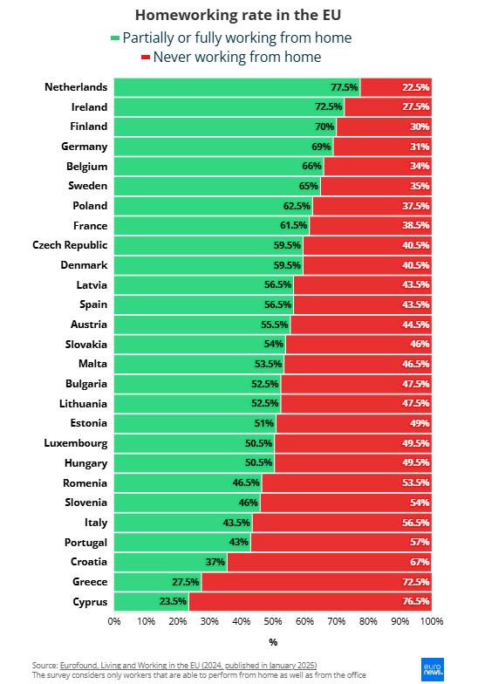
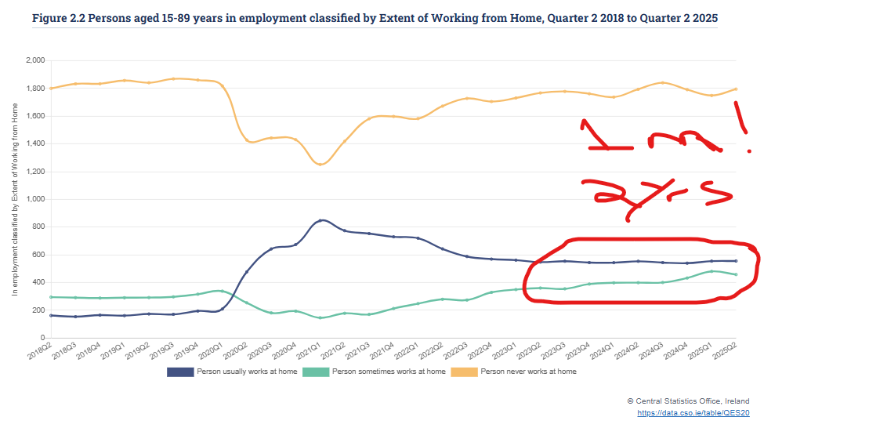
There has never been a better time to Fáilte Back

Slide 12
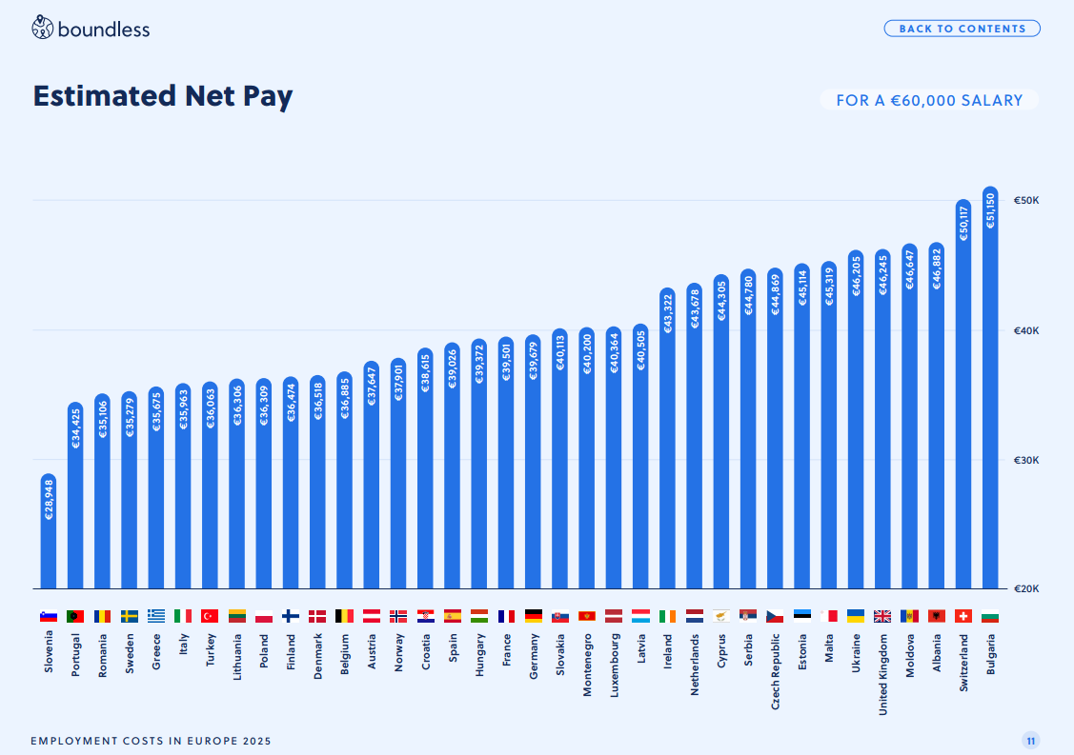
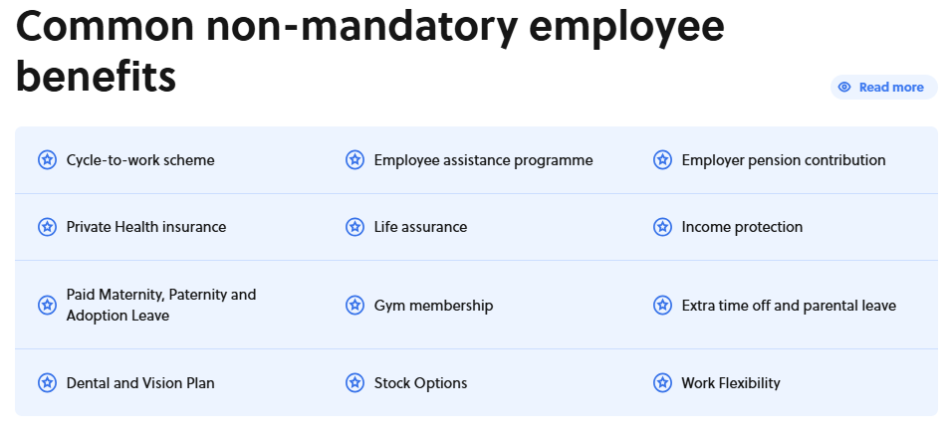
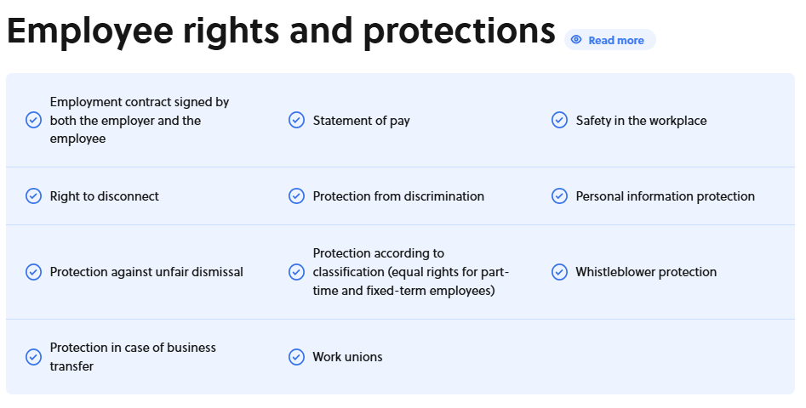

The State of Remote in Ireland 2025
THE STATE OF REMOTE IN IRELAND

Slide 13


1
Fully Remote
3 Types of
Remote Work
Operating Models
2
Remote First
3
Hybrid
Notes:
Fully Remote: No office, complete flexibility. In a fully remote operating model, the entire workforce operates remotely, with no physical office or location. Employees work from their preferred locations, which can be their homes, co-working spaces, or any other place with an internet connection. The organization is structured to support remote work and has the necessary tools, technologies, and policies in place to enable effective remote collaboration and communication. Benefits:
Global Talent Pool: Access to a diverse talent pool without geographical constraints.
Cost Savings: Reduced expenses related to maintaining a physical office space.
Flexibility: Employees have the freedom to choose their work environments.
Challenges:
Communication Challenges: Maintaining effective communication can be more challenging without face-to-face interactions.
Isolation: Employees might feel isolated or miss out on the social aspects of an office environment.
Remote First: An office, complete flexibility A remote-first operating model prioritizes remote work as the default mode of operation for the organization, even if it has physical office spaces. In this model, the organization's policies, practices, and culture are designed to empower and support remote employees. Remote work is seen as equal to or even more important than in-person work, and the organization provides the necessary infrastructure and tools to ensure seamless remote collaboration. Remote-first companies typically have well-established processes for remote onboarding, communication, and decision-making. Benefits:
Flexibility: Employees can choose where they work based on their preferences and needs.
Access to Office Space: Offices are available for those who prefer or need a physical workspace.
Remote-Optimized Processes: Business processes are designed with remote work in mind.
Challenges:
Potential for Disconnection: There might be a risk of creating a divide between remote and in-office employees.
Cultural Shift: Requires a cultural shift to ensure that remote workers feel included and valued.
Hybrid: A hybrid operating model combines remote work and in-person work, allowing employees to work both remotely and from physical office spaces. In a hybrid model, employees have the flexibility to choose where they work based on their preferences, the nature of their tasks, or other factors. The organization typically maintains physical office spaces where employees can come together for meetings, collaboration, or specific activities, while also supporting remote work through digital tools and technologies. Hybrid models often require careful coordination, communication, and scheduling to ensure a smooth balance between remote and in-person work. Benefits:
Flexibility: Employees can choose the best work environment for different tasks.
Preservation of Office Culture: Allows for in-person collaboration and team-building activities.
Geographic Flexibility: Access to a broader talent pool while maintaining some physical presence.
Challenges:
Logistical Complexity: Managing the logistics of a hybrid model can be challenging.
Communication Balance: Ensuring effective communication and collaboration between remote and in-office teams.
Equitable Policies: Establishing fair policies for both remote and in-office workers.
Each remote operating model has its advantages and challenges, and the choice depends on the nature of the business, the preferences of the workforce, and the company's culture. Organizations should carefully consider their goals, communication strategies, and the nature of their work when selecting or transitioning to a specific remote operating model. The key is to create a model that supports productivity, collaboration, and employee well-being.

Slide 14
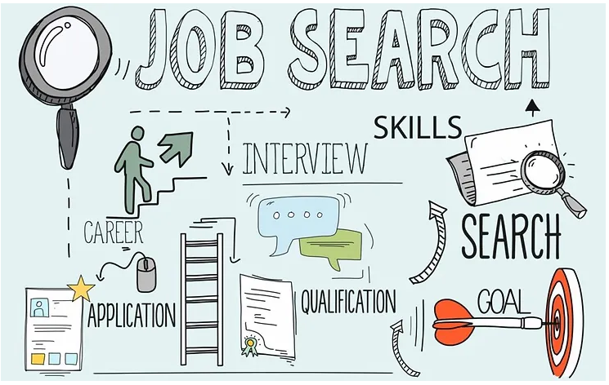
Finding Remote Employers - Where are they?
1
Employers
2
Jobs Boards
3
Networking

Slide 15
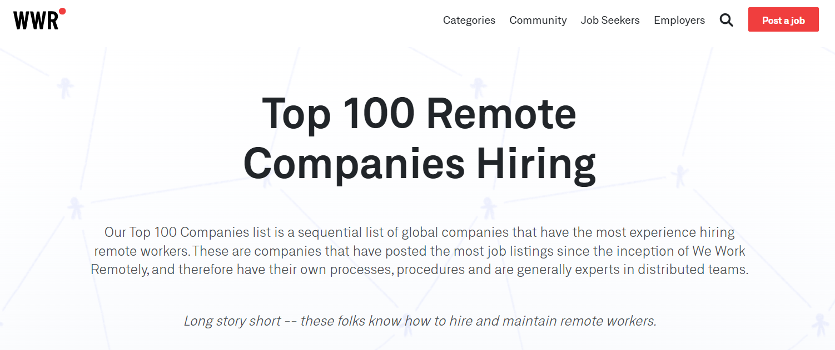
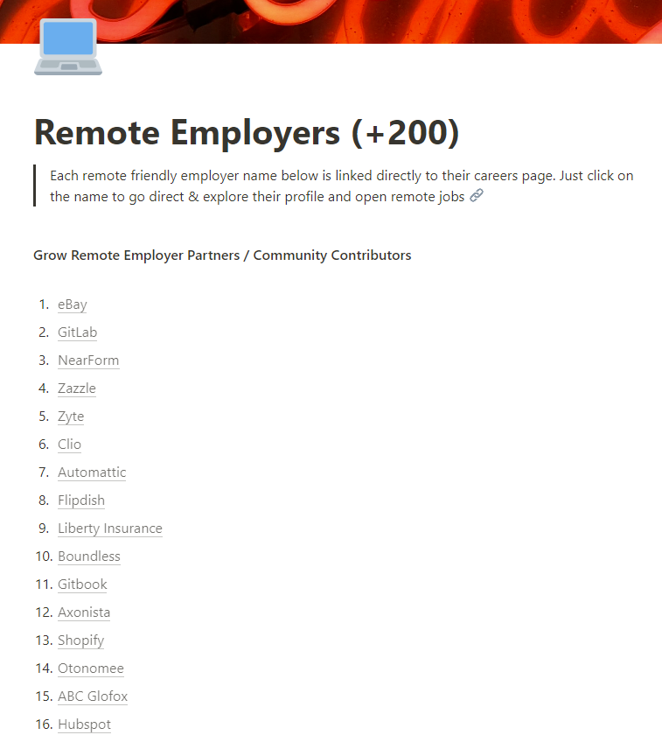
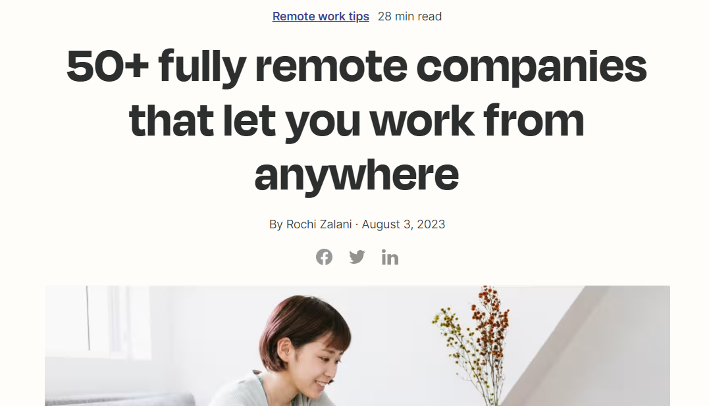
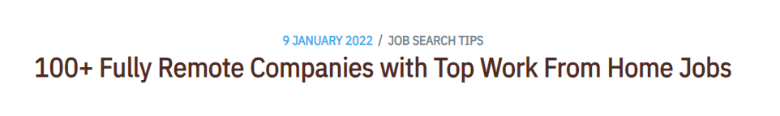
Remote Employers

Slide 16
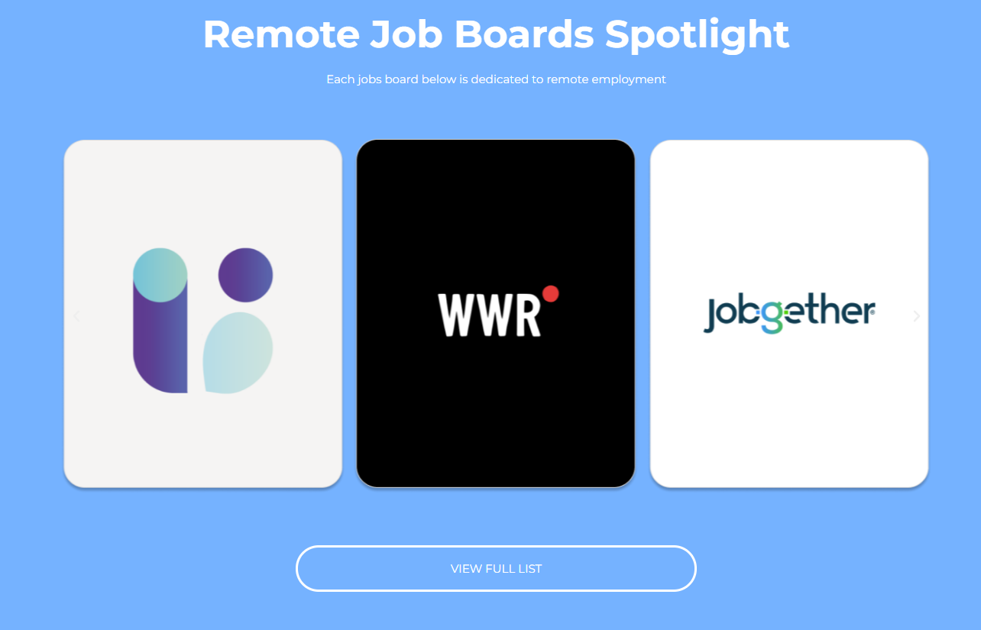
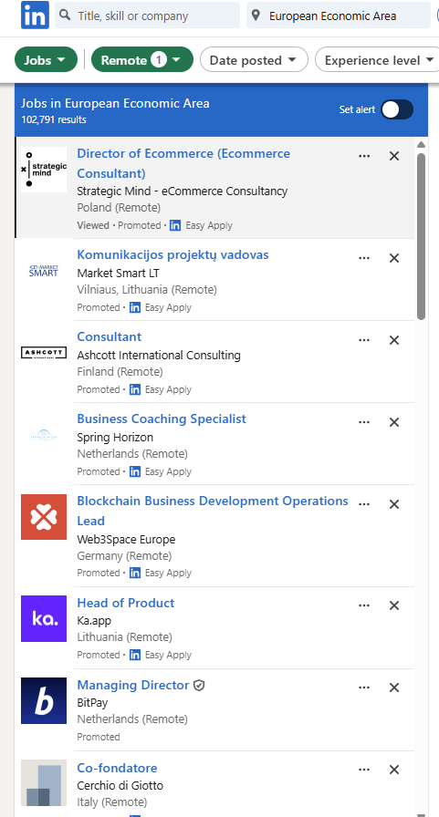
Remote Jobs Boards

Slide 17
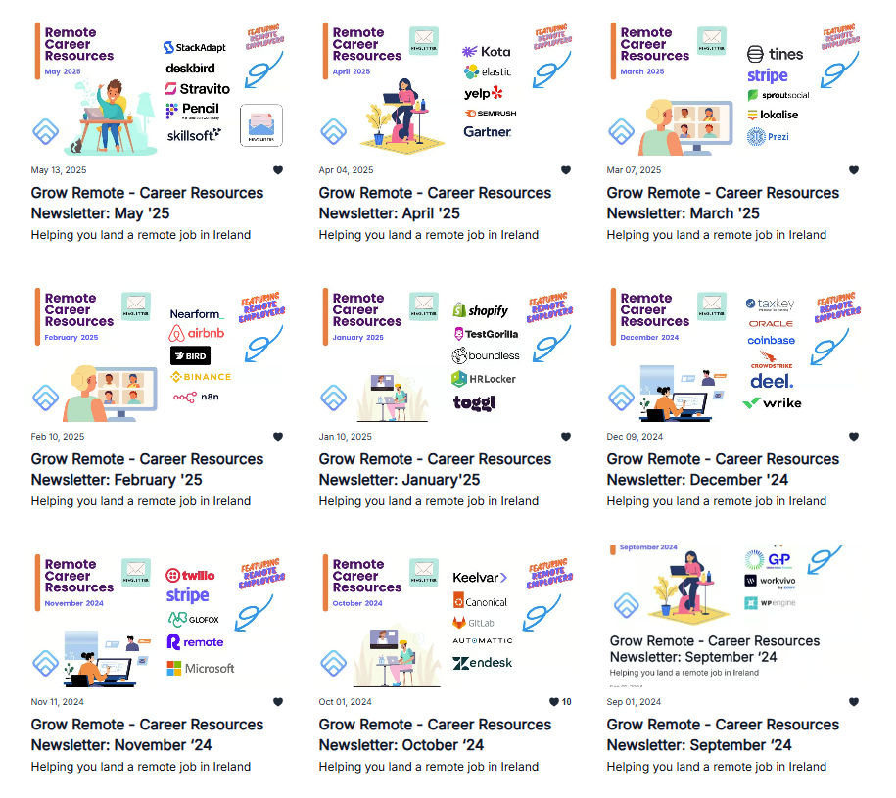
Career Resources Newsletter
x12 Editions Published A monthly release spotlighting remote employers, remote jobs boards & the skills or tools needed to find a remote job – all wrapped up with a story of impact. Includes 👇 - Employers & Jobs - Jobs Board - Remote Work skills - Impact of Remote
- State of Remote in IE

Slide 18
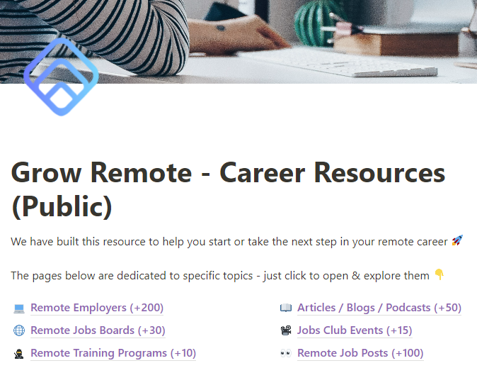
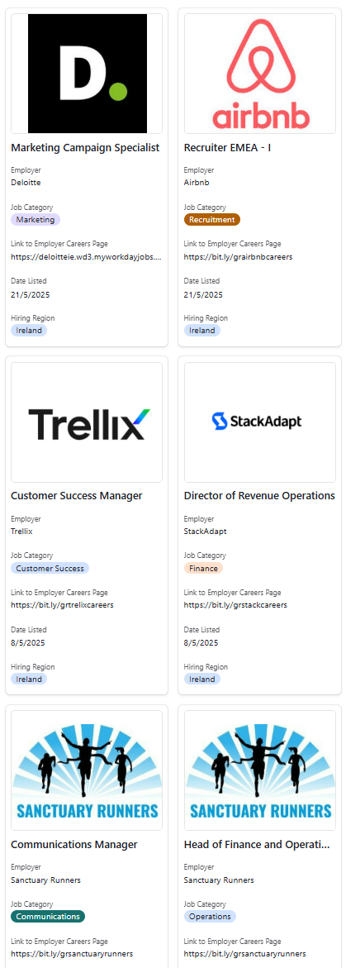
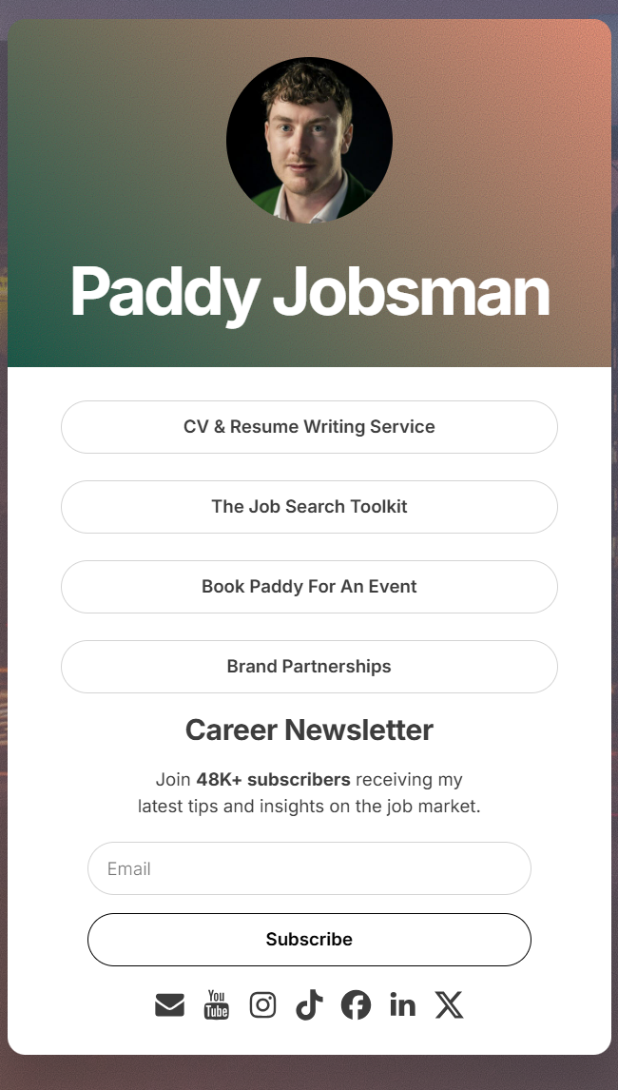
Career Resources Newsletter

Slide 19

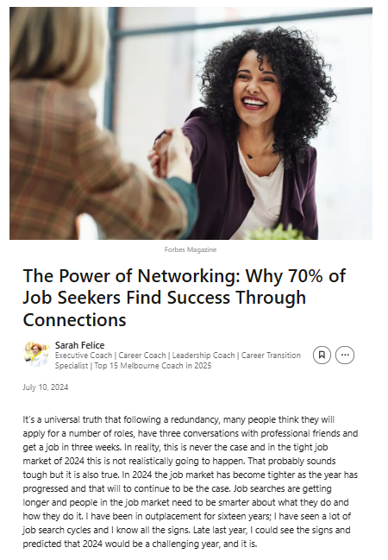
Networking
Kingsley Aikins

Slide 20
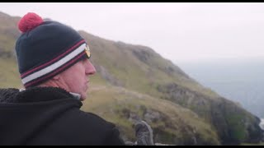

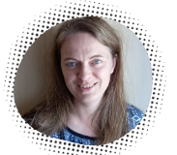
The Impact of Remote in IE
“
Remote work is unlocking positive social, economic and environmental change for individuals, employers and local communities 🚀
What happens when you remove location as a barrier to employment? On the small island of Inishturk we helped Joe Whelan get a remote job, allowing him to stay close to his young family in this beautiful place by the sea, while also building his career. Duration: 1:49 (Click to play)
"The rise of remote work has allowed me to transition from local jobs in the food/retail sector to data research, which is so much more suitable for me that I still can't believe it. I could use my multilingual skills to land an entry-level job in data analytics. Most language jobs used be located in Dublin, Galway and Cork, and therefore I was losing out on my competitive edge."

Slide 21
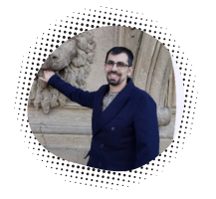
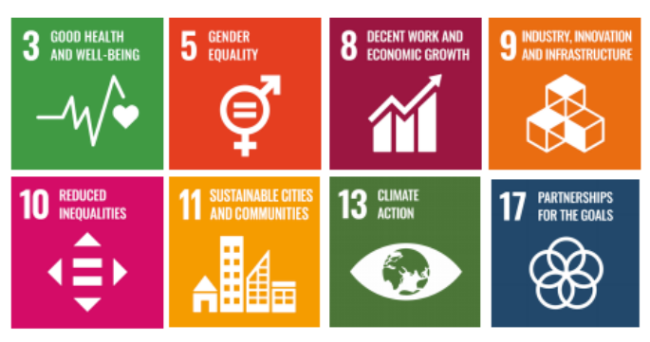

The Impact of Remote Work in IE & EU
Remote employment is unlocking positive social, economic & environmental change in local communities across Ireland.
A remote worker & Grow Remote volunteer in Enniscorthy
"Remote work allowed me to relocate from the Dublin area to Enniscorthy in Wexford and improve my quality of life overall. I can work from home, have more time flexibility, and the absence of commuting gave me that extra time to spend with the family, my hobbies, and within my local community participating to events, volunteering, and supporting local activities."
Remote work has a direct link to 8 of the 17 United Nations Social Development Goals

Slide 22
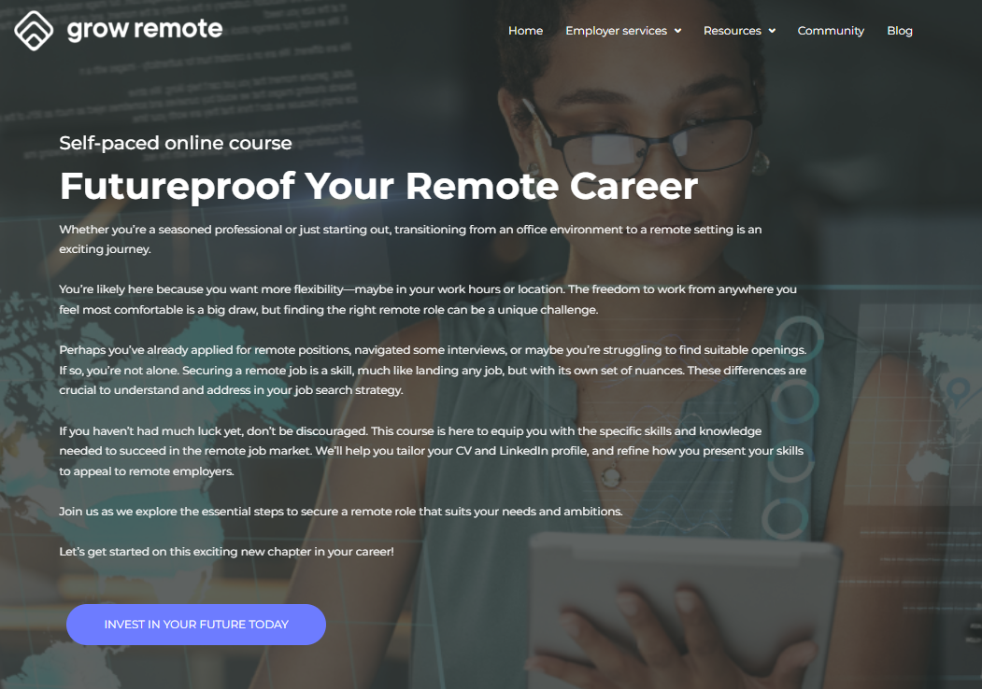


Ireland is a great place to live and work remote
WORK IS NOT A PLACE, IT IS SOMETHING YOU DO!

Slide 23
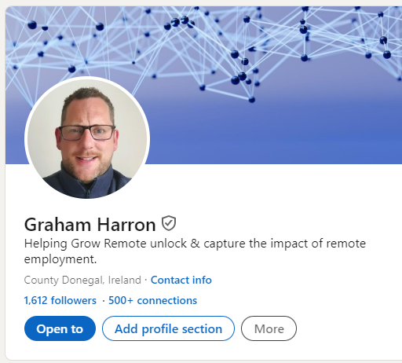
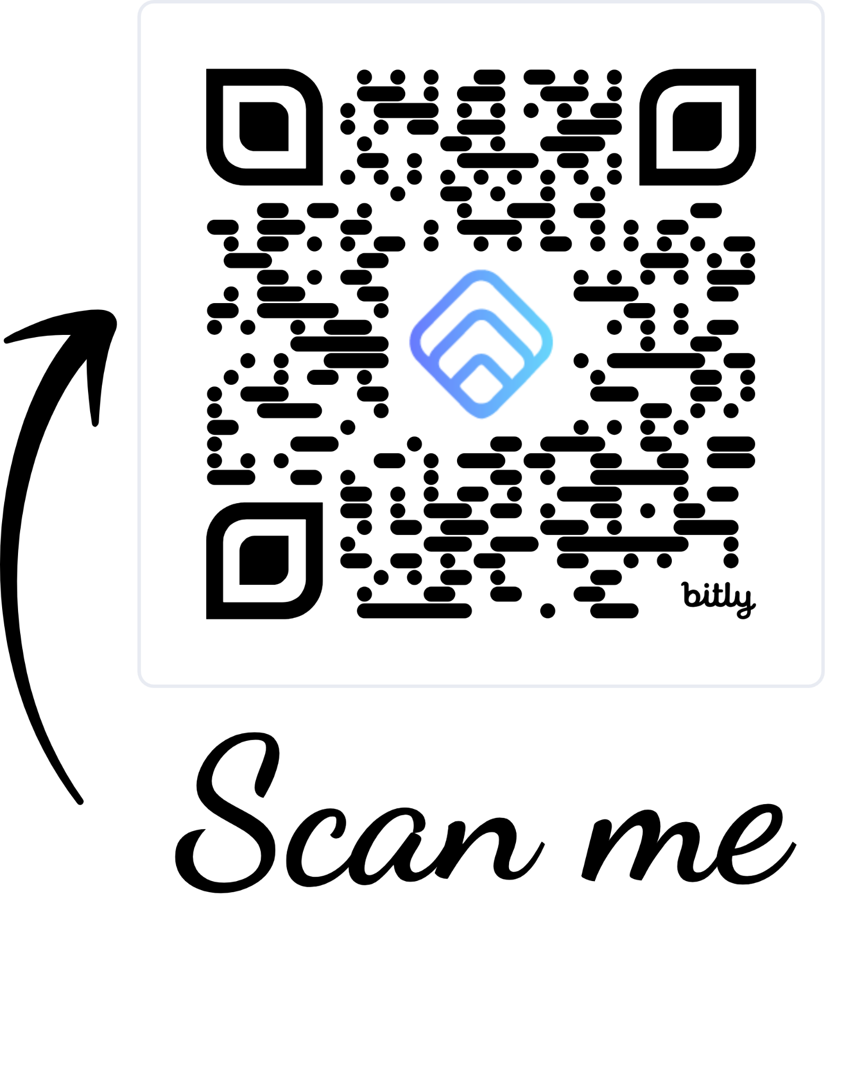
LETS CONNECT FOR A VIRTUAL COFFEE ?
GRAHAM @ GROWREMOTE.IE

Slide 24

Go raibh maith agaibh 🙏
Fáilte Back
Graham Harron, Impact & Data
graham@growremote.ie

