Slide 1

Welcome
Ciara Fitzachary,
Talent Partner

Slide 2


Slide 3
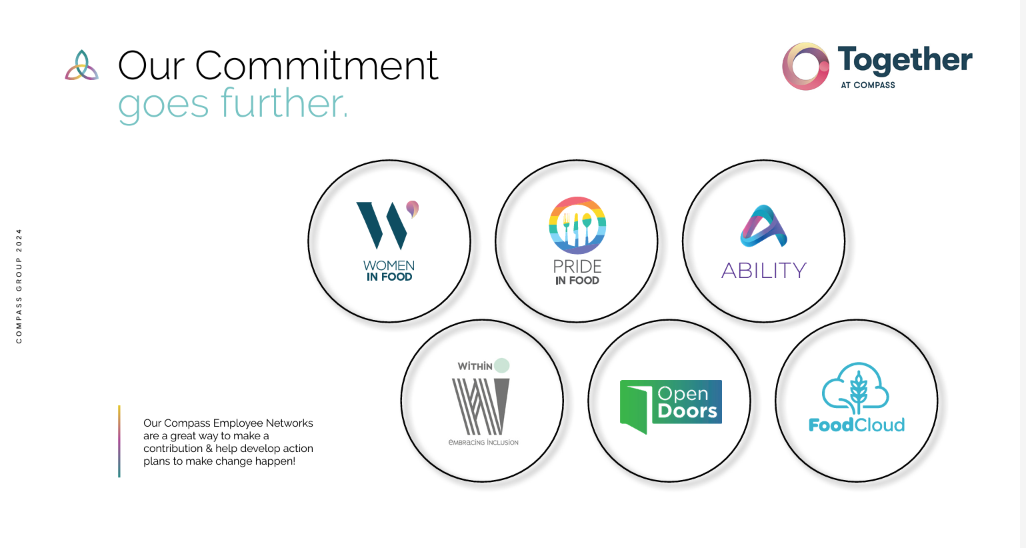
Notes:
https://www.compassatlas.co.uk/portals/5fbfpkg1/DI-Homepage

Slide 4

Notes:
https://www.mylearningatcompass.co.uk/totara/dashboard/index.php?id=54

Slide 5

Notes:
https://www.mylearningatcompass.co.uk/totara/dashboard/index.php?id=266

Slide 6
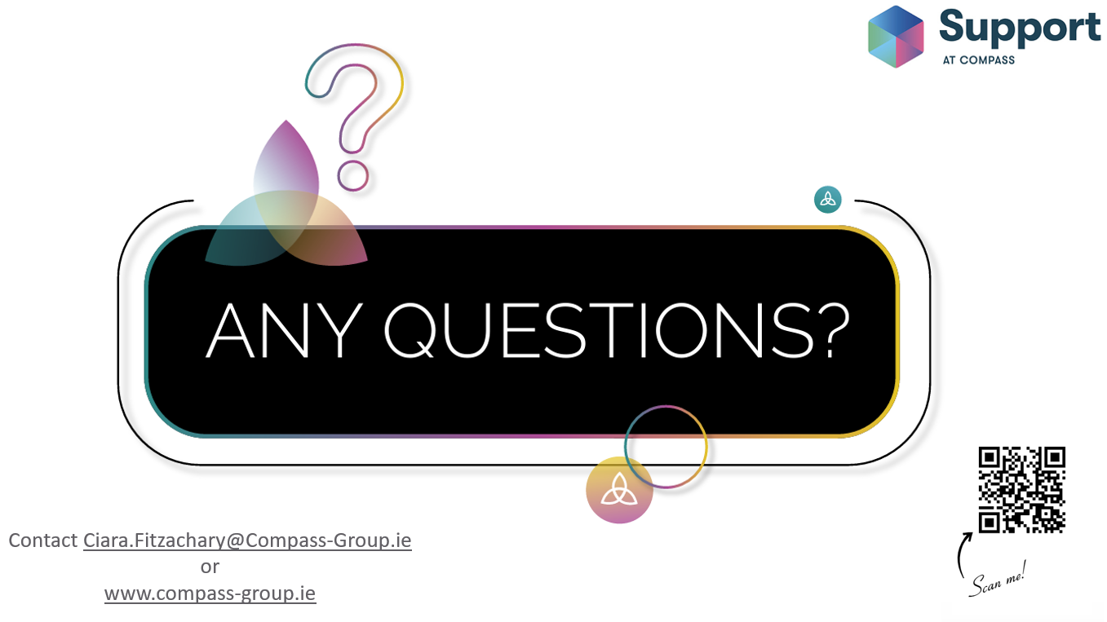
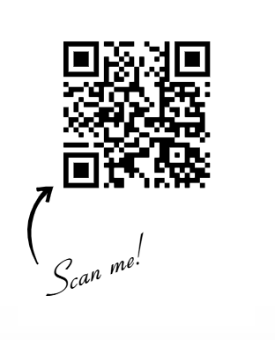
Contact Ciara.Fitzachary@Compass-Group.ie
or
www.compass-group.ie

