Slide 1

Fáilte Back 2025
Veolia Ireland
Presented by Kellie Quinn & Michaela Doyle

Slide 2
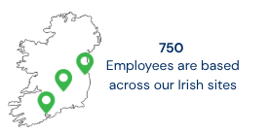
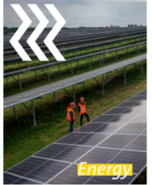
About Veolia in Ireland
Veolia in Ireland is a subsidiary of Veolia Group which started in France in 1853. It began operations in Ireland in the 1990’s under a variety of different businesses. Our Head Offices are located in Dublin, Cork and Kilkenny.
Energy BU
We are at the forefront of Ireland's energy transition.
We provide innovative solutions for sustainable energy management.
Services include operating district heating networks.
We implement energy-efficient and renewable energy systems.
This reduces carbon footprint and optimizes energy consumption.

Slide 3
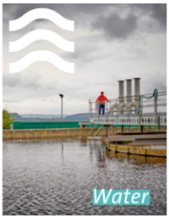
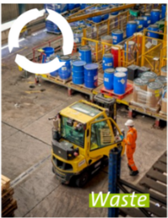
About Veolia in Ireland
Water BU
Veolia is Ireland's leading water services provider.
We manage and operate water and wastewater treatment facilities nationwide.
Expert teams ensure the delivery of clean, safe drinking water to communities.
Wastewater is processed to the highest environmental standards.
This work serves clients and protects Ireland's water resources.
Hazardous Waste BU
Specialising in the safe management and treatment of hazardous waste.
We provide comprehensive solutions for industrial and commercial clients.
Our facilities and expert teams ensure compliant, environmentally responsible handling of dangerous materials.
Supporting Ireland's circular economy through specialised treatment and recovery processes.
Protecting the environment.

Slide 4
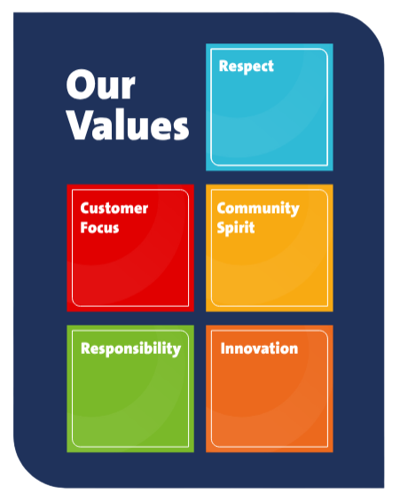

Our Values
At Veolia, we act because we care and this shared spirit drives everything we do. Our values of responsibility, community spirit, respect, innovation, and customer focus, are integral to our approach to social value

Slide 5






Veolia Employee Benefits
Private Health Insurance
Employee Cover Only
Bike to Work Scheme
Tax-efficient bike & accessories purchase
Life Insurance & Pension Cover
Provided through Irish Life
Paid Volunteering Day
One paid day each year to volunteer
Annual Leave & Buy-More Scheme
Option to purchase up to 5 extra days
Learning & Development Support
Ongoing training and development programmes

Slide 6
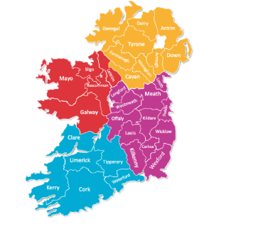

85 Open Vacancies
Vacancies at Veolia
Utilities Technicians - Electrical, Mechanical (Day and Shift Roles)
Maintenance Technicians
Maintenance Leads
Refrigeration Technicians
Site Managers
Construction Site Managers
Project Engineers
Project Managers
Mechanical Design Engineers
Senior Mechanical Design Engineers
BIM Technicians
Automation Engineers
Commissioning Engineers
Health & Safety Officer
Water Engineers
Donegal
Mayo
Dublin
Kilkenny
Cork

Slide 7
Career Paths at Veolia
Internal Promotions: 41 employees were promoted internally this year, demonstrating strong career advancement opportunities
Lateral Movements: 14 employees made lateral moves, allowing for skill diversification and cross-functional experience
Monthly Internal Job Postings: All vacancies are advertised internally on our Workday system - ensuring transparency and equal opportunity for current employees,
Internal-First Culture: Managers are actively encouraged to consider internal candidates before seeking external hires
Career Development Focus: Veolia prioritises growing talent from within, supporting employee career progression and retention

Slide 8

Our Success Story: Relocating with Veolia
Would you recommend your friends working for Veolia Ireland?
Yes, I would recommend it. It's truly amazing, especially seeing the best practices that could be adopted across other Veolia entities
How would you describe your experience relocation to Ireland?
Easier than I could of anticipated. The only challenge I faced was trying to integrate into the Irish culture.
Would you recommend your friends working for Veolia Ireland?
Yes, I would recommend it. It's truly amazing, especially seeing the best practices that could be adopted across other Veolia entities

