Slide 1


PRESENTATION
TINTSCHL GROUP
Notes:
We sincerely appreciate the opportunity to introduce our company and share more about what we do.

Slide 2

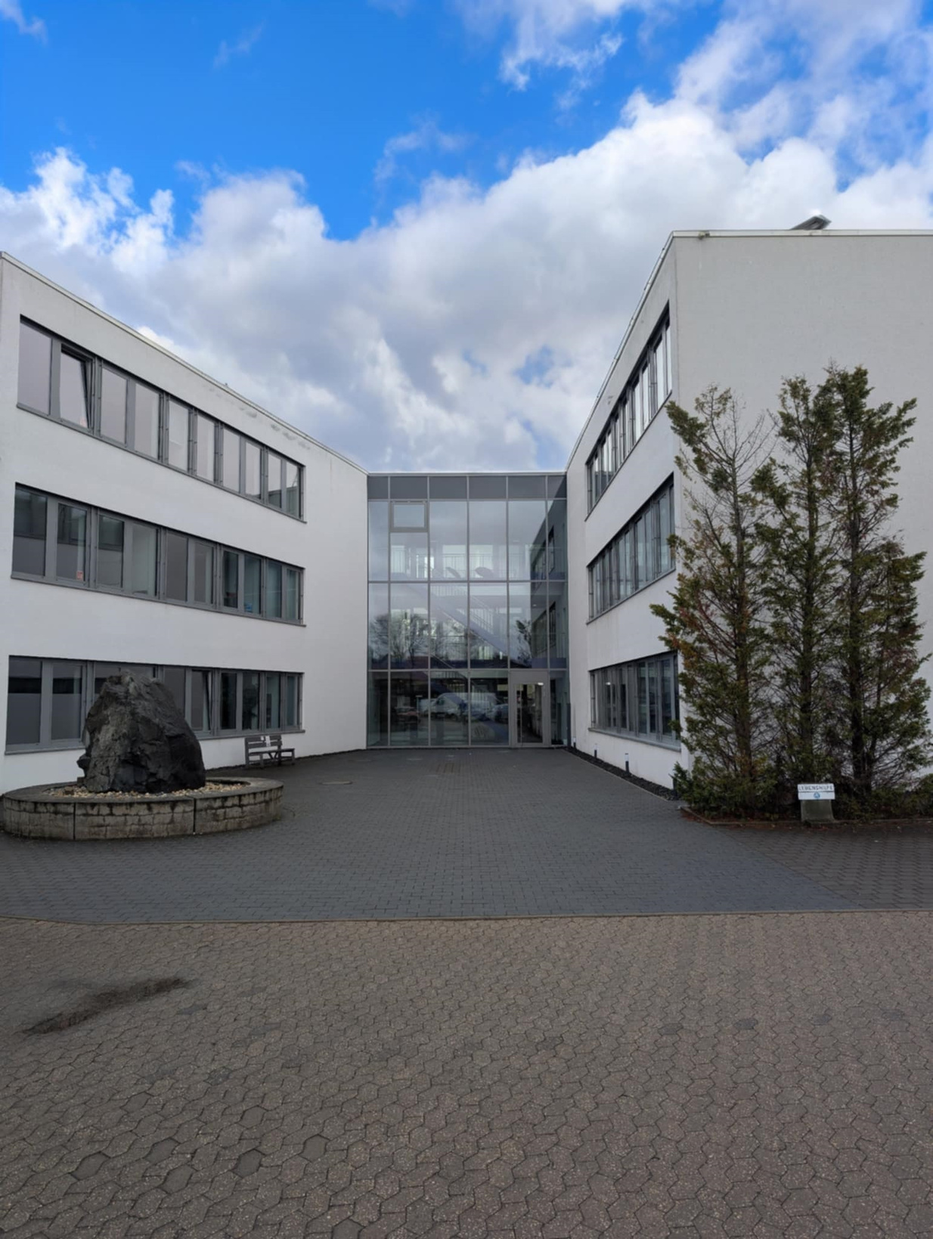

ENGINEERING EXPERTISE ACROSS EUROPE
Founded in 1997 in Germany, the Tintschl Group provides engineering, IT and consulting services to major industrial sectors.
Active across Europe, especially in aerospace, automotive, energy and plant engineering.
12 Location all over Germany (Augsburg, Berlin, Düsseldorf, Erfurt, Erlangen, Essen, Hannover, Leipzig, Mannheim, Nürnberg, Regensburg, Wilhelmshaven)
Notes:
The company was founded in 1997 by the Salleck family, who still retains ownership. Our operations span multiple sectors, such as aerospace — where both Ester and I are currently involved — in addition to automotive, energy, and information technology.
We have a nationwide presence across Germany, with 12 offices throughout the country.

Slide 3
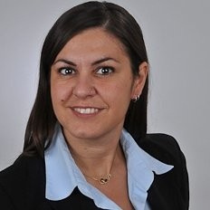
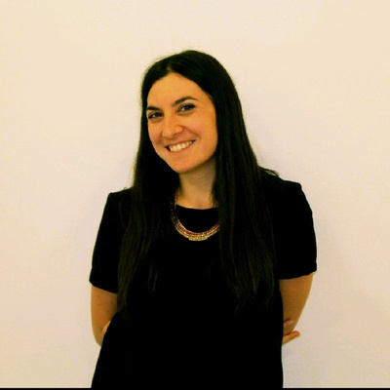
International Recuiter Specialist
International Recruiter Specialist
Master´s degree in Anthropology
10 years of experience in the field of talent acquisition across different industries
Working as consultant for Tintschl since 2024
Master’s degree in Psychology and Human Resources Management
Over 15 years of experience in personnel consulting and talent acquisition, active in Germany since 2011
Working as a consultant at Tintschl since 2021

Slide 4

TEMPORARY WORK HOW DOES IT WORKS?
Permanent Contract with Tintschl Unternehmensgruppe
Work placement in one of our customer companies
The same tasks as a comparable employee
Same rights and obligations as comparable employees
Fixed contact person during the entire assignment with our customers
Support in the arrangement of a follow-up assignment
Notes:
We are a temporary employment agency — but what does that mean in practice?
We offer a permanent contract directly with us, while the employee works on-site at our clients’ offices. All aspects of the daily work are managed by a designated person at the client company, typically the hiring manager or direct supervisor.
At Tintschl, the employee will also have a dedicated contact person on our side, especially helpful during the initial phase — for example, if relocation from another country is required, or for any other kind of support.
We have extensive experience working with international candidates and supporting them throughout the relocation and onboarding process.

Slide 5


OUR SERVICES FOR YOU!
We offer you suitable positions that fit to your resume
We optimize your application for the German market and specifically designed for our customers’ need
We advise you on all labor law issues in Germany
We provide you with a permanent contact person for all kind of problems during your application process
Notes:
In addition, we offer the following services:
We help you enhance your CV by assessing your skills and matching them with our open positions — so you don’t need to apply to multiple roles yourself.
We optimize your CV for the German job market and provide information about our clients’ expectations as well as relevant labor laws in Germany.
During the recruitment process, you’ll have a dedicated contact person available to support you and provide any additional information you may need.

Slide 6
INTERNATIONAL RECRUITING
Tintschl has more than 10 years 'experience in international recruitment
We are presently seeking young professionals and experienced individuals who wish to gain international experience for our available positions in the aerospace industry

Slide 7


OUR OPEN POSITIONS
•System Engineer (f/m/d)
•Human Factors Engineer (f/m/d)
•IT Expert (f/m/d)
•Mechanical Engineer (f/m/d)
•HR Specialist (f/m/d)
•SW Engineer (f/m/d)
•Artificial Intelligence Engineer(f/m/d)
•Customer Support (f/m/d)
•Controller (f/m/d)

Slide 8

OUR RECRUITMENT PROCESS
Our recruitment process is simple and fast, designed to respect your time and keep things clear at every step. Our team is always available to support you throughout the journey and ensure a smooth, positive experience.
Discussion with our team to support the relocation and discussion of the offer
Techinical interview with the client
Interview with recruitment team

Slide 9
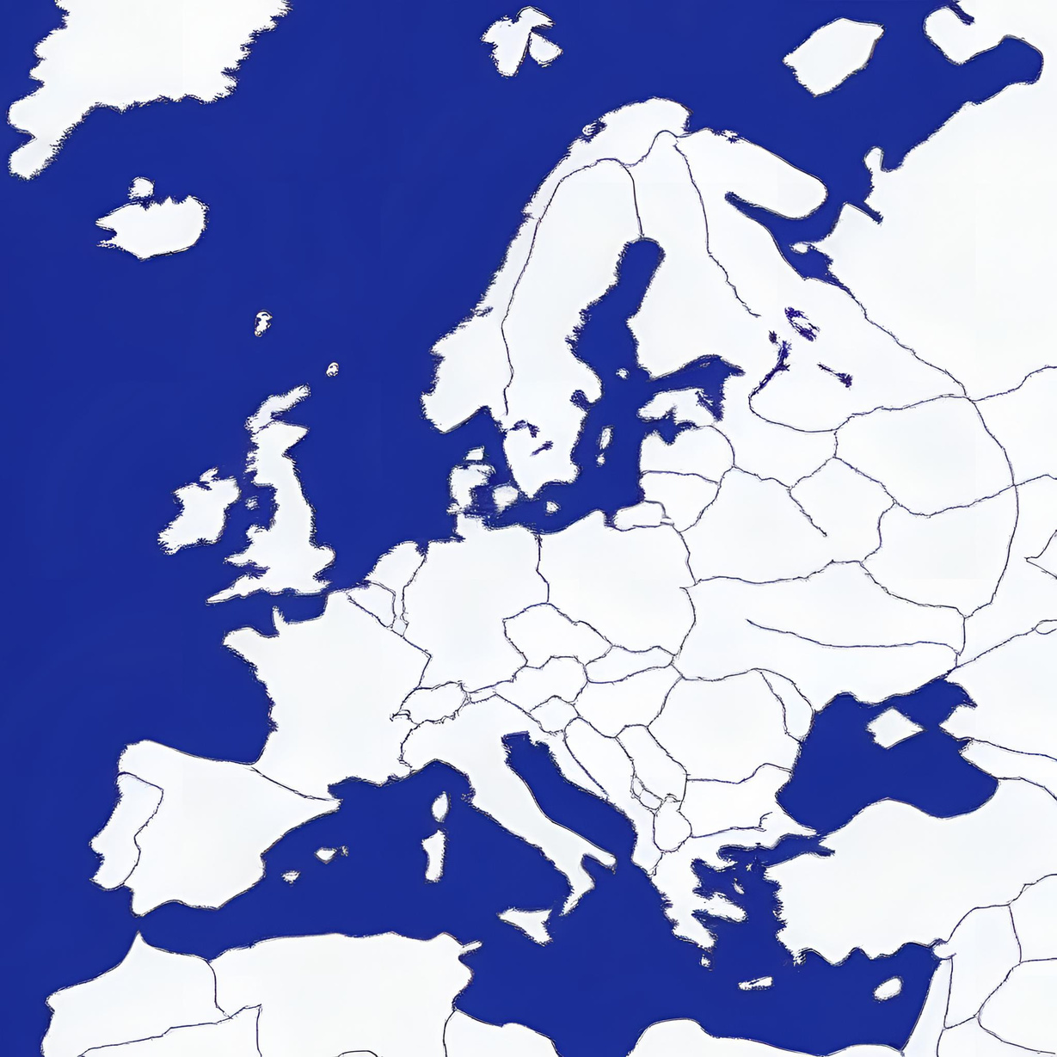

OUR ACTIVITIES
We’re a truly international team, with people from all over Europe. To help everyone feel at home, we organize team dinners, social events, and offer shared spaces that make relocation easier and encourage both professional and personal connections. We also run webinars for potential candidates, where our colleagues share their own stories and give a real sense of what it’s like to work with us.

Slide 10




THANK YOU
OFFICE
Goerdelerstr. 21 9105 Erlangen
https://www.linkedin.com/company/tintschlunternehmensgruppe
www.tintschl.de
We look forward to working with you

