Slide 1


European Labour Authority
Boost Your Career with EURES
5 June 2025
Lisa Jacobs
Senior Labour Mobility Officer
Remote Working in the EU – social security

Slide 2
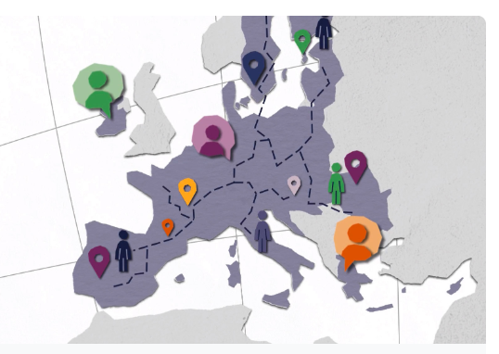
Coordination of social security systems
When moving within Europe (EU and Iceland, Liechtenstein, Norway and Switzerland), the EU provides common rules to protect your social security rights.
All countries have their own national social security system, and they are free to decide who is insured under their legislation
The coordination rules do not replace national systems
Four main principles:
Single applicable legislation
Equal treatment
Aggregation
Exportability

Slide 3
Coordination of social security systems
Branches covered by the coordination rules:
Sickness, maternity and equivalent paternity benefits
Old-age pensions, pre-retirement and invalidity benefits
Survivors’ benefits and death grants
Unemployment benefits
Family benefits
Benefits in respect of accidents at work and occupational diseases.

Slide 4
Coordination of social security systems
Worker
As a basic rule, if you work in one country you are subject to the legislation of the country where you actually work as an employed or self-employed person. It does not matter where you live or where your employer is based.
Employer
If you employ workers in another EU Member State, you must register with and pay contributions into the social security system in the country where your employees work, even if your business is not based there.
Exceptions: posted workers and work in two or more countries simultaneously

Slide 5
Coordination of social security systems
Telework and social security coordination
Due to pandemic, telework increased considerably, leading to force majeure
How to deal with telework in normal working circumstances?
Development of Guidance note on telework.
The framework agreement facilitates individual derogations in the interest of a category of employed teleworkers and their employer(s), provided that certain conditions are met.
Only possible between countries that are signatory to the agreement. (FR, DE, IE, PL, ES, NL yes. EE not (yet))
See for more information: https://socialsecurity.belgium.be/en/internationally-active/cross-border-telework-eu-eea-and-switzerland

Slide 6
Coordination of social security systems
More information:
Social security and benefits
Your rights country by country
Which rules apply to you?
Europe Direct
Your Europe - Advice
Solvit
EURES
FAQ – European Commission

Slide 7

Thank you
www.ela.europa.eu

