Slide 1
Telework in the EU: Trends, Models and Regulations
Oscar Vargas Llave
EURES, 5 JUNE 2025

Slide 2
Trends

Slide 3
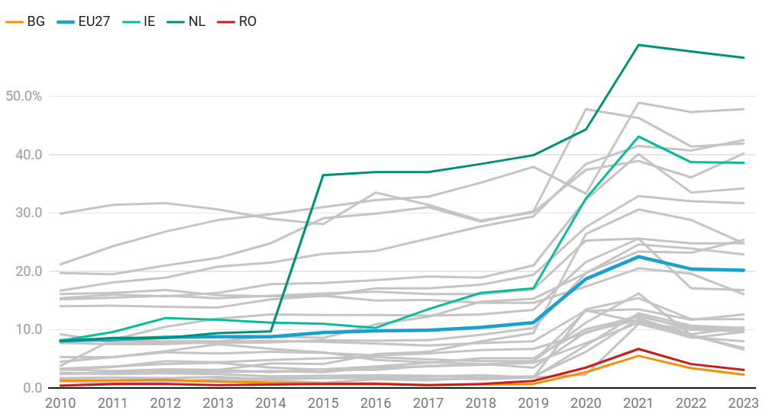
Employees working usually or sometimes from home (EU-LFS 2010 – 2023)

Slide 4
Terms and models

Slide 5
Terms and models
Gradual social expansion of time and place limits (Technology)
Telework
Hybrid work
Flexible working
Digital nomads
Remote work
Virtual work,
ICT-based Mobile work
Agile work
Smart work

Slide 6
Regulations

Slide 7
Working time
Health and safety
Access / Request
Costs coverage

Slide 8
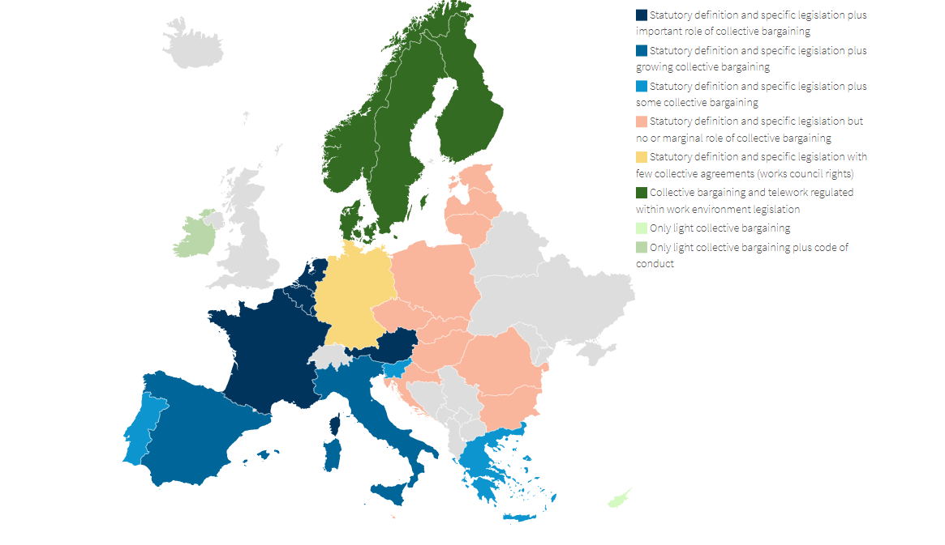
Sources of telework regulation
Notes:
In this map countries are classified according to the main sources of regulation of telework. When clustering we always generalise and therefore you should take this with caution, but it is a way to understand Europe.
Blue: legislation on telework and well-developed Social dialogue in darkest colours
Orange: legislation and almost non existent social dialogue at all levels
Green: almost no legislation and regulated mainly by social dialogue. Light green very few examples of collective bargaining on the topic.
Yellow: a singular case with legislation and few examples of collective agreements but with works council in companies negotiating on working time related matters including telework.

Slide 9
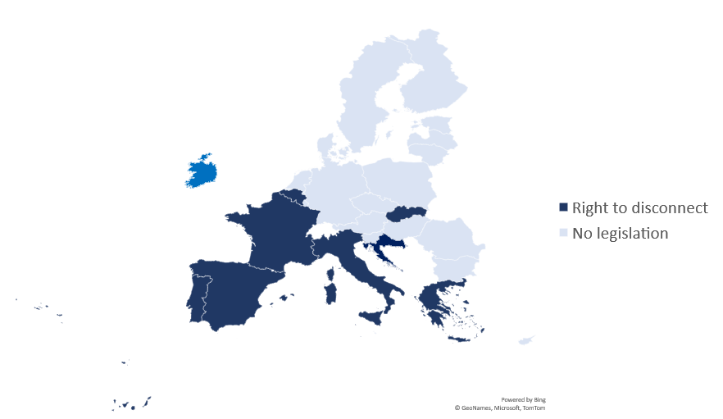
Right to disconnect
2023

Slide 10
Thank you / Gracias

