Slide 1
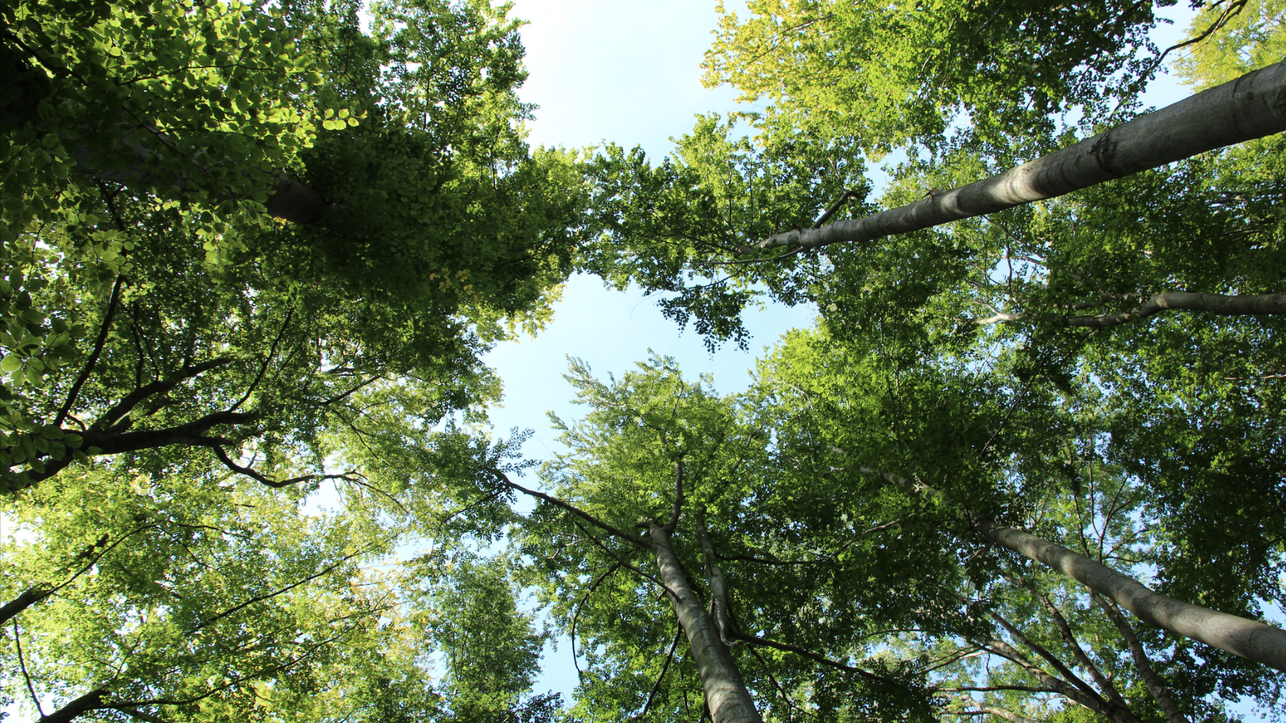
Start your career with Pollmeier!

Slide 2
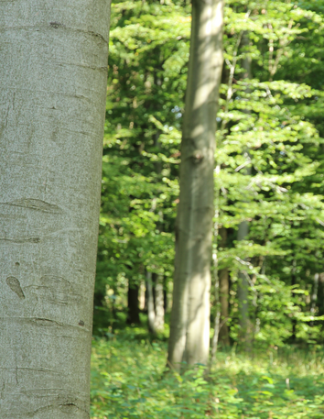
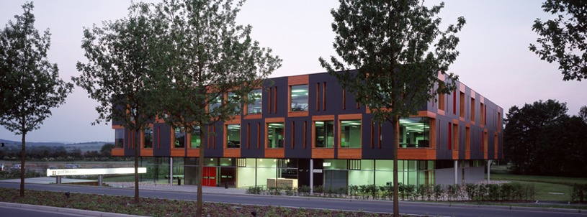
The four Pollmeier hardwood sawmill plants are located in:
We are the Pollmeier Group
Malchow
Owner of the most modern and efficient hardwood sawmills in Europe.
Creuzburg
2x
Owner-managed family business
Founded in 1996 in Creuzburg/ Germany
Over 1000 employees
Specialised in European beech
Internationally successfull
Export in over 70 countries
Aschaffenburg
We are deeply rooted in these regions, operate sustainably and work together with our partners at a local and international level.
Global market leader for hardwood products

Slide 3
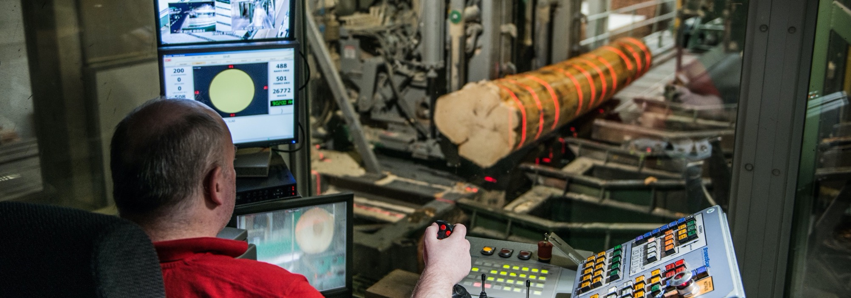

Industrialised, highly efficient production
High level of automation
High Volume Production
Consistent, high quality at competitive prices

Slide 4
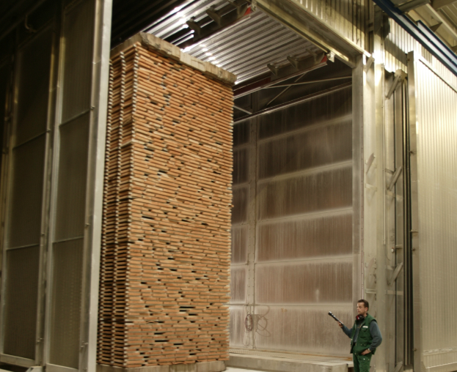
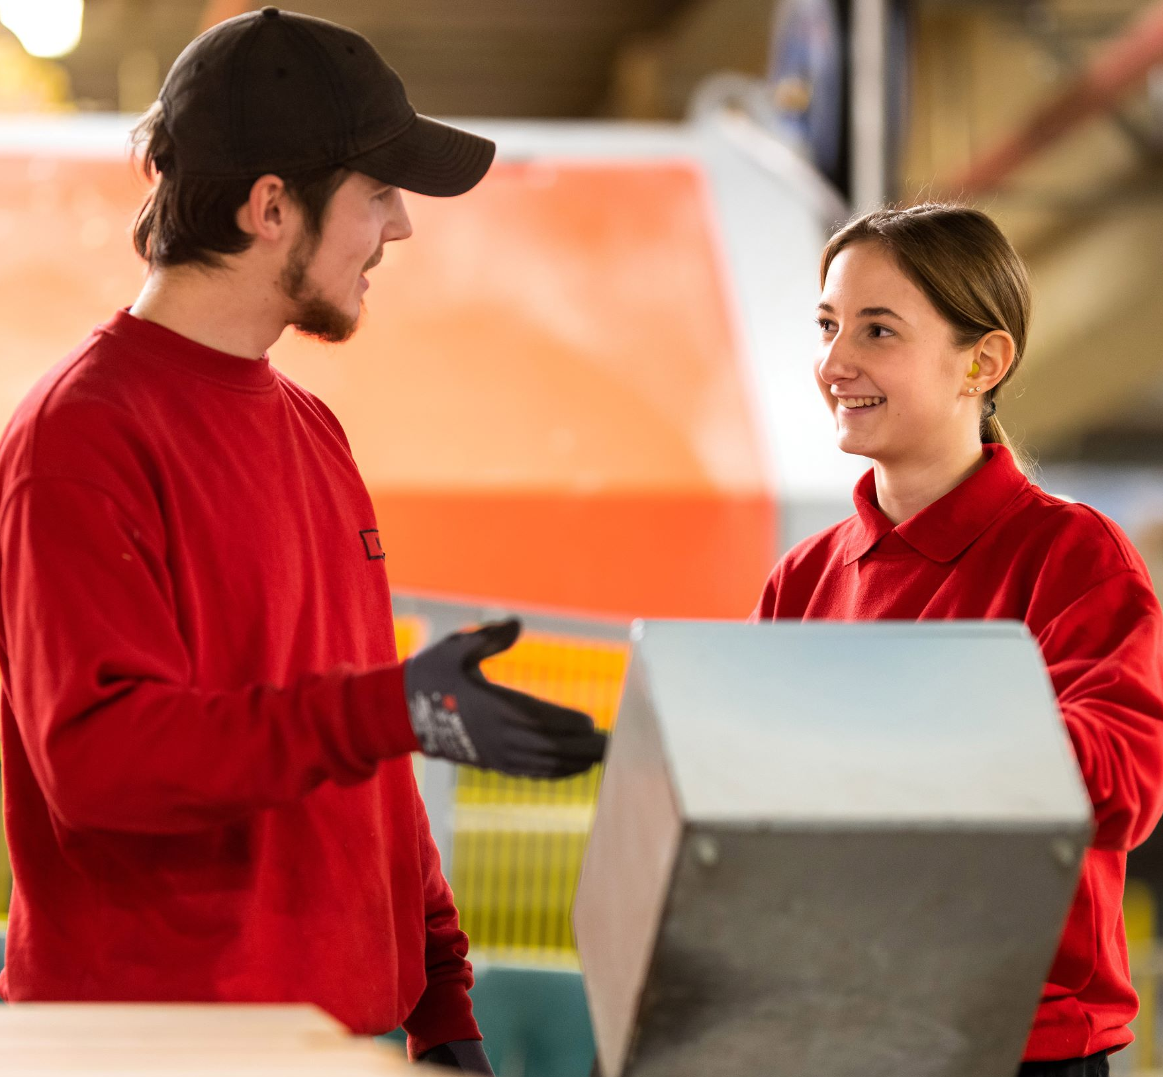
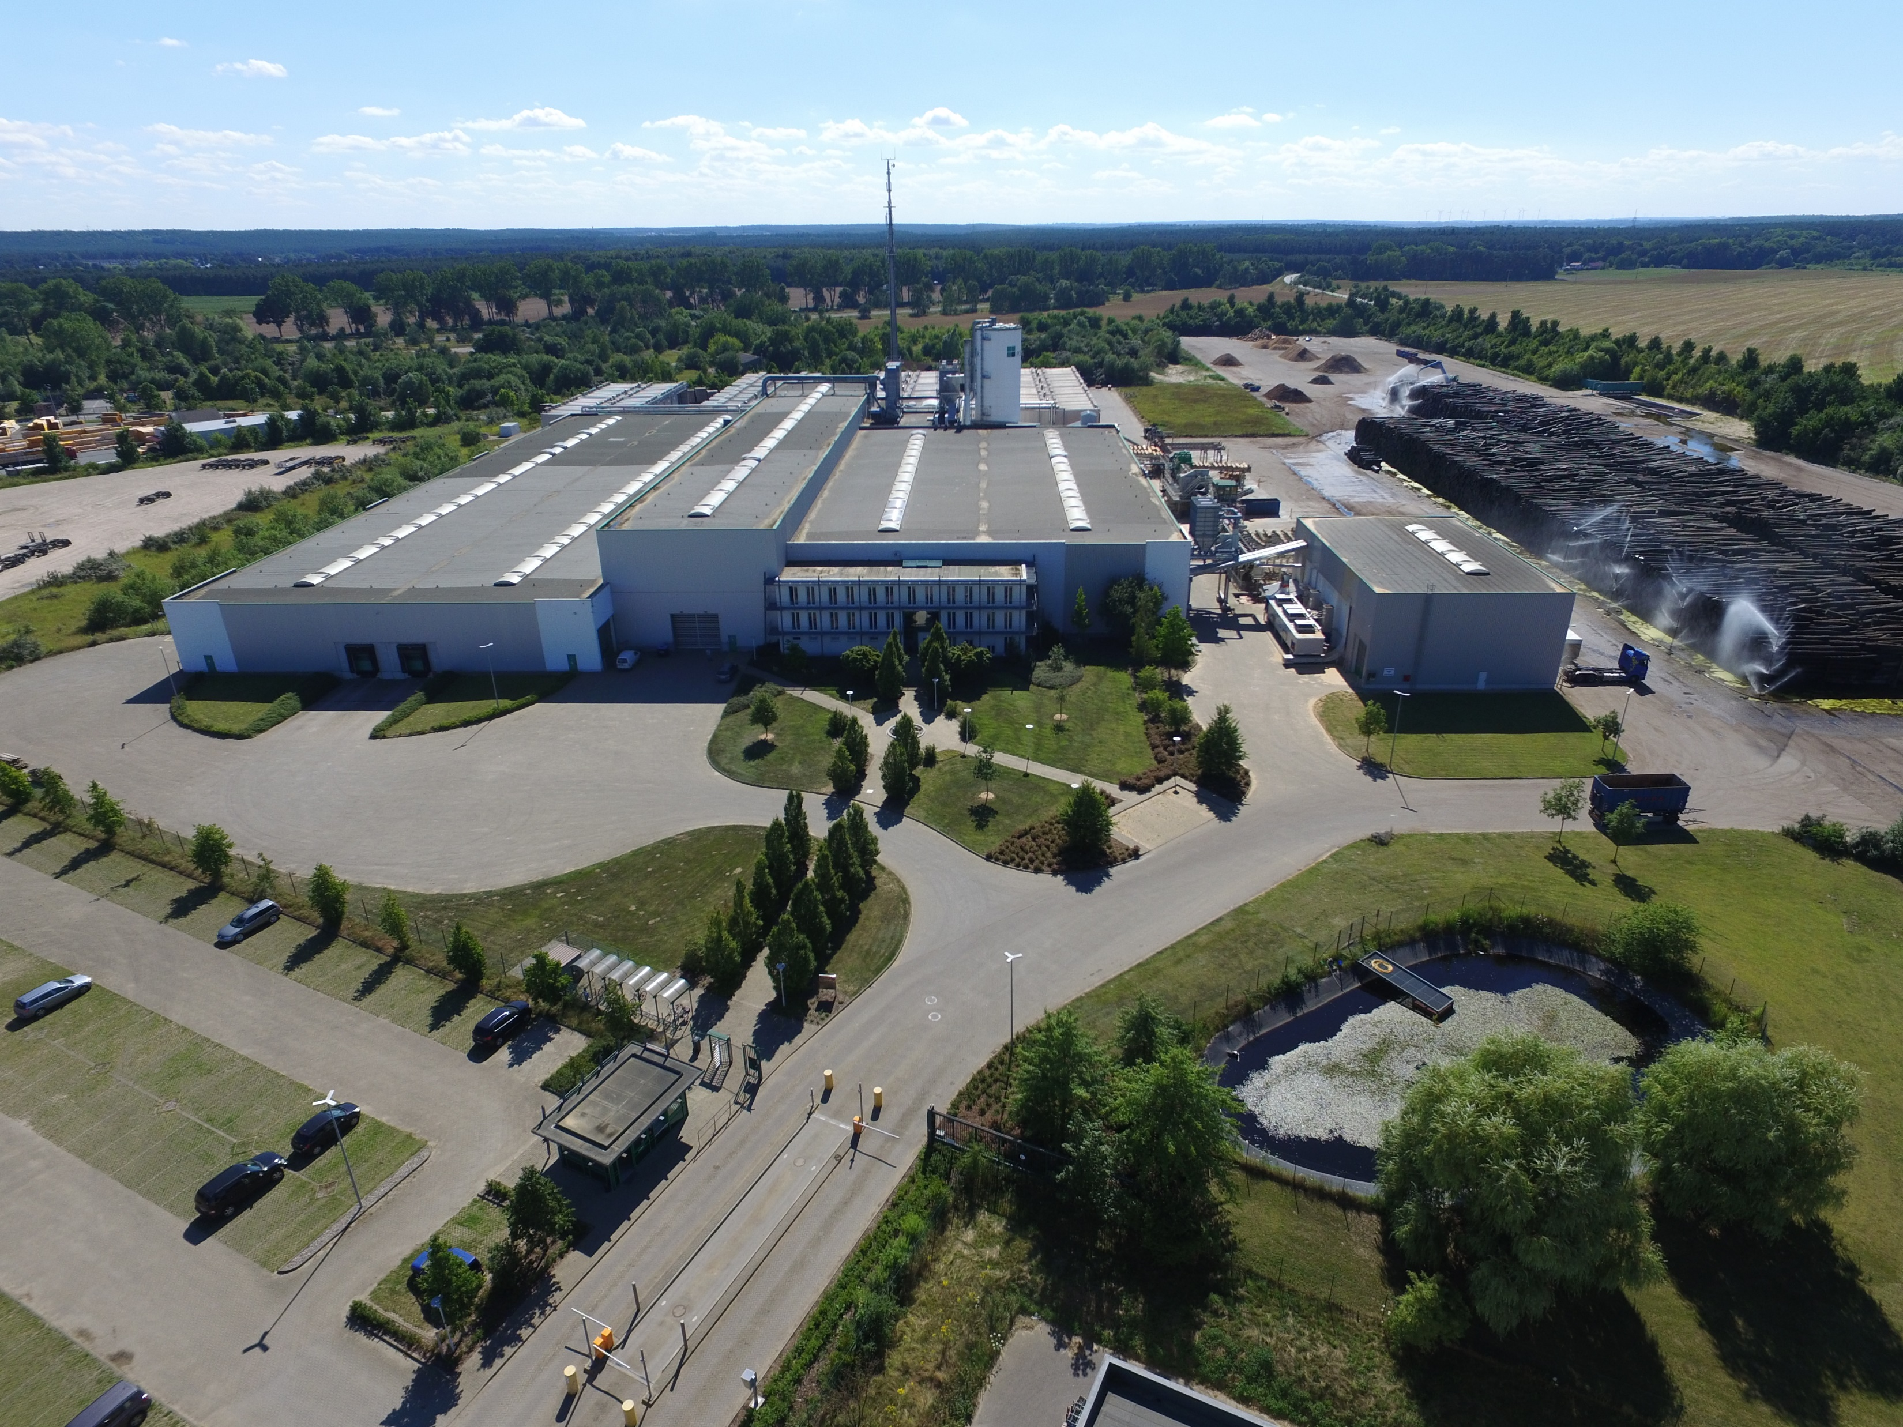
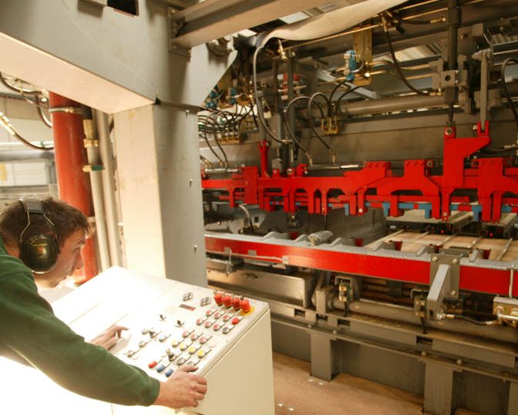
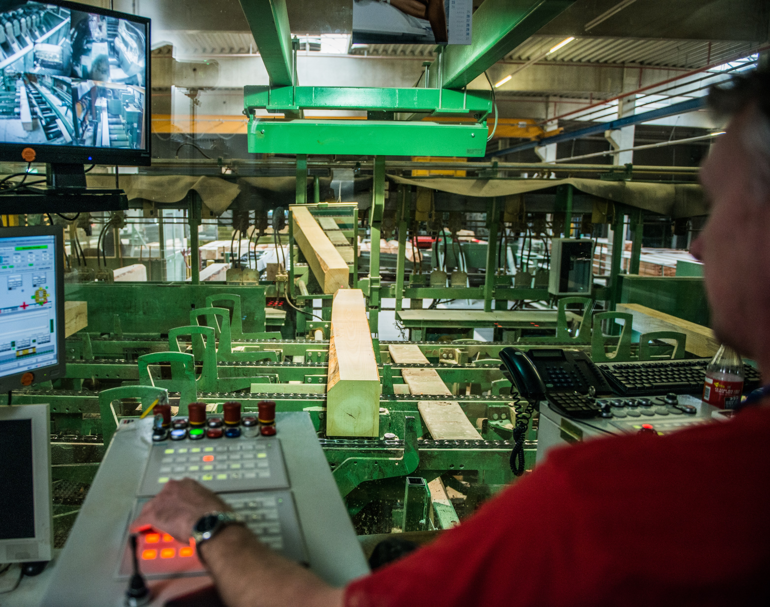
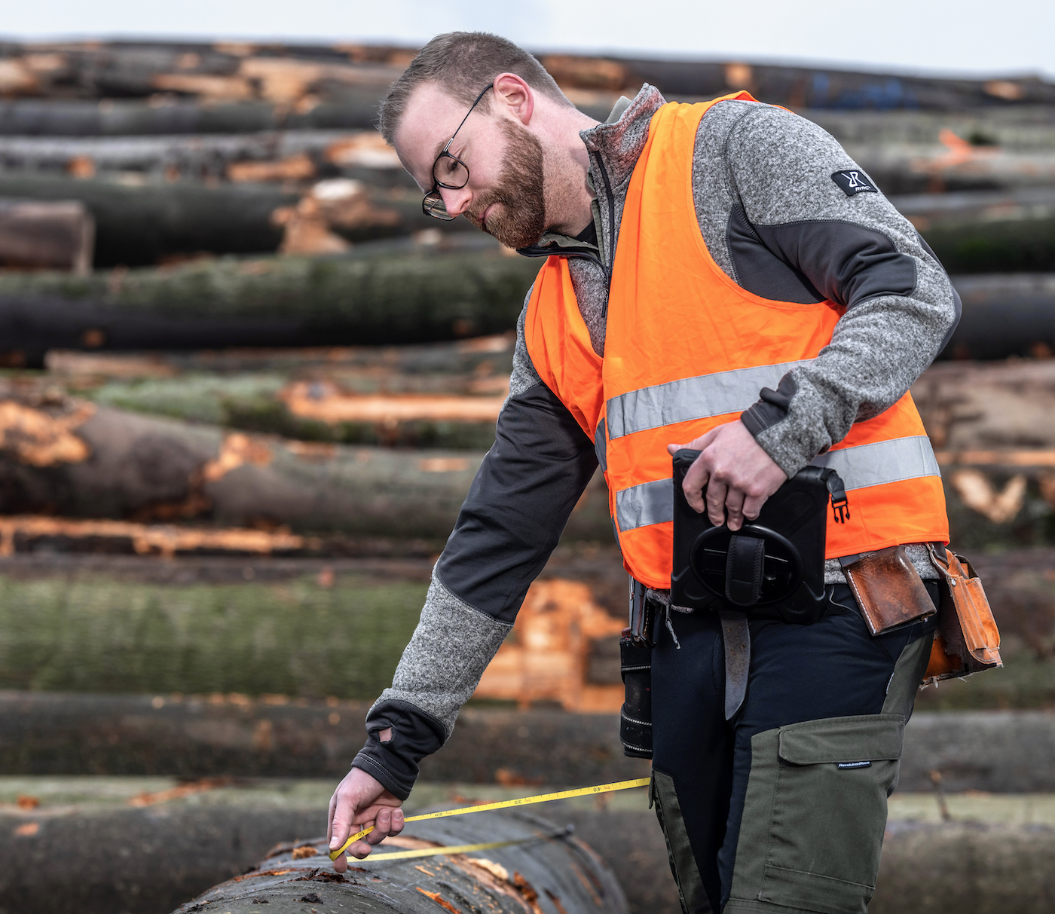
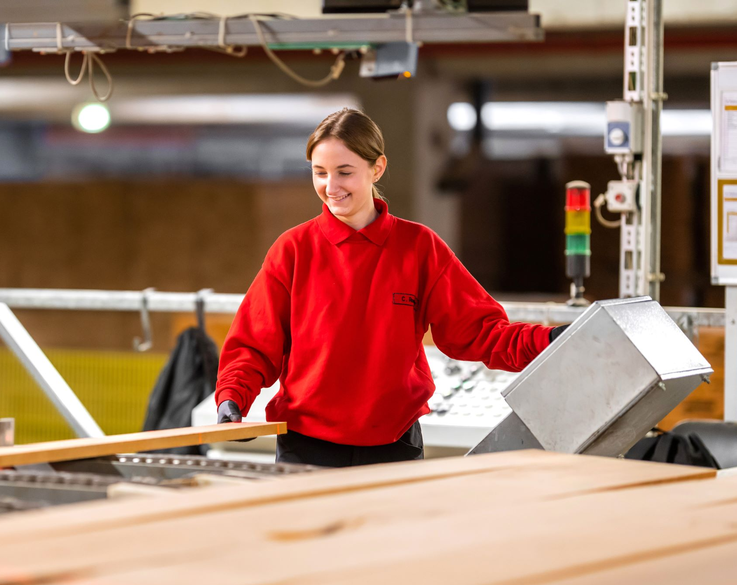
Pollmeier represents wood from sustainable forestry with high quality at economical prices.

Slide 5
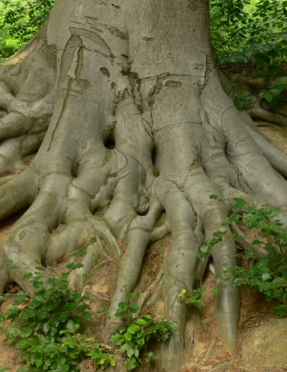


At Pollmeier, we practice sustainability in everything we do.
Our Beech Roundwood:
From sustainably and ecologically managed forests
Sourcing from a radius up to 150 km around each factory
No waste, as 100% usage
We think in generations
We only use as much wood from the forest as will grow back in the same amount of time.
This means that the resource is also available to future generations without restriction.

Slide 6
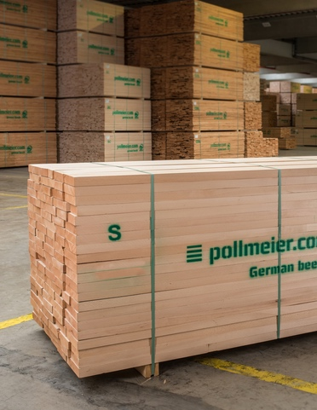
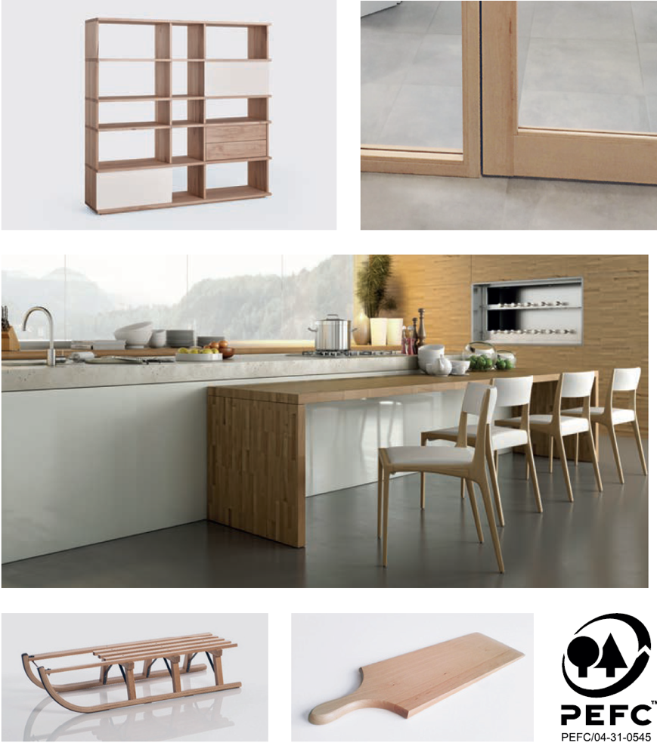

Beech Timber

Slide 7
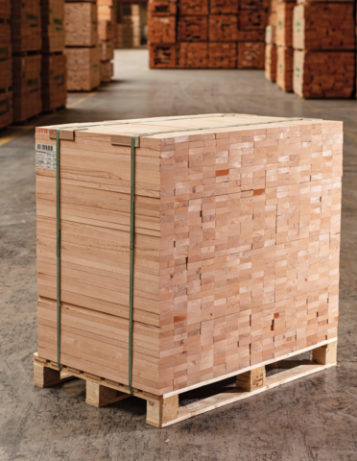
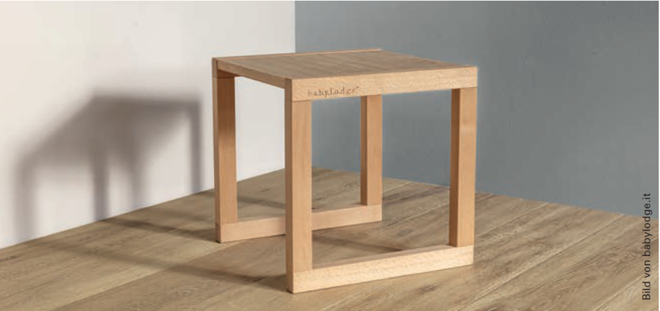
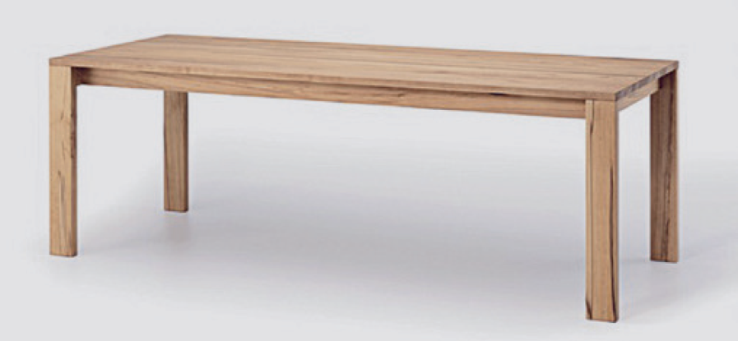
Components // Solid Beech

Slide 8
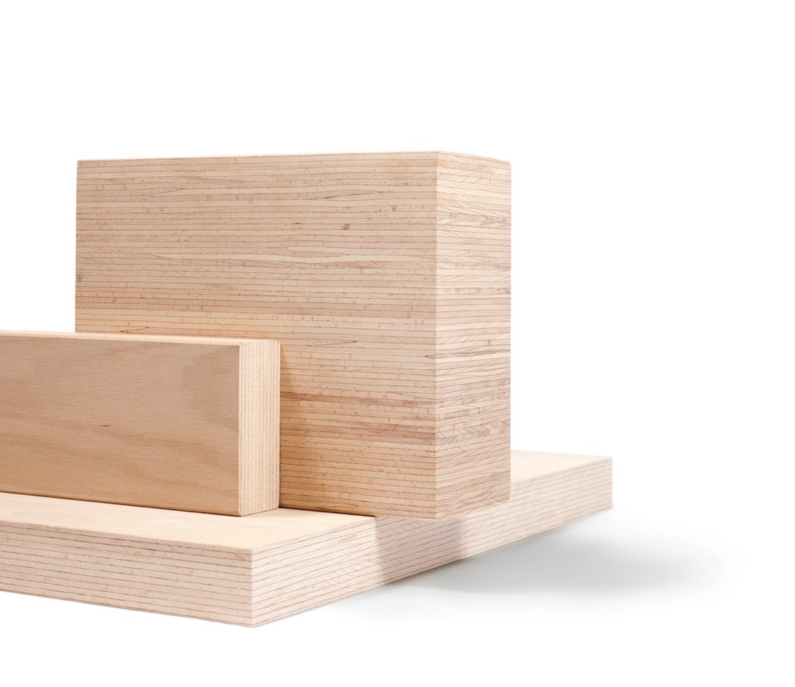
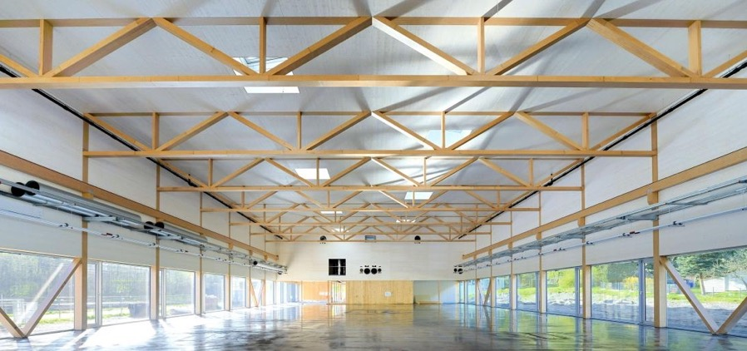
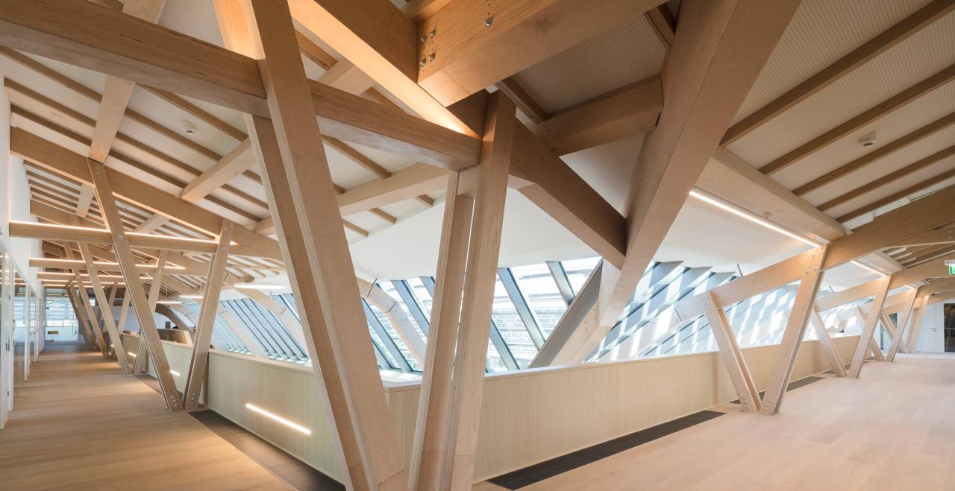
BauBuche // Construction Wood

Slide 9
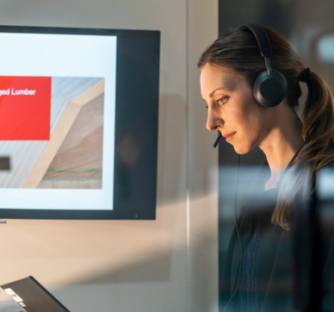
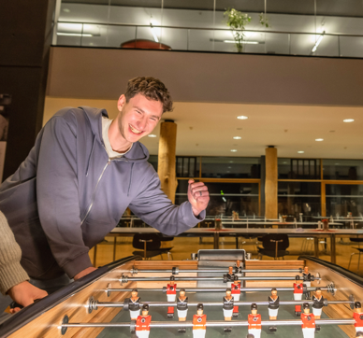


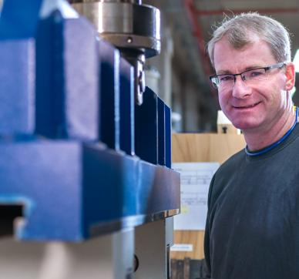
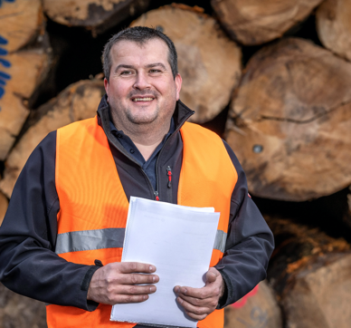
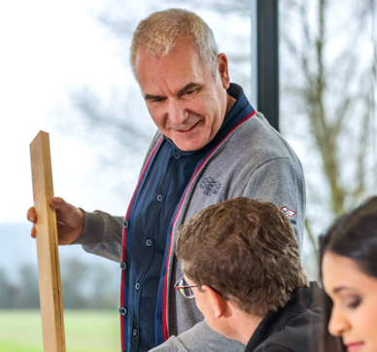


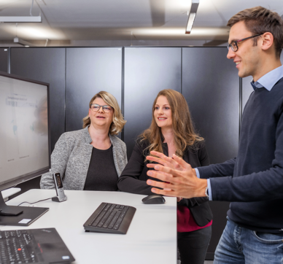
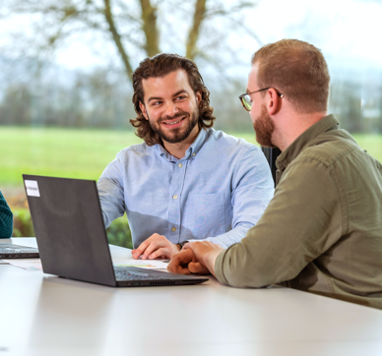
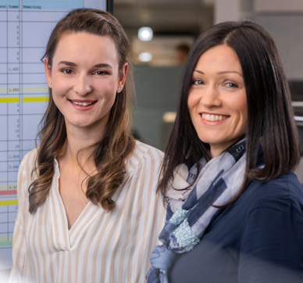


OUR CORE VALUES
Reliability
Respect
Innovation
Honesty
Trust
Responsibility

Slide 10





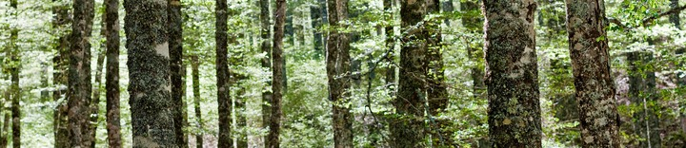
Nice to know – some side facts about Pollmeier!
1.100 kg of fruit
each month
Delivery of approx. 200 trucks with beech logs per day
Over 100 Leased Bicycles
25.000 cups of coffee
per month

Slide 11
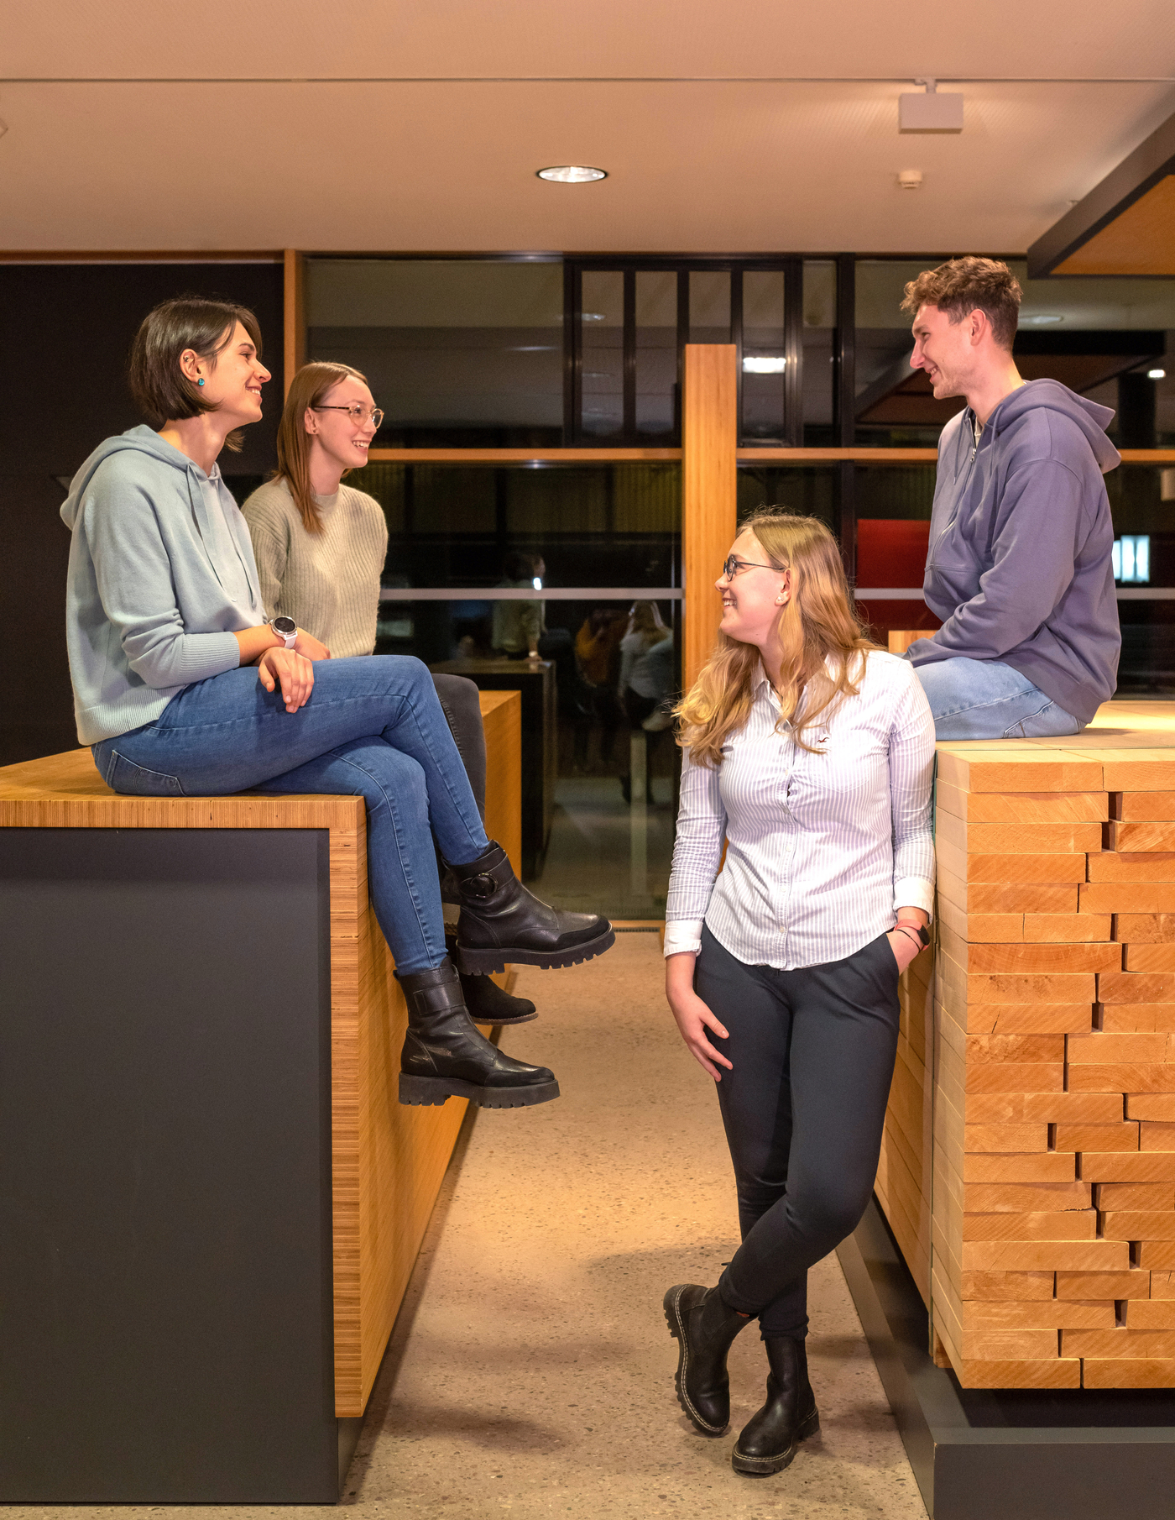
Our Departments
Sales
Purchasing
HR
Accounting
Logistics
IT
Engineering
Quality
Production
Production Planning
Austauschen
Notes:
10

Slide 12


You've come to the right place!
We offer:
Secure Job, Innovative, Growth- and Future-Oriented Company
Flat Hierarchies, Familiar Atmosphere, Short Communication Channels
Lucrative Financial Benefits, Capital-forming Benefits and much more…
Diverse Training Career-Building Opportunities
Notes:
Sehr gute Übernahmechancen nach erfolgreicher Ausbildung
Du-Kultur, flache Hierarchien
Benefits – Ausbildungsvergütung, VWL, Ticket Plus Karte
Weiterbildungsmöglichkeiten

Slide 13
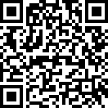
Our Career Page
Austauschen
Notes:
10

Slide 14
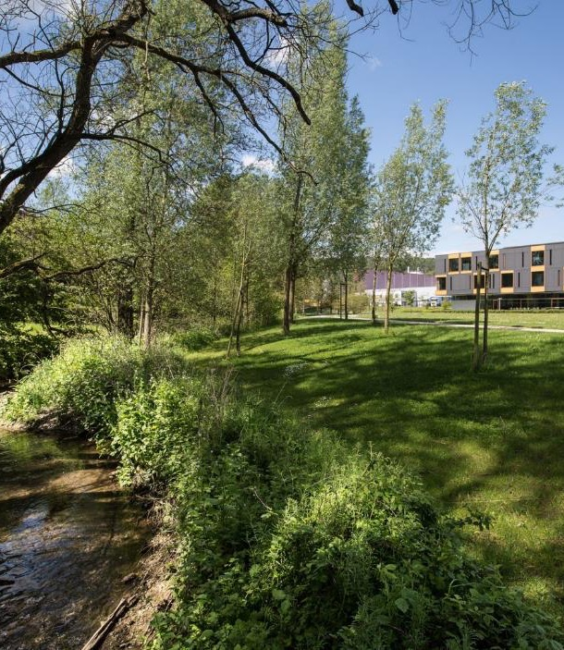
Thank you very much for your attention!
Michaela Zeiß
  Referentin Recruiting
  T +49 (0) 36926 945 499
  michaela.zeiss@pollmeier.com

